Slide 1
ASDAN CoPE (Certificate of Personal Effectiveness)
Vocational Qualification

Slide 2
Vocational Learners
Students are selected for the course who:
Prefer practical tasks
Are good at making things with their hands
Struggle to complete lots of homework on time
Already have an idea of what you want be when you leave Sheldon
Like to work as a team

Slide 3
ASDAN CoPE
All Portfolio Based – No exams and no regular homework set. Giving students more time to focus on their other subjects.
Covers key skills
The Challenges cover areas such as:
Independent living
Healthy living
Citizenship and community
Communication

Slide 4
ASDAN CoPE Modules
Communication
Citizenship and Community
Sport and Leisure
Independent Living
The Environment
Vocational Preparation
Health and Fitness
Work Related Learning
Science and Technology
International Links
Expressive Arts
Beliefs and Values

Slide 5
Qualifications
12 Credits are needed in total (6 Units must come from the skills section) = ASDAN Cope Qualification
Level 1 = 22 points (Level 3 GCSE equivalent)
Level 2 = 46 points (Level 5 GCSE equivalent)
All Portfolio no Exam!!!
No frequent homework's set allowing students more time to focus on
Separate Level 1 qualification awarded by Wiltshire College for the retrospective course followed.

Slide 6
College options
Students spend one morning a week at Wiltshire College where they study one of the following courses:
Hair and beauty*
Motor vehicle maintenance*
Animal care*
* NB subject to availability
Year 10s Attend Wiltshire College on Thursday mornings 9-12
Year 11s Attend Wiltshire College on Monday mornings 9-12

Slide 7
College options
Hair and Beauty at Chippenham College 9.00 - 12.00
Students walk to and from college

Slide 8
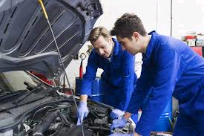
College options
Motor vehicle maintenance at Chippenham College 9.00 - 12.00
Students walk to and from college

Slide 9
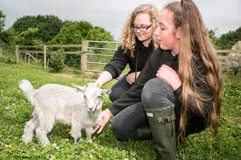
College options
Animal care at Lackham College 9.00 - 12.00
Students use the School mini bus to and from Sheldon to Lackham college

Slide 10
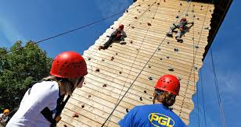
Residential trip
In the summer term of year 10 there is a residential trip to South Wales for 3 days.
Activities include;
Gorge jumping
Rock climbing wall, high ropes, zip line.
Team building
Students do all the cooking for the trip, including buying all the food for the trip and managing the budget.
Build confidence and learn how to work as a team.
If you have any queries, please contact Mr M Harrison, mharrison@sheldonschool.co.uk or Mrs S Wilson, swilson@sheldonschool.co.uk

