Slide 1




NCFE Level 1/2 Technical Award in Business and Enterprise

Slide 2
Topics
Overview of course and who might enjoy it
Example units
Examples of work produced
How the course is assessed
Example exam questions or project briefs/both
Further information (exam board websites)

Slide 3
Overview of Topics
Throughout this qualification you will gain valuable knowledge of:
Entrepreneurial characteristics and business aims and objectives
Legal structures, organisational structures and stakeholder engagement
The marketing mix, market research, market types and orientation types
Internal and external influences on business

Slide 4
Overview of Topics
Throughout this qualification you will gain valuable knowledge of:
Research, resource planning and growth for business
Human resource requirements for a business start-up
Sources of enterprise funding and business finance
Business and enterprise planning.

Slide 5
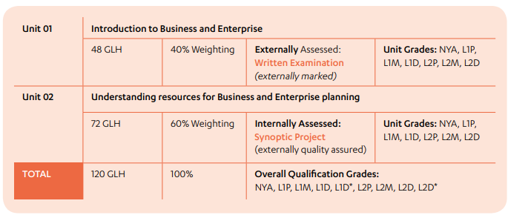
Units

Slide 6
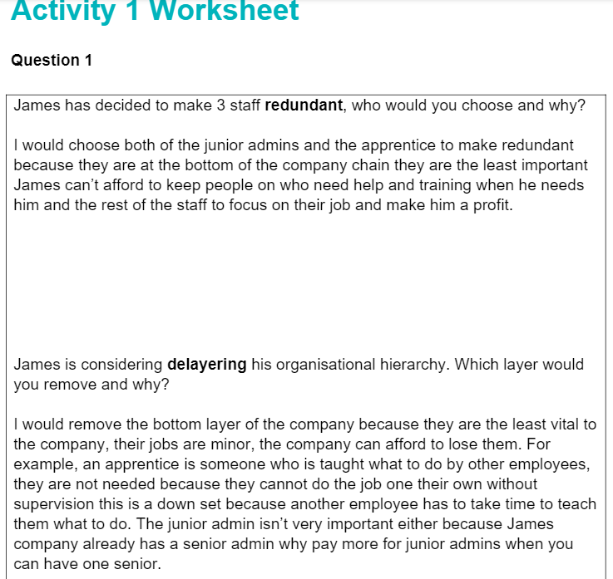
Example Work – Unit 1

Slide 7
Assessment
To achieve the NCFE Level1/2 Technical Award in Business and Enterprise:
Learners must successfully demonstrate their achievement of all assessment objectives of each unit
Learners must achieve a minimum of a Level 1 Pass in unit 1 and 2 to achieve the overall qualification.

Slide 8
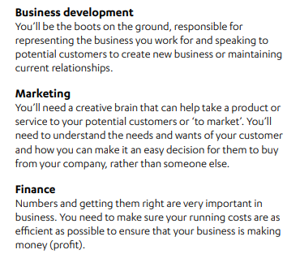


What sort of job could I do with Business?

Slide 9
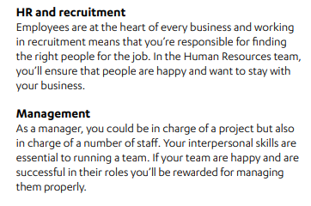


What sort of job could I do with Business?

Slide 10
Further Information
What can you study after this qualification?
https://www.qualhub.co.uk/media/9252/career-card-business.pdf
Exam Board Website
https://www.qualhub.co.uk/qualification-search/qualification-detail/ncfe-level-12-technical-award-in-business-and-enterprise-4594#SupportMaterials

