Slide 1
Numeracy for Learning

Slide 2
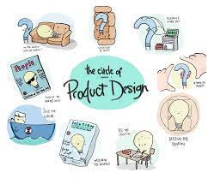
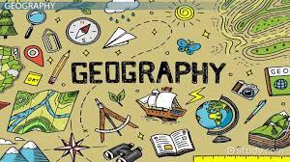
Numeracy for Learning
Being good at numeracy is not just for maths.
You will need maths skills in all subjects from history, geography, sports studies, music, product design, food, science and computer science to name a few.

Slide 3
Numeracy for Learning
In history you have to put dates into chronological order and have to analyse data including statistics
In food you have to purchase ingredients and weigh them
In computer science you use coding
In science you use formulae and equations

Slide 4
Key Mathematical skills
Numerical skills:
Decimals
Percentages
Fractions
Ratios
Estimation
Shape and space:
Measurements
Area, surface area and volume
Using scales on maps/diagrams
Co-ordinates
Data processing:
Using statistics
Interpreting graphs and charts
Calculating rates/gradients
Drawing graphs and charts
Calculating averages (mean, mode, median)
Algebra skills:
Use formulae
Rearrange equations
Balance equations
Linking formulae

Slide 5
Basic transferrable maths tips

Slide 6
14.2 × 97.54
(8.56 - 6.02)²
≈ 15 x 100
≈ (9 – 6)²
= 3²
9
1500
139
0.47 × 121.7
6.9
≈ 0.5 x 120
≈ $\frac{140}{7}$
20
60

Slide 7
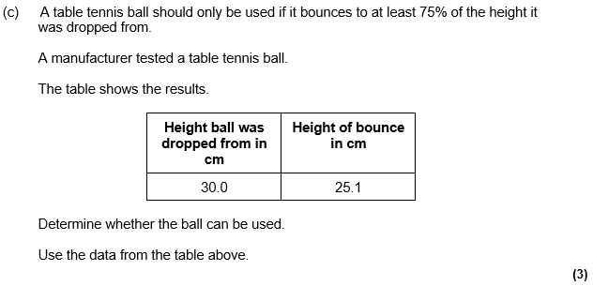
Examples of exam questions across subjects - Science

Slide 8
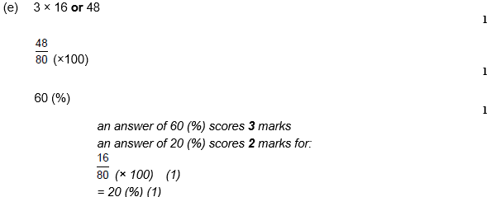
Exam questions – Science

Slide 9
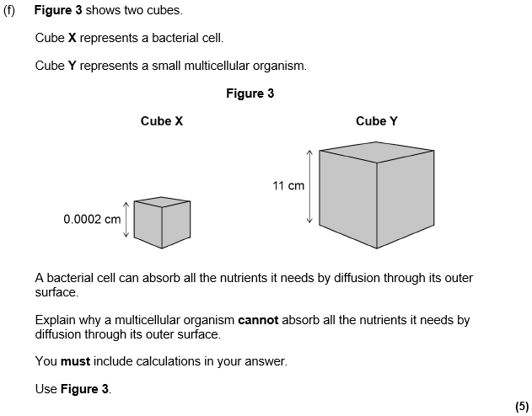
Exam questions – Science
3 of the 5 are for maths
Small cube
SA = 0.0002 x 0.0002 x 6 = 2.5x10^-7
V = 0.0002 x 0.0002 x 0.0002 = 8x10^-12
SA:V 30000:1
Large cube
SA = 11 x 11 x 6 = 726
V = 11x11x11 = 1331
SA:V 0.55:1

Slide 10
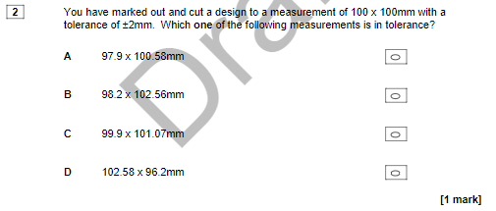
Exam questions – DT
X

Slide 11
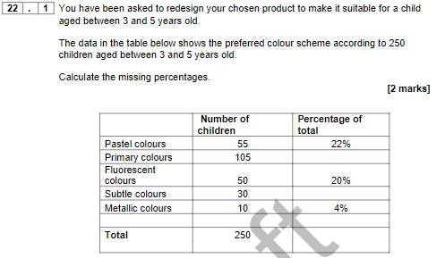
Exam questions – DT
42 %
12 %

Slide 12
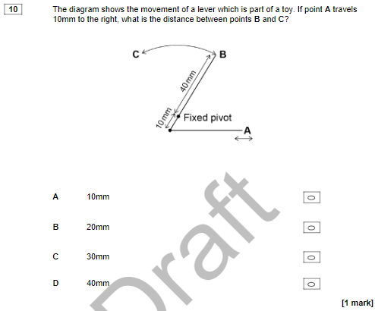
Exam questions – DT
X

Slide 13
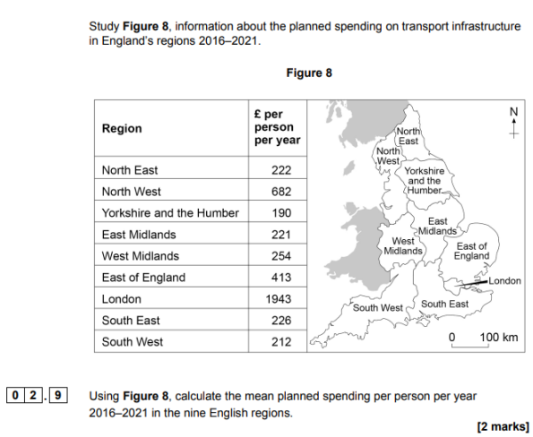
Exam questions – Geography
4363 / 9
485

Slide 14
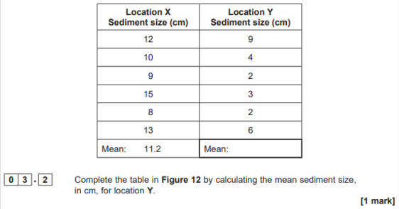
Exam questions – Geography
2.9
4.3

Slide 15
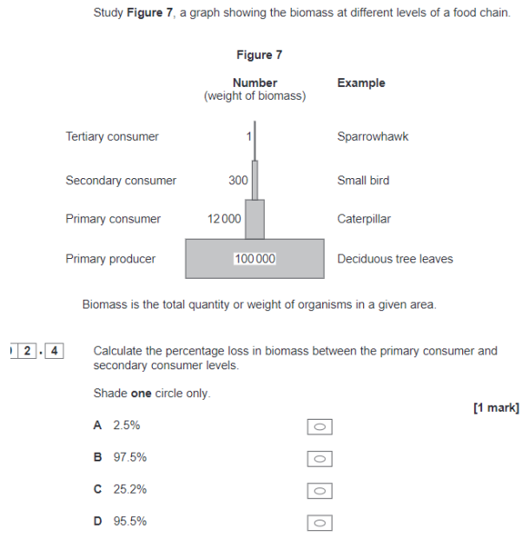
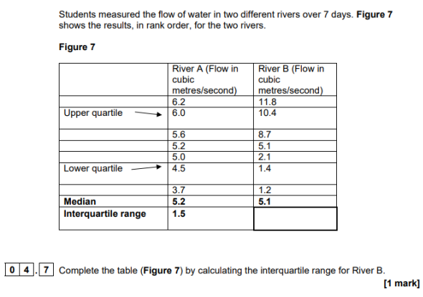
Exam questions – have a go
9
X

Slide 16
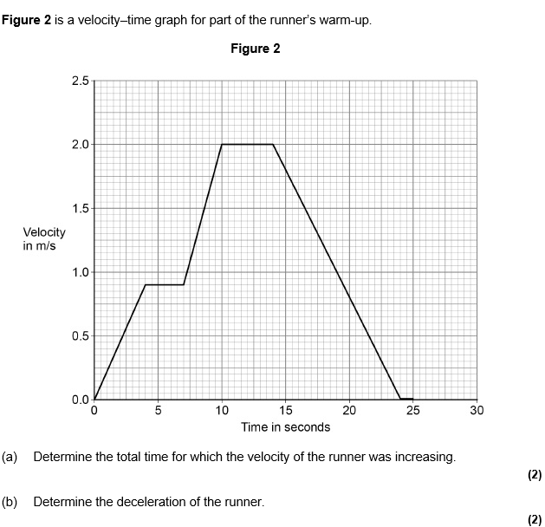
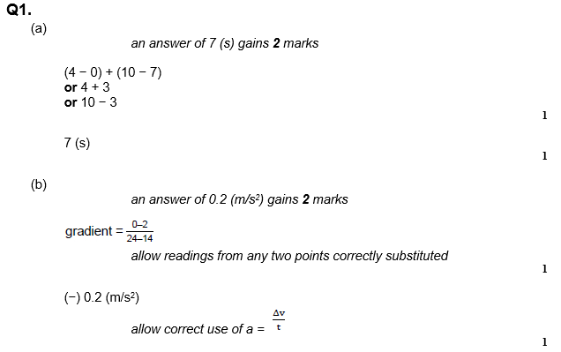
Exam questions – Science again!!

