Slide 1
Welcome to Year 11 revision information evening

Slide 2
The purpose of this evening
Explaining how to find information for each subject – exam boards and our website.
Providing you with the skills and techniques to help you revise and memorise information.
Helping you with revision timetables and maintaining a healthy balance between work and rest.
Providing key literacy and numeracy tips.
Showing you how technology can support revision.

Slide 3
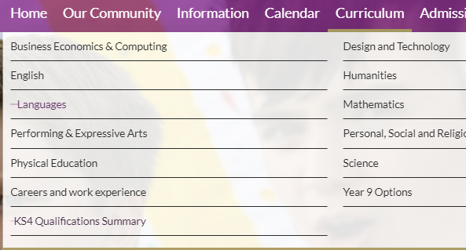
Where to find information for each subject
Sheldon School website
Curriculum
Subject information for KS4
KS4 Qualifications Summary
Revision booklet

Slide 4
Exam specifications
The single most important piece of information that you can access as a parent to support your child, is the exam specification
These documents are freely available on the appropriate exam board website and they list all the aspects of that particular subject that could be examined.
A single document with links to each exam specification for the KS4 qualifications at Sheldon School can be found on the Curriculum page underneath each Faculty.
The exam boards also publish specimen papers, past papers and mark sheets for practice. It is usual that the most recent paper is not freely available, as they are held back for use as mock exams in schools.

Slide 5
Overview – Exams 2022
Exams in summer 2022 will go ahead as planned
In the event that summer exams are cancelled then schools are expected to have a contingency in place
The January internal assessments will form part of our teacher assessed grading in the event that the summer exams are cancelled

Slide 6
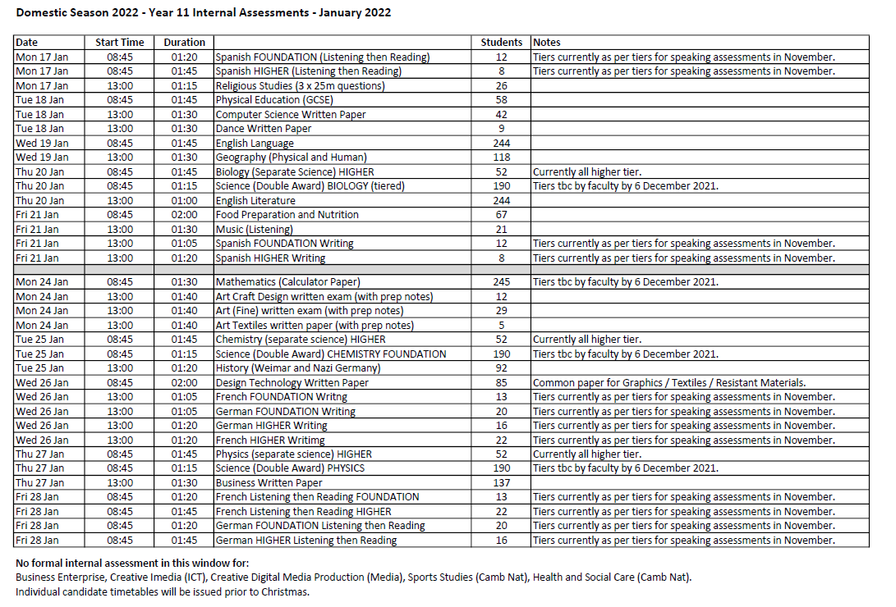

Slide 7
Changes to Exams
No change:
Computer Science, Business Studies, Religious Studies, English Language, Maths, Science although equation sheets will be given for physics and maths
DT, Music, Art, Dance, PE:
Reduced aspects of NEAs/activities
Geography:
No resource management in paper 2 and no reference to own fieldwork in paper 3
History:
No paper 1 – medicine through time
Languages:
The written examination time has been extended to reflect that there are more options for the writing tasks
English Literature:
One less text – students at Sheldon will not study Jekyll and Hyde

Slide 8
When will we get more information?
Students taking GCSEs in all other subjects will be given advance information about the focus of the content of the exams to support their revision.
The advance information for GCSE will be published no later than 7th February 2022.
The government will decide whether the advance information should be published earlier.
The government will take account of the level of disruption to students’ education being caused by the pandemic if it decides that advance information should be published before 7 February 2022. It will give at least a week’s notice if it decides exam boards should publish the information before that date.

Slide 9
How does learning happen?
When we teach something it will go into students’ working memories. For examinations students need to retrieve or recall information from their long-term memories.
In order for information to pass from working to long-term memory students need to revise or regularly recap and practise the information that has been taught.

Slide 10
The best approach for revision
Reading, highlighting and notetaking
Testing knowledge – quizzes, content tests, flash cards and mind maps
Plan and practice past paper questions
Useful at the start but low impact in terms of memory
High impact in terms of understanding what you know/don’t know
High impact before exams when content is more secure

Slide 11
How to revise effectively
Research clearly shows students need to be active rather than passive.
Reading and note taking is a start, but to be able to remember information you need to regularly test what you do and don’t know.
Don’t waste time re-making lots of notes and making pretty revision materials.
Instead quizzes, flashcards, mind maps, mnemonics are better ways of remembering information.
Practice exam style questions when happy with the content.
Start revision early and plan for a little but often revision.

Slide 12
How can you help your child?
Make sure your son/daughter has a quiet place to work.
Help them to be organised.
Ask them to teach you something they have learned.
Help them stay positive.
Help them avoid distractions.
Ensure they are getting enough exercise, rest and are eating well.

Slide 13
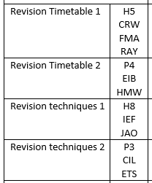
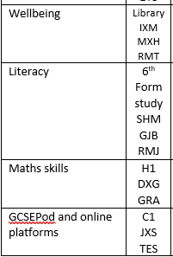
Plan for the evening
You and your son/daughter should have been given your schedule for the evening.
Staff have details if you are unsure.

