Slide 1
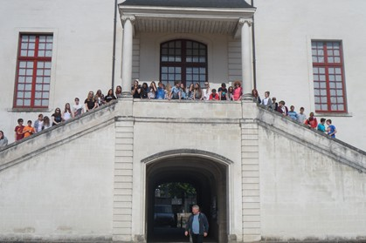
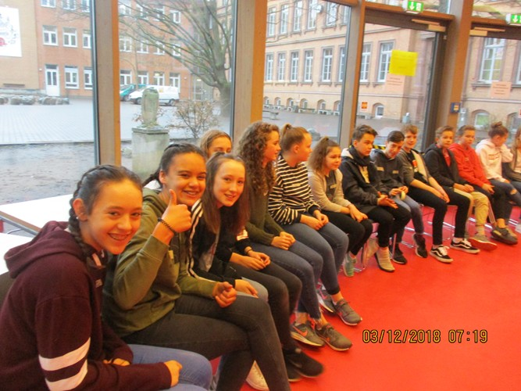
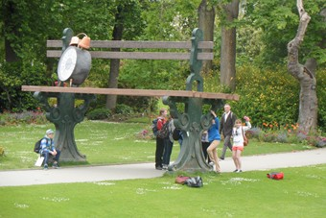
Sheldon School and Languages in Year 9.

Slide 2
You will soon be choosing the language you are going to study in Year 9.

Slide 3
Why do I need a language?
It will show people that you can think and learn in a particular way.
At GCSE it is useful to have a range of types of subject.
It can help you get that apprenticeship, job or college place instead of someone else who doesn’t have these in-demand skills.

Slide 4
What happens in Year 9?
You will have 6 lessons a fortnight.
You will focus your time on ONE language*
Your Year 9 language is also the one you are likely to carry on with in Years 10 and 11, if you choose to continue with MFL.

Slide 5
I like Language A but my best friend wants to do Language B?
In Year 9, classes will be re-set and you do not know who will be in your class.
You should choose the language that you feel more comfortable with.
You might have different friends next year anyway.

Slide 6
I’m finding Language A easier. I’ll choose that one.
Different things in German and French are challenging at different stages.
By the end of Year 9 there is no difference in the challenges of the two languages.

Slide 7
I don’t get on with my teacher in Language
A. I’m going to choose Language B.
Almost all Sheldon language teachers teach French AND German.
Your teacher for Language A this year may be your teacher for Language B next year.

Slide 8
So how should I choose?
Think about the language you find easier to learn – the more you have learnt = the most progress.
Which one do you feel you are likely to do best in?
Think about what is best for YOU in the long run.
Don’t choose because of friends or teachers.
Talk about it at home and with your languages teachers.
Think about which language you have support in at home (an older sibling/a parent)
If you don’t mind which, that’s fine, we can choose for you.

Slide 9
*What if I like both languages?
There is an option for you to continue with both French and German next year, if there are sufficient numbers to run a group. You MUST think about which one of the two languages you would do in case you can't do both.
Doing 2 MFLs is a challenge as you will have fewer lessons of each one, so think very carefully.
If you continue to GCSE and decide you want to do 2 languages at that point, this is still possible if you are doing well with the first.
For students who have shown a positive attitude in languages. Spanish is taught from beginners in Year 10 and 11.

Slide 10
How do I let you know?
Your parents will receive a letter via email.
The letter has a link to this presentation
It also has a link to the online form you need to complete
Do this by 9th May. If it is not complete by 9th May, we will choose the language you will study in Year 9!

Slide 11
What happens once I have chosen?
As long as staffing and timetabling will allow, you will be given your first choice.
MFL staff will re-set the year group based on numbers and ability in agreement with the HOY.
You will continue with BOTH languages until Turnaround Week.

Slide 12
Who do I ask for help?
Your languages teachers know you well, speak to them
Talk to your tutor
You will have talked about your subject likes and dislikes with your family, ask them to go through the decision with you.

Slide 13
GOOD LUCK!
BONNE CHANCE!
VIEL GLÜCK!

