Slide 1
Trialing some revision techniques

Slide 2
Mistakes students often make:
Spend ages re-reading notes.
Highlighting notes.
Keep making notes.
Spending time on making beautiful revision materials.
Spending ‘hours’ revising – but actually checking phones or being distracted.
Spending hours revising in one go.

Slide 3
What revision techniques work?
Anything that tests your memory:
Online quizzes.
Your own set of questions and answers.
Flash cards.
Mind maps.
Brain dumps.
Visual prompts e.g. dual coding or timelines

Slide 5
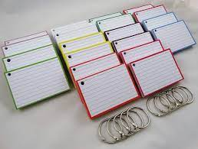
Flash cards
You do not need to buy special cards!
You can cut regular paper or card into rectangles.
Once you have your flashcards made, you should revisit them regularly.
One side of the flashcard contains the information you need to recall.
The other side has the prompt. This could be text in a form of a question, an image or both!
They can be used in a range of subjects from key vocabulary for Languages to memorising mathematical equations.
Remember to keep them brief. The prompt should be brief and the information should also be brief. Yet, it should be able to help you use the information more effectively.
There is also a website called Quizlet where you can create your own flashcards and other resources online! https://quizlet.com/gb/552406158/collapse-of-soviet-union-1985-1991-flash-cards/?i=34scxl&x=1jqY

Slide 6
Your turn
YOUR TASK:-
Now have a go at applying these principles to create a set of flashcards on how our memory works.
Read through the information.
On one side, write down key questions e.g. what is the sensory store? What is the duration and capacity of our short term memory?
On the other side, write down the answers for each.
Make a note of how you could use flashcards in your revision!

Slide 7
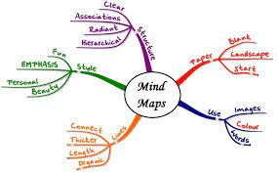
Mind maps
Take a sheet of white unlined paper and turn it ‘landscape’.
Choose some bright felt tip pens.
Draw a picture/ large heading in the centre of the page which connects with what you want to learn.
Choose a colour and draw a main branch off the central picture/heading.
Write the first idea/key concept about the subject in CAPITAL letters.
Draw separate branches for each idea in different colours.
Develop each main branch into separate smaller branches as you add more ideas with a minimal number of words.
Finally add pictures to each branch to aid your memory.

Slide 8
Your turn
YOUR TASK:-
Now have a go at applying these principles to create a mind map for Inspector Calls.
Read through the information.
Divide up the information into different categories. You decide on the categories.
Each category will be a main branch and evidence for it smaller branches.
Create a slimmed down version of the most important elements for your mind map.
Make a note of how you could use mind maps in your revision!

Slide 9
Key Points
Use exam board specifications to create your revision notes
Add key details using your exercise books and revision books
Create your flash cards, quizzes, mind maps
Test yourself regularly
For work that you are unsure of go back to exercise books, revision books, GCSEPod, Seneca, BBC Bitesize – re-learn
Regular testing of all topics and all subjects

Slide 10
Once you’re secure in your knowledge …
Practice answering exam questions!
Start by completing the question using your own knowledge. If you are struggling use your revision notes but add this to your answer in green pen.
Once you are writing most of your answer without using revision notes, start timing yourself (give yourself the same amount of time you would have in the exam).

