Slide 1
Welcome to Year 11 revision information evening

Slide 2
The purpose of this evening
Explaining how to find information for each subject – exam boards and our website.
Providing you with the skills and techniques to help you revise and memorise information.
Helping you with revision timetables and maintaining a healthy balance between work and rest.
Providing key literacy and numeracy tips.
Showing you how technology can support revision.

Slide 3
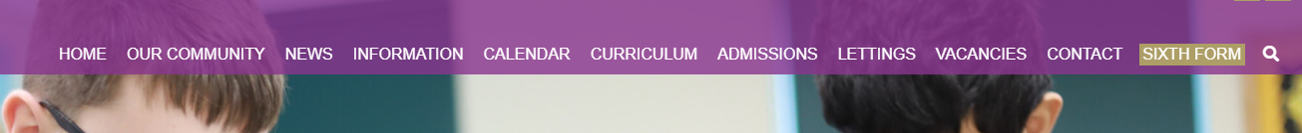
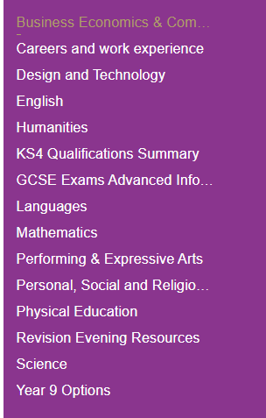
Where to find information for each subject
Sheldon School website
Curriculum
Subject information for KS4
KS4 Qualifications Summary
Revision evening resources

Slide 4
Exam specifications
The single most important piece of information that you can access as a parent to support your child, is the exam specification
These documents are freely available on the appropriate exam board website and they list all the aspects of that particular subject that could be examined.
A single document with links to each exam specification for the KS4 qualifications at Sheldon School can be found on the Curriculum tab and then KS4 qualification summary
The exam boards also publish specimen papers, past papers and mark sheets for practice. It is usual that the most recent paper is not freely available, as they are held back for use for mock exams in schools.

Slide 5
Where to find information for each subject
Sheldon School website
Curriculum
Subject information for KS4
KS4 Qualifications Summary
Revision evening resources

Slide 6
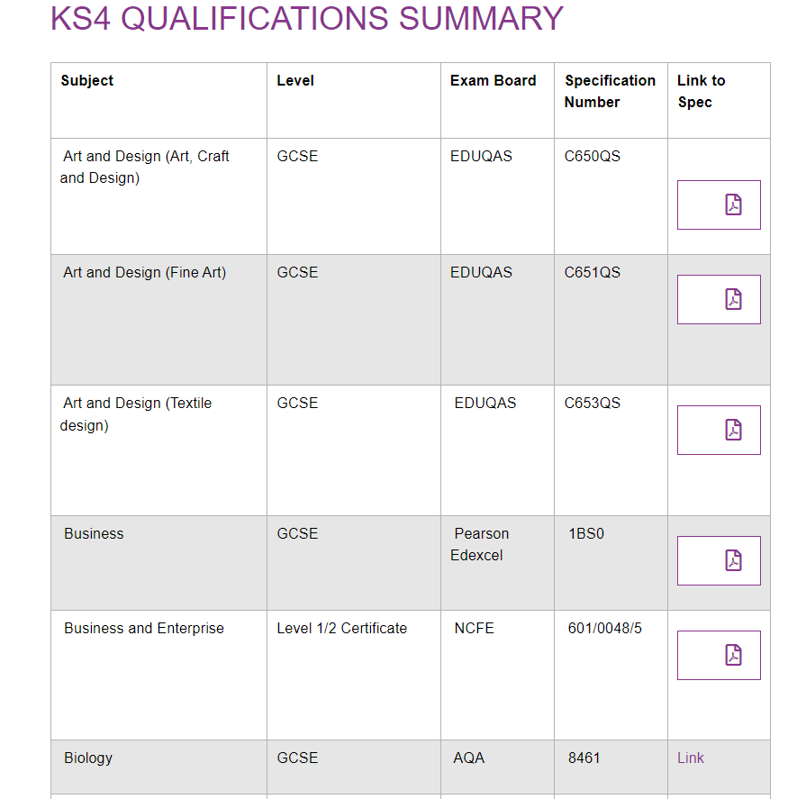
KS4 Qualifications Summary

Slide 7
Overview – Exams 2023
Exams in summer 2023 will go ahead as normal
There will be no advance materials
There is no optionality i.e. no missing aspects from any syllabus
In the very unlikely event that summer exams are cancelled then schools are expected to have a contingency in place
  The January internal assessments will form part of that contingency

Slide 8
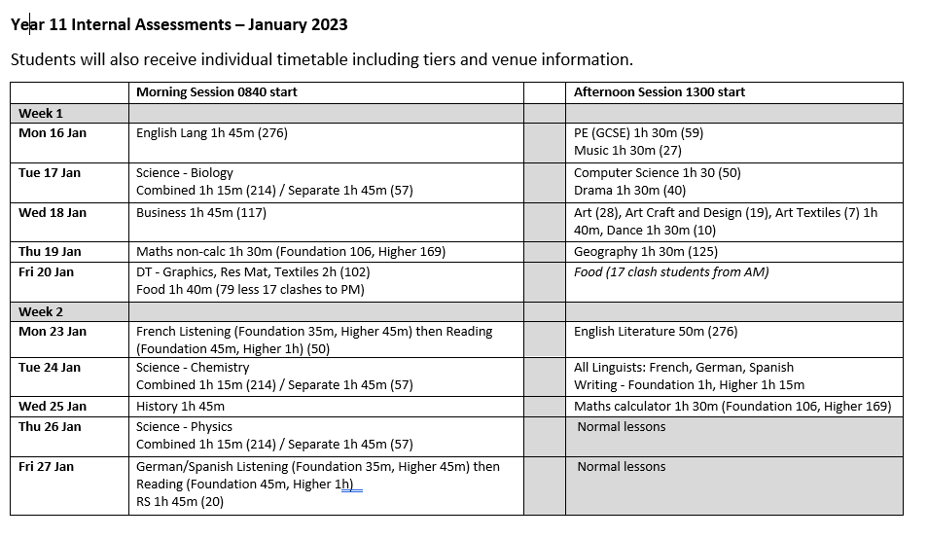

Slide 9
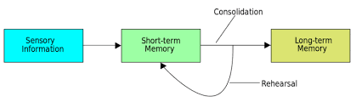
How does learning happen?
When we teach something it will go into students’ working memories. For examinations students need to retrieve or recall information from their long-term memories.
In order for information to pass from working to long-term memory students need to revise or regularly recap and practise the information that has been taught.

Slide 10
The best approach for revision
Reading, highlighting and notetaking
Testing knowledge – quizzes, content tests, flash cards and mind maps
Plan and practice past paper questions
Useful at the start but low impact in terms of memory
High impact in terms of understanding what you know/don’t know
High impact before exams when content is more secure

Slide 11
How to revise effectively
Research clearly shows students need to be active rather than passive.
Reading and note taking is a start, but to be able to remember information you need to regularly test what you do and don’t know.
Don’t waste time re-making lots of notes and making pretty revision materials.
Instead quizzes, flashcards, mind maps, mnemonics are better ways of remembering information.
Practice exam style questions when happy with the content.
Start revision early and plan for a little but often revision.

Slide 12
How can you help your child?
Make sure your son/daughter has a quiet place to work.
Help them to be organised.
Ask them to teach you something they have learned.
Help them stay positive.
Help them avoid distractions.
Ensure they are getting enough exercise, rest and are eating well.
Know when to back off!!

Slide 13
Sessions Available
Wellbeing and how to deal with stress and anxiety in Year 11
Creating a revision timetable and plan and sticking to it
Trialling some revision techniques
Literacy across all subjects – how to make effective notes and literacy tips for examinations
Numeracy for learning – maths skills that will support a range of subjects
Using GCSE Pod and other online platforms

Slide 14
Plan for the evening
You and your son/daughter should have been given your schedule for the evening.
Staff have details if you are unsure.
 | Timings
Workshop 1 | 6:00pm – 6:25pm
Workshop 2 | 6:30pm – 6:55pm
Workshop 3 | 7:00pm – 7:25pm

Slide 15
Session 1 rooms
Session | Room
Revision Timetable 1 | H5
Revision Timetable 2 | P4
Revision techniques 1 | H8
Revision techniques 2 | P3
Wellbeing | Library
Literacy | 6th Form Study

