Slide 1
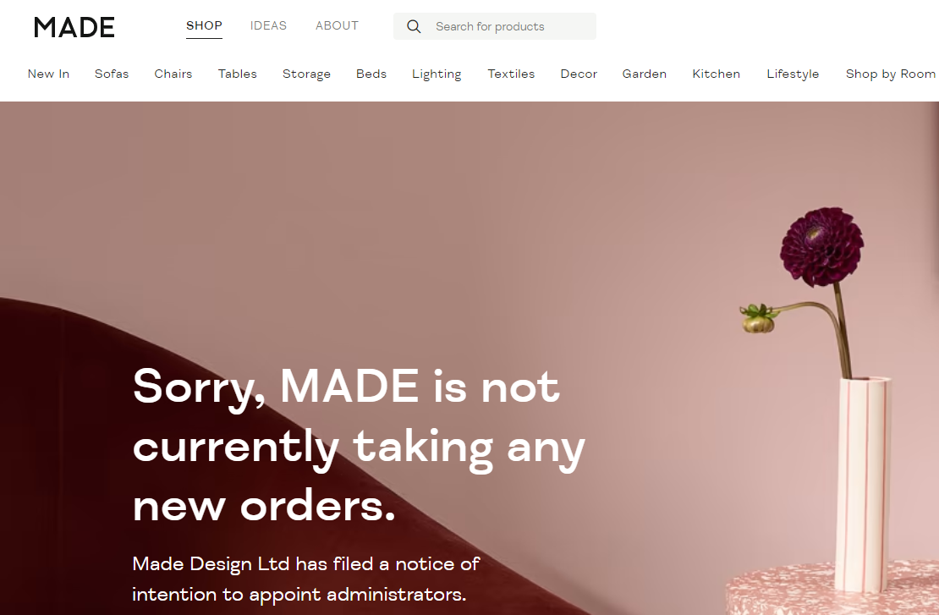


Questions to ponder while you wait
1. Do christmas ads work and why have they been ‘toned down’ this year?
2. Why have MADE.com just gone into administration?
3. What impact will rising interest rates have on business?
4. How have Nike been so successful in building their brand?
Tim Rand, Head of Business, Economics & Computing
A Level Business Studies
Sixth Form presentation

Slide 2

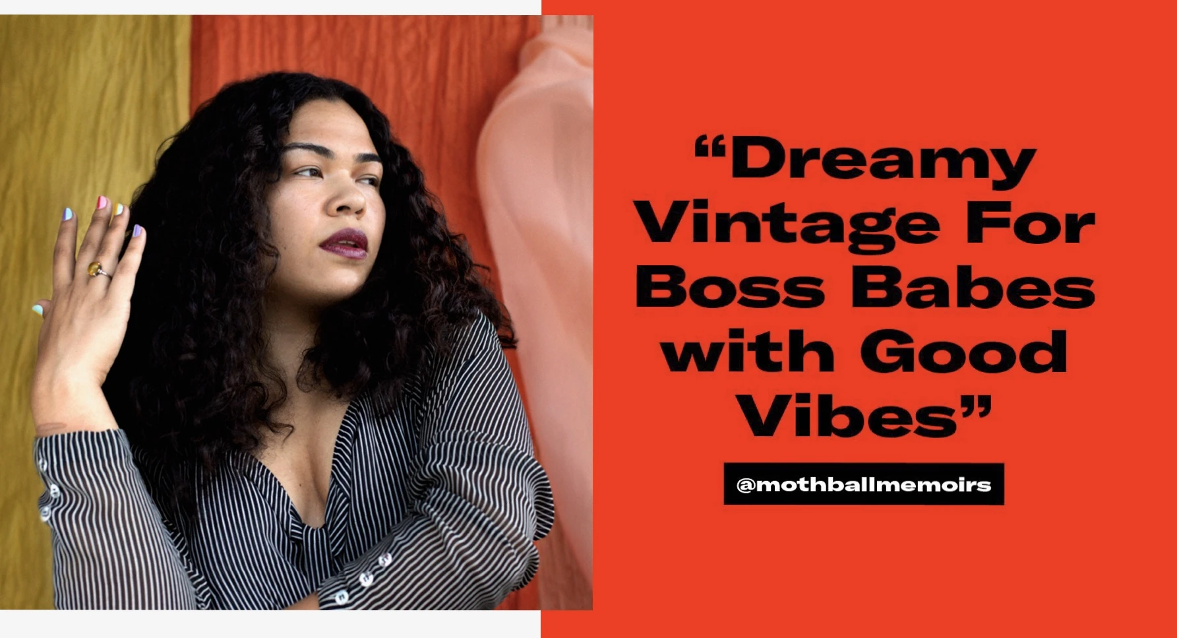
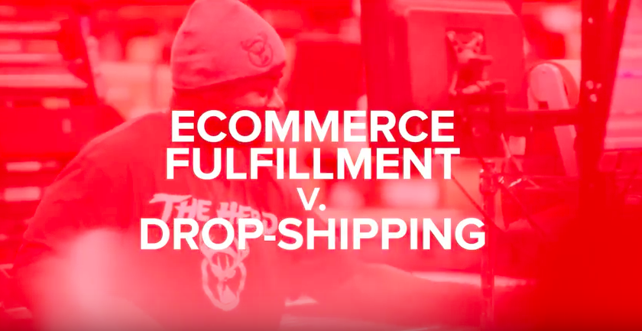
What will I learn?
How to find a gap in the market
How to market to the right people
How to manage people
Decision making skills
Business trends
How to manage a budget
How to make a profit
Why some businesses fail
The impact of globalisation
Amongst many other topics

Slide 3
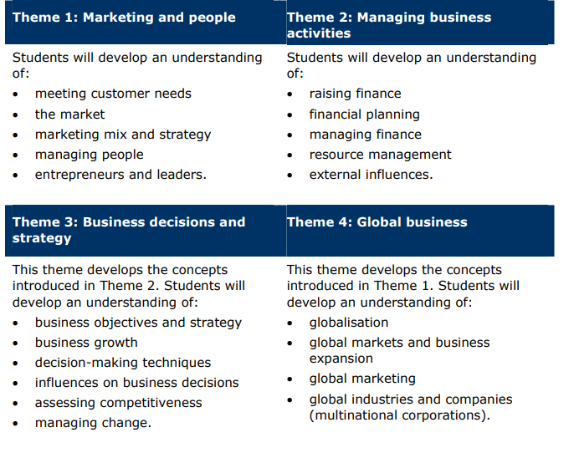
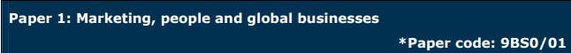
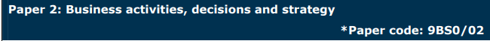
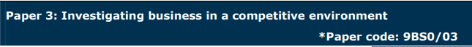
The course… The assessment…
Three exams at the end of the course:
Paper 1
Paper 2
Paper 3: Case study paper
Previous papers on travel, chocolate, trainers and
entertainment markets.

Slide 4
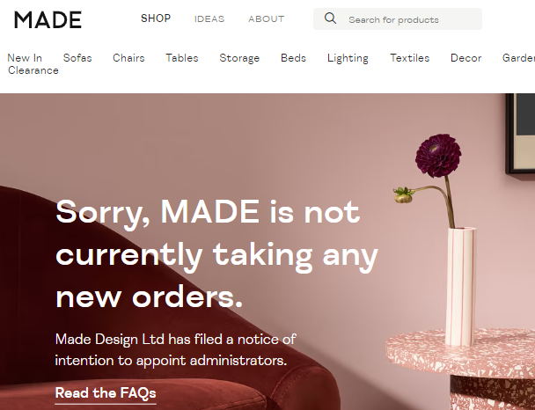
MADE.com
Example of a research task…
Yesterday, MADE went into administration and has now been bought by Next.
Using on-line sources, you are to research and develop some answers to the following:
- In which market do/did MADE operate?
- What was their business model and why has it been successful?
- What have been MADE’s financials over the last 3 years?
Explain what has caused them to go into administration?
What has gone wrong? What could they have done differently?
Discuss why Next may have decided to buy them?

Slide 5


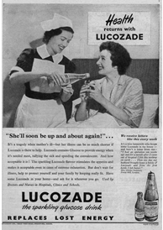
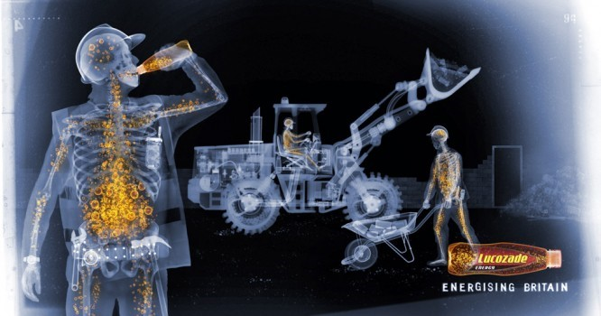
Lucozade was originally positioned as an aid to recovery from illness
Now it is an energy drink in several flavours.
Using market research analyse how successful the repositioning strategy is amongst those under 25 years old and those over 25 years old.
Example of another research task…
From sickness to fitness….
Brand repositioning occurs when a brand tries to change its market position to reflect a change in consumer tastes. The Lucozade brand is one of the most successful sports and energy drinks in the world. The brand was originally positioned as an aid to recovery from illness.

Slide 6


Is Business Studies for me?
Yes, if you enjoy:
Communicating and explaining ideas
Exploring and presenting alternative courses of action
Thinking strategically and making decisions
Keeping up to date with national and international business news
Learning about the world of business through research and investigation
Studying a subject that will have relevance for everyone in their future lives, regardless of what you end up doing

Slide 7
Career or university options?
You might want to study a degree in
  Business studies
  Business management
  Accountancy
  Marketing
  Tourism
  International business
Or go straight into the place of work through a degree apprenticeship with a company such as KPMG in areas such as:
Accounting, law, consulting 360, Technology & Engineering
You might progress to a career in marketing, banking, sales, accountancy, management consultancy, with charities, or perhaps you will set up your own business.
There are many possibilities.

Slide 8
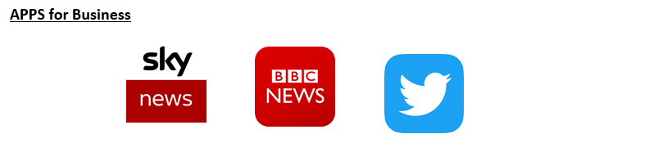

What if I didn’t do GCSE Business?
You don’t need to have studied Business at GCSE to do the A level – you will be introduced to all the core content
It is more important that you are interested in business...
  You might want to start your own business one day, be interested in the world around you, explore how businesses work and consider the challenges businesses face
A level Business helps you to understand all of this and more!

Slide 9
For more details….
Speak to Mr Rand, Head of Business, Economics and Computing
trand@sheldonschool.co.uk
Or Miss Tuttiett, A level Business teacher
ltuttiett@sheldonschool.co.uk

Slide 10
Final thought…
“The only thing we know about the future is that it will be different.”
Peter Drucker (the father of strategic management and all-round clever guy)

