Slide 1
A Level Business Studies
Sixth Form options presentation

Slide 2
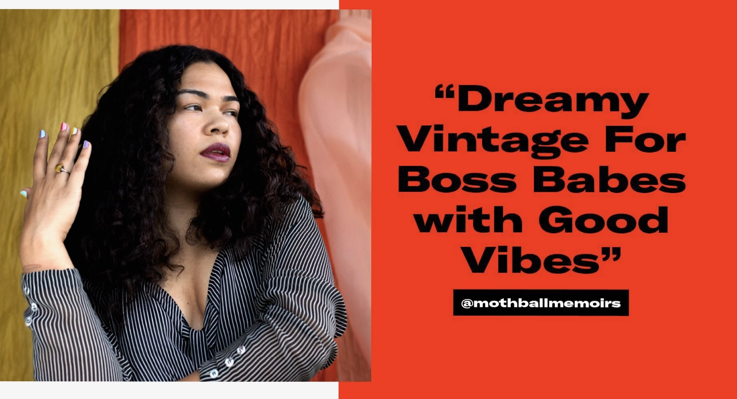
What will I learn?
How to find a gap in the market
How to market to the right people
How to manage people
Decision making skills
Business trends
How to manage a budget
How to make a profit
Why some businesses fail

Slide 3
The course… The assessment…
Three exams at the end of the course:
Paper 1
Paper 2
Paper 3: Case study paper
Previous papers on travel, chocolate, trainers and entertainment markets.

Slide 4
Mini are launching a new electric car. You have £1 million to promote it in the UK. Who would you target your promotion to? What type of promotions would you do?
Example of a research task…

Slide 5
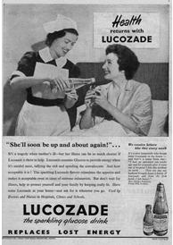
Lucozade was originally positioned as an aid to recovery from illness Now it is an energy drink in several flavours. Using market research analyse how successful the repositioning strategy is amongst those under 25 years old and those over 25 years old.
Example of another research task…
From sickness to fitness….
Brand repositioning occurs when a brand tries to change its market position to reflect a change in consumer tastes. The Lucozade brand is one of the most successful sports and energy drinks in the world. The brand was originally positioned as an aid to recovery from illness.

Slide 6
Is Business Studies for me?
Yes, if you enjoy:
Communicating and explaining ideas
Exploring and presenting alternative courses of action
Thinking strategically and making decisions
Keeping up to date with national and international business news
Learning about the world of business through research and investigation

Slide 7
Career or university options?
Business prepares you for progression to further study or the world of work:
You might want to study a degree in
business management,
accountancy,
marketing,
tourism
international business
You might progress to a career in banking, sales, marketing or for charity. Many students get apprenticeships.
There are many possibilities!

Slide 8
What if I didn’t do GCSE Business?
You don’t need to have studied Business at GCSE to do the A level – you will be introduced to all the core content
It is more important that you are interested in business...
You might want to start your own business one day, be interested in the world around you, explore how businesses work and consider the challenges businesses face
A level Business helps you to understand all of this and more!

Slide 9
For more details….
Speak to Head of Business Studies A Level at Sheldon;
Mrs Kemp Dao
Skempdao@sheldonschool.co.uk
Or Head of Faculty for Business, Economics and Computing (BEC);
Mr Scourfield
Jscourfield@sheldonschool.co.uk

Slide 10
Final thought…
“The only thing we know about the future is that it will be different.”
Peter Drucker (the father of strategic management and all-round clever guy)

