Slide 1
A-Level Computer Science
Notes:
Welcome
This short presentation will go over the subject as a whole at A Level – look at the content of lessons, the units we cover, the practical project and have a look at a few exam questions.

Slide 2
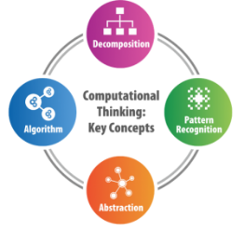
What is Computer Science?
Computer Science is not just about computers, or just about programming.
Computer Science includes theoretical ideas about how information is stored and processed.
Computer Science is also about practical techniques for the creation of new computer software and hardware.
Computer Science teaches us how to think
computationally -
to solve problems in a logical and
organised manner.
Notes:
Computer Science is a diverse subject.
As well as teaching and practising key practical skills, it also changes the way we think about problems, how we solve problems and how we work with one another.

Slide 3
Why do we need Computers and Computer Scientists?
Computers are essential to our lives. We use them at work, to organise our social lives and to play games.
They're also fundamental to services that keep society running smoothly such as hospitals, banks, governments and public transport.
With more jobs available than qualified students/graduates, job prospects for computer scientists have never been better.
Notes:
One of the key reasons I like teaching computer science is that the subject and the course have a tangible link to the working world.

Slide 4
Careers
Application analyst
Applications developer
CAD technician
Cyber security analyst
Data analyst
Database administrator
Forensic computer analyst
Game designer
Games developer
Information systems manager
IT consultant
Machine learning engineer
Multimedia programmer
Penetration tester
SEO specialist
Software engineer
Systems analyst
UX designer
VFX artist
Web designer
Web developer

Slide 5
Destinations:
Apprenticeships – software, electrical engineering, IT systems
Computer Science undergraduate courses
Warwick
Manchester
Birmingham
Bristol
IT related courses – Cyber Security, Computing and Mathematics
Business and IT related, ‘Business Information Systems’
Sheldon students recent locations
Notes:
Students studying a level computer science have pursued a wide range of opportunities after Sheldon
Traditional computer science course are a very popular choice.
We also see students choosing apprenticeships in the IT world,
as well as IT and Computing courses relating to cybersecurity and the business world.

Slide 6
OCR A-Level Course Overview – Key Units
Unit 1 Computer systems:
Unit 1.1: The characteristics of contemporary processors and storage devices
Unit 1.2 Software and software development
Unit 1.3 Exchanging data
Unit 1.4 Data types, data structures and algorithms
Unit 1.5 Legal, moral, cultural and ethical issues
Unit 2 Algorithms and programming :
Unit 2.1 Elements of Computational Thinking
Unit 2.2 Problem Solving and Programming
Unit 2.3 Algorithms
Unit 3 – Programming Project
Notes:
The course has strong links with the GCSE course – if you are a current year 11 student you will recognise many of the unit titles seen here.

Slide 7
Course Delivery
This course offers a good balance of breadth and depth of theory, matched with practical skills and understanding.
We use: Python, PyGame, HTML, JavaScript, SQL, Assembly, Defold Game Engine….and more

Slide 8
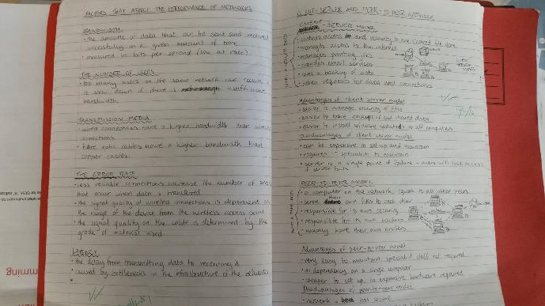
Notes

Slide 9
‘SLR’ creation and assessment

Slide 10
Practical Working of Theory

Slide 11
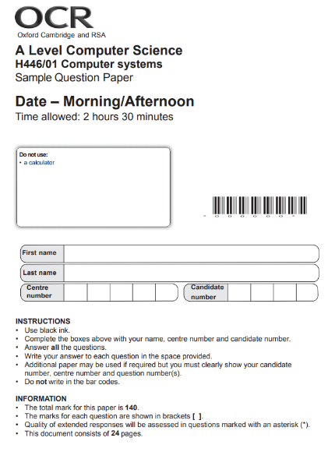
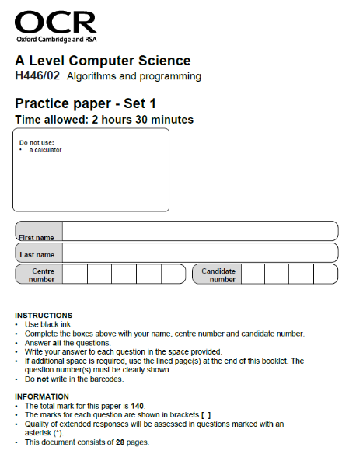
Examinations

Slide 12
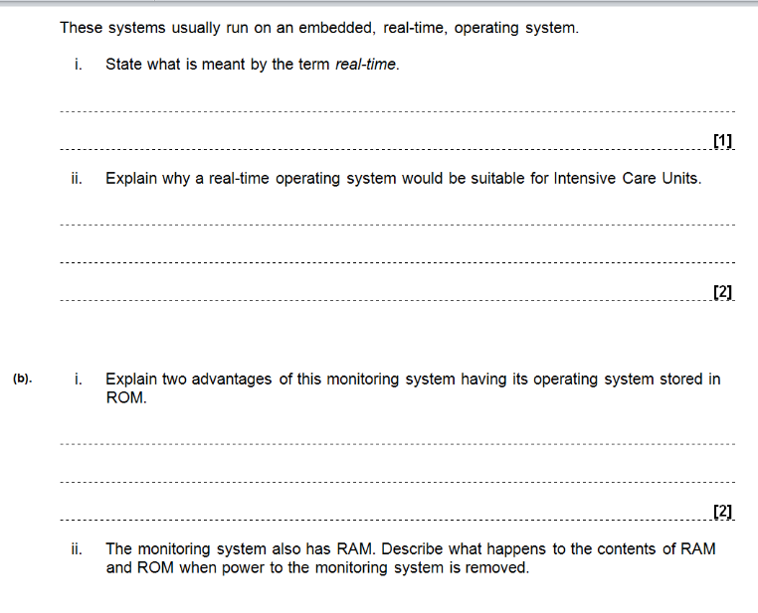
Computer Systems exam – example 1

Slide 13
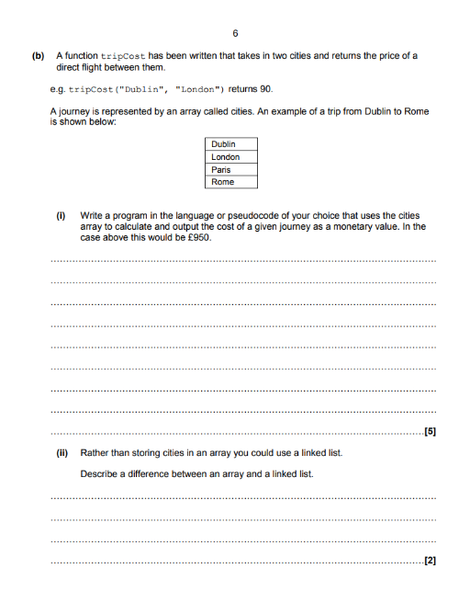

Slide 14
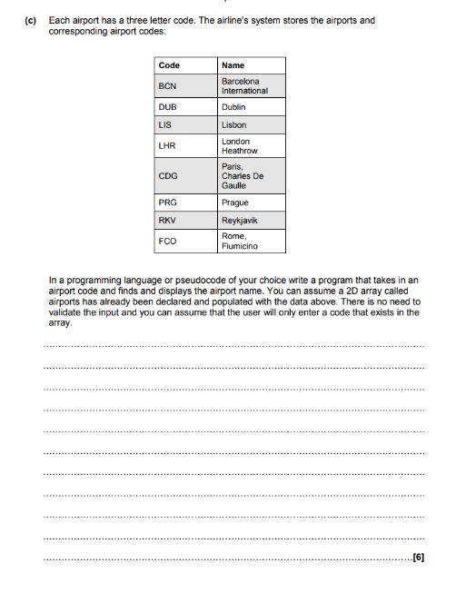

Slide 15
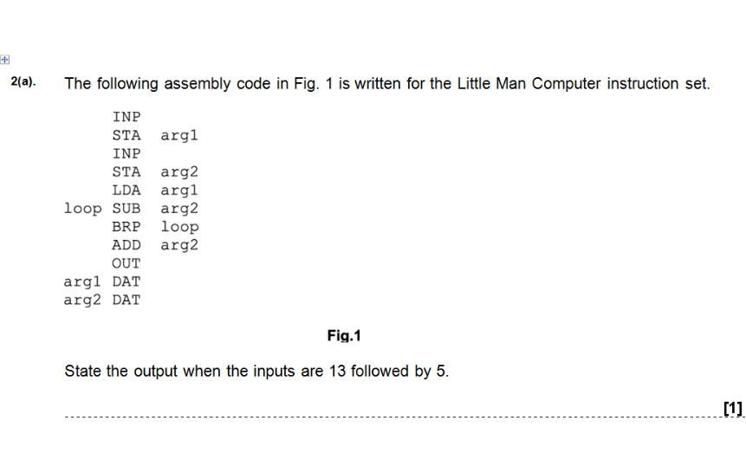
Paper 2 – Algorithms and Programming
Notes:
Higher end questions may focus on solutions regarding object oriented techniques.

Slide 16
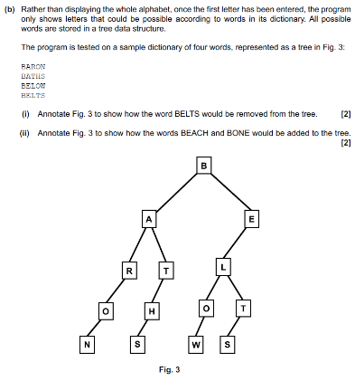
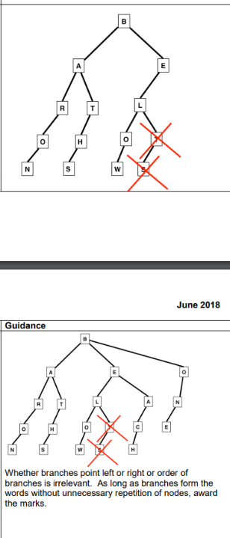

Slide 18
projects
Solving a ‘real world’ problem
Sufficiently complex to meet marking criteria…
…but not so complicated/extensive in scope that they are never finished.
- Arcade games (2d) with a purpose (i.e. a revision or maths game)
- Database driven websites
- data management/database projects
- mobile app
- VR development

Slide 19
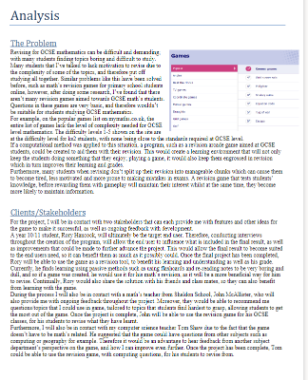
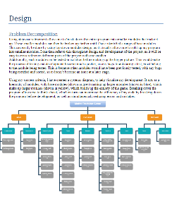
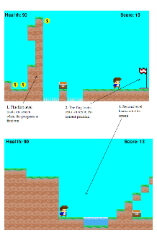
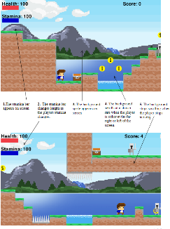
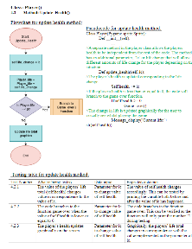
Project examples

Slide 20
What we look for…
Independent learner – and a real interest in Computers
Ability to meet deadlines and exceed expectations
A student who enjoys the challenge of learning and applying advanced skills
The students that achieve the most and enjoy the course the most are those that come with a strong desire to work.
A strong pass at GCSE level is a good indicator of overall suitability

Slide 21
FAQs
Do I have to have a GCSE in Computing to study Computing at AS and A2 level?
The transition from KS4 to KS5 ICT should not be underestimated. A proven interest in Computing will be needed if you haven’t studied Computing during KS4. In short, a GCSE in Computing is relatively essential!
What if I don’t get the GCSE grade I need for Computing?
We look at all cases on an individual basis, but it is unlikely that you will be successful studying Computing at A Level if you do not achieve the expected grade at GCSE.
Do I need to buy any specialist software or other equipment?
Although not strictly essential, a laptop or PC at home (with broadband internet)
would be very useful.

Slide 22
tshaw@sheldonschool.co.uk

