Slide 1
A level Economics
Jon Scourfield
Head of business, economics and computing

Slide 2
What is Economics ?

Slide 3
What will I study ?
Supply
Demand
Inflation
Interest Rates
The economy
Markets
Global issues

Slide 4
The course

Slide 5
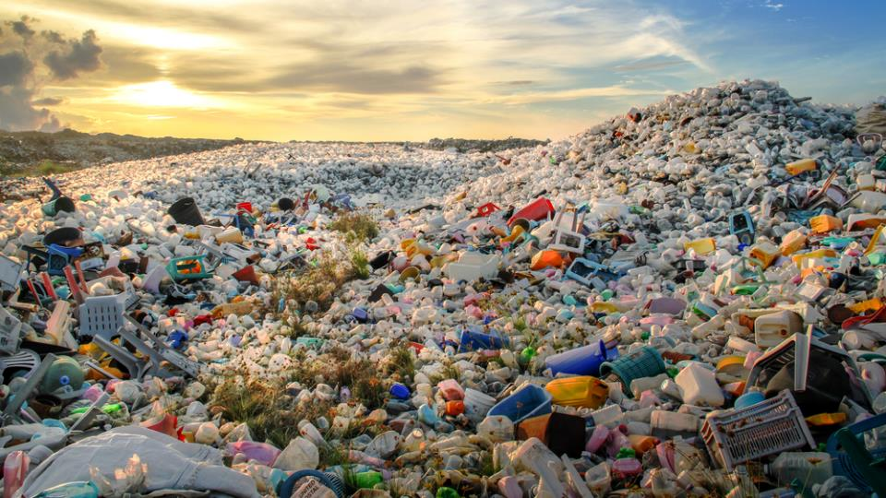
Which policies are effective in curbing the plastic pollution crisis?
Notes:
In 2016, the world generated 242 million metric tons of plastic waste—12 percent of all municipal solid waste, according to the What a Waste report.
Some 90 percent of floating marine debris is plastic, of which nearly 62 percent is food and beverage packaging

Slide 6
How will businesses and consumers be affected by Brexit?

Slide 8
What future for cinemas in a world dominated by Netflix and Amazon?

Slide 9
Does globalisation create more winners than losers? Is the age of globalisation coming to an end?
Notes:
The OECD defines globalisation as “the economic integration of different countries through growing freedom of movement across national boundaries of goods, services, capital and people”. Globalisation has coincided with a decrease in extreme global poverty and a decrease in inequality between countries. However, globalisation has also coincided with an increase in inequality within countries according to some measures, and can have both positive and negative effects on the labour market in developed economies.

Slide 10
The Market for Cd’s
Price (£)
S
£14
£8
D1
D
250
600
Quantity Bought and Sold (000s)
Notes:
The slides that follow will put the demand curve and supply curve together. The emphasis is on explaining the PROCESS by which markets change.The initial starting point will be the basic equilibrium position Students can be advised that this type of analysis begins with a starting point, introduces some form of change and then analyses the process by which prices and quantity will change and the reasons for this. The first slide deals with a fall in demand. The reasons for the fall in demand could be related to an event occurring at the time but needs to be linked in to the formula given earlier. As demand falls consumers now wish to purchase less at each price. The emphasis must be on the fact that suppliers cannot control demand and therefore do not necessarily anticipate such changes, they therefore need time to be able to react. The fall in demand will mean that some suppliers will not be selling as many items, a surplus will develop (highlighted by a flashing ‘surplus’ sign) that will force prices down. A new equilibrium will be established where the new demand curve intersects with the existing supply curve at a lower price and with less items bought and sold. There is much room for confusion of this process and students need time to be able to experiment with it to reflect on it and build it into their learning. The second slide deals with a change in supply – this time creating a shortage. The same process occurs but in reverse. The next stage would be to get students to explain what would happen if the demand rose and if supply also rose.

Slide 11
Results
Consistently strong results over 15 years
2017/18 – 84% A* - C / 55* A*-B
2018 / 19 – 95% A*-C / 67% A* - B
Large proportion go on to Econ related degree courses

Slide 12
Is Economics for Me?
Universities and employers regard economics as a 'numerate' discipline.
It has the reputation of being a demanding subject, and therefore a qualification in it is a valuable asset.
A-level economics crosses the arts/science divide.

Slide 13
Career
Students typically go on to study economics, or Management,
Law or other business related courses. Also students often study courses combined with a wide variety of other subjects such as History,
Maths or a language because of the strong logical base that the subject provides.
Would-be engineers should be aware that a number of degree courses in engineering include an economics component.
Accountants take economics exams as part of their professional qualification.

Slide 14
More info?
Email jscourfield@sheldonshool.co.uk
Come and find me

