Slide 1
Welcome to A level DT: Fashion & Textiles
Teacher I/C: Mrs Faye Blackhall
Main Subject Teachers:
Mrs Faye Blackhall, Mrs Katherine Driver and
Mrs Janine Cheverton

Slide 2
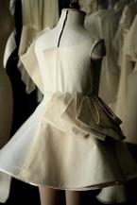
Why choose A level DT: Fashion & Textiles?
You have really enjoyed GCSE Design and Technology and found the subject interesting. You are prepared to work hard and be organised. The coursework will be familiar to you.
You hope to gain a grade 5 or above at GCSE.
You may be interested in following a career working in design, fashion or textiles.
You think it will match well with other choices.
It will give a creative balance to your A level choices
and give you a more diverse set of skills.

Slide 3
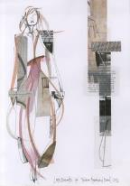
What is A Level Fashion & Textiles?
Students following this course will develop the following skills:
Enhance their own creative and innovative design skills while following the design process.
Develop a critical understanding of processes through product analysis.
Develop an insight into modern fashion and textiles industries including CAD/CAM, as well as providing an understanding of practical aspects such as fibre properties, fabric and garment construction techniques, dyeing and decorative finishing processes.
Explore new fields such as innovations in smart textiles and modern materials.
Develop an understanding of the history of fashion and explore how textiles products have evolved. Students will use these new skills to create their own modernised designs.
Design and make high quality textiles products that meet real needs.

Slide 4
Course Structure
Y12 DT: Fashion and Textiles students complete a practice coursework project to develop design skills, practical skills and subject knowledge.
A range of contexts will be given to students who will write their own design brief.
Students will all produce a creative textiles product that meets the needs of a client and their chosen context/design brief.
Lessons are divided between coursework and theory.

Slide 5
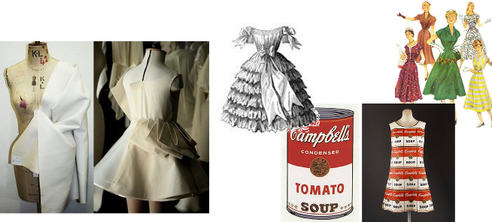
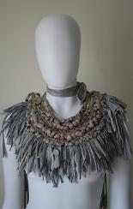
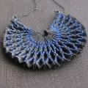
Year 12
Year 12 is a foundation year in preparation for year 13. Students are given a range of opportunities to build on their technical skills and are encouraged to fully challenge themselves in the design process. Students are provided with a range of contexts which they select to produce an original and unique design. Students produce a coursework folder that responds to a real need and often work with real clients.

Slide 6
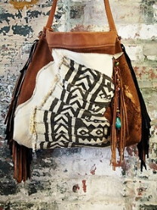
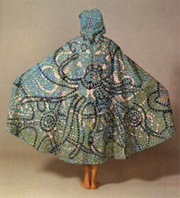
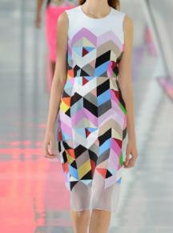
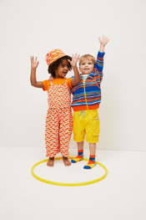
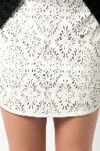
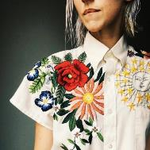
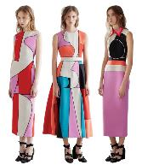
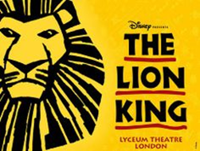
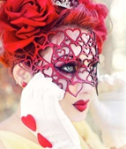
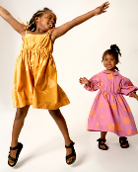
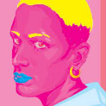
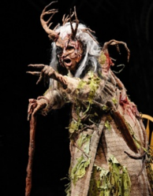
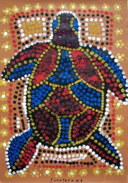
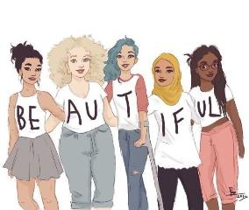
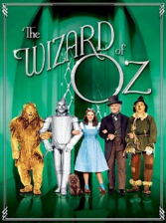
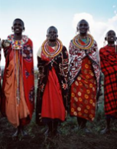
Examples of Y12 DT: Fashion and Textiles Contexts

Slide 7
Year 12
Examples of Y12 contexts given to students;
Natural forms are a constant source of inspiration for fashion designers. Design and make prototype(s) that reflect the elegance of nature.
Travelling. Design and make prototype(s) for a product that could be used by people travelling abroad.
Sustainable futures. Design and make prototype(s) for a product that will alleviate an environmental problem.
Stage and film costumes provide fashion designers with inspiration. Design and make prototype(s) for a product inspired by a stage or film production which will appeal to a modern market.
Body image. Design and make prototype(s) for a teenager to boost body confidence.
Culture. Different cultures around the world provide fashion designers with inspiration. Design and make prototype(s) for a product inspired by a culture.
Identity. Design and make prototype(s) for a product that celebrates the distinguishing character or personality of an individual or group of people.

Slide 8
The A Level Course
Major Project
Students write their own context and briefs
Students work with a real life client
Students will produce one working prototype/ final piece
50% Design Coursework
30% 2.5 hour exam focusing on technical principles in both design and making.
20% 1.5 hour exam focusing on specialist principles of design and manufacturing.
Development of existing products
Ergonomic development: Perfect posture chair

Slide 9
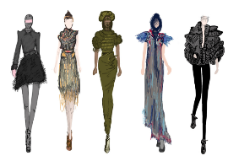
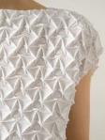
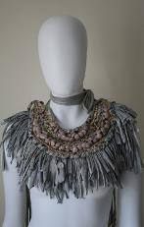
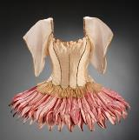
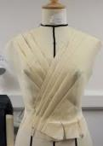
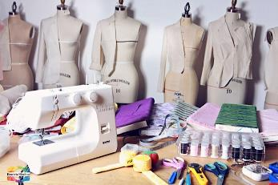
Potential Projects
Costume design for TV, Theatre, Film etc
Catwalk Fashion & Abstract Fashion
Fashion Garments
for high street stores
Childrenswear
Androgynous clothing
Menswear
Home Furnishing
Accessories
Fashion Garments taking inspiration from a variety of areas
Fashion Jewellery
Tailoring
Fashion garments that respond to a gap in the market

Slide 10
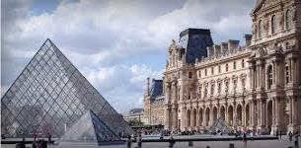
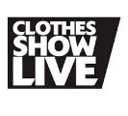
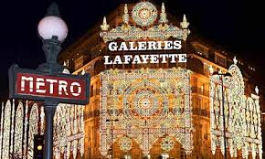
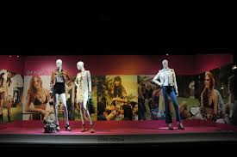
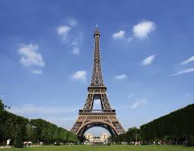
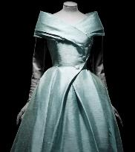
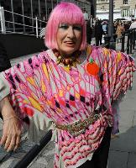
Trips & Visits
As part of the course students will be given the opportunity to attend a selection of trips to aid the development of their coursework. Examples of previous
A Level trips:
Three day residential trip to Paris combining curriculum work with cultural and leisure activities.
Dior Exhibition 2019
Zandra Rhodes Textile Museum
V&A Visit
Harry Potter Studios (Costume Design Workshop)
In-house workshops provided by specialist textiles designers

Slide 11
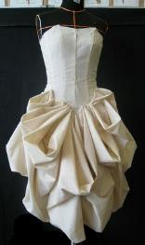
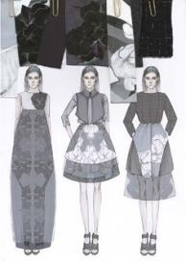
Where can DT: Fashion and Textiles lead?
​
The Textiles & Fashion ​
Industry is one of the ​
biggest employers ​
in this country offering over 800,000 jobs. Following Higher​
Education, you could command a ​
very high salary in:
Art Foundation
Design Degrees
Apprenticeships
Fashion Design
Product Design
Interior Design
Tailoring
Costume Design
Knitwear Design
Textiles Design
Pattern Cutter
Weaver
Buyer/
Merchandising and
Marketing careers
Fabric/Garment
Technology
JUST TO
NAME A FEW!!!

