Slide 1
WJEC
Level 3 – Food Science and Nutrition
Certificate and Diploma

Slide 2
History of the course
2015 the Government decided to drop the Food Technology A Level.
2017-18 is the last Year of Food Technology A Level.
At Sheldon we had 70 GCSE students doing Food Technology GCSE with no relevant Post 16 Food based course.
2016 WJEC introduced the Level 3 Certificate and Diploma Qualification in Food Science and Nutrition.
Offered for the first time at Sheldon in 2017 for first assessment in 2018 (Certificate) and 2019 (Diploma)
We currently have 17 students studying the course
September 2022 will be the sixth cohort taking the course

Slide 3
Level 3 v’s A Level
FAQ’s
Will the qualification support me applying to Universities?
Is the qualification easier than an A Level?

Slide 4
Will the qualification support me applying to Universities?
Absolutely yes.
The qualification has been endorsed by a number of Universities that specialise in food based degree courses.
The qualification has the same University Tariff Points as an A Level

Slide 5
A Level Marks – Compared to Level 3 Marks
E Grade at A Level = Pass at Level 3
C Grade at A Level = Merit at Level 3
A Grade at A Level = Distinction at Level 3
A* Grade at A Level = Distinction* at Level 3 (Diploma Only)

Slide 6
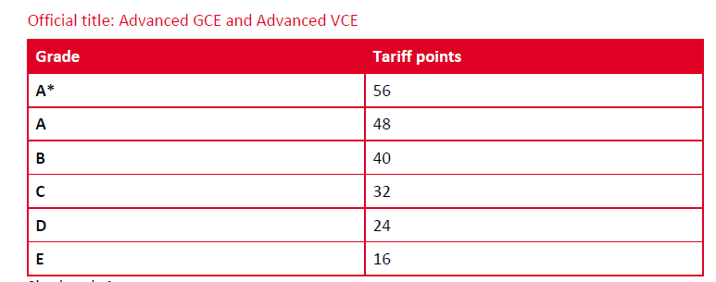
UCAS Tariff Points
(half published points for Certificate)
Resource – Page 149 of UCAS Tariff Tables 2020

Slide 7
Is the qualification easier than an A Level?
No.
The qualification has been structured to be as rigorous as an A Level qualification.

Slide 8
Two Year Course Structure
Year 12 – Certificate
Unit 1 – Meeting the Nutritional Needs of Specific Groups
Internal Project 50% of Certificate (and 25% of Diploma)
External Exam 50% of Certificate (and 25% of Diploma)

Slide 9
Year 12 Certificate - Content
Nutrients – Function, Structure
Specific Dietary Needs of Individuals
Food Hygiene and Safety
Complex Practical Skills

Slide 10
Year 12 – Practical Tasks
You will be taking part in high level, independent practical work at least once a week.
Each practical task will have a specific theme or focus and you will need to research and execute appropriate recipes in the time allowed.
It is expected that you will demonstrate high skills in your Unit 1 Internal Assessment.

Slide 11
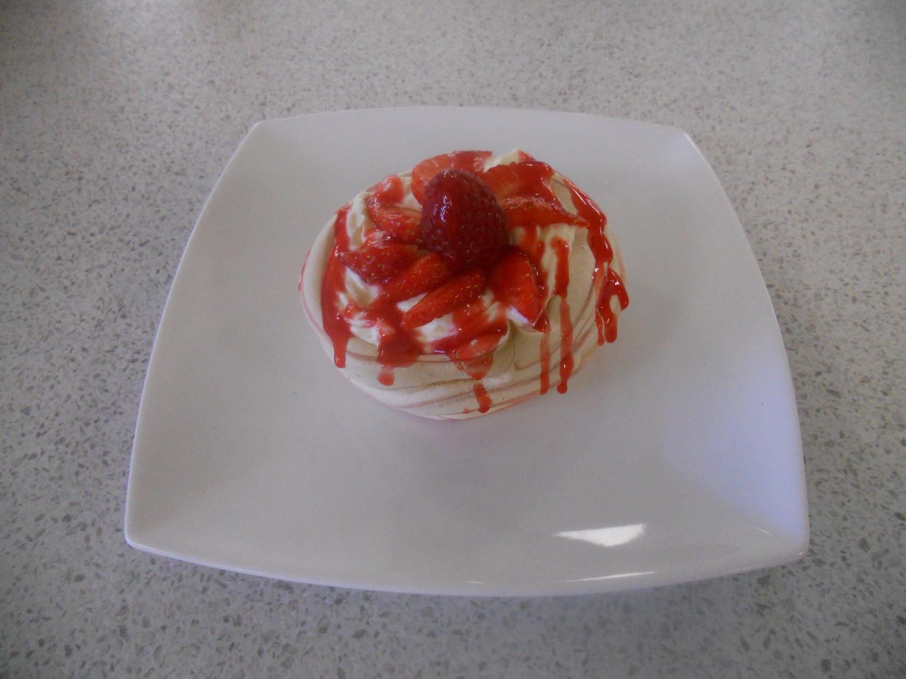
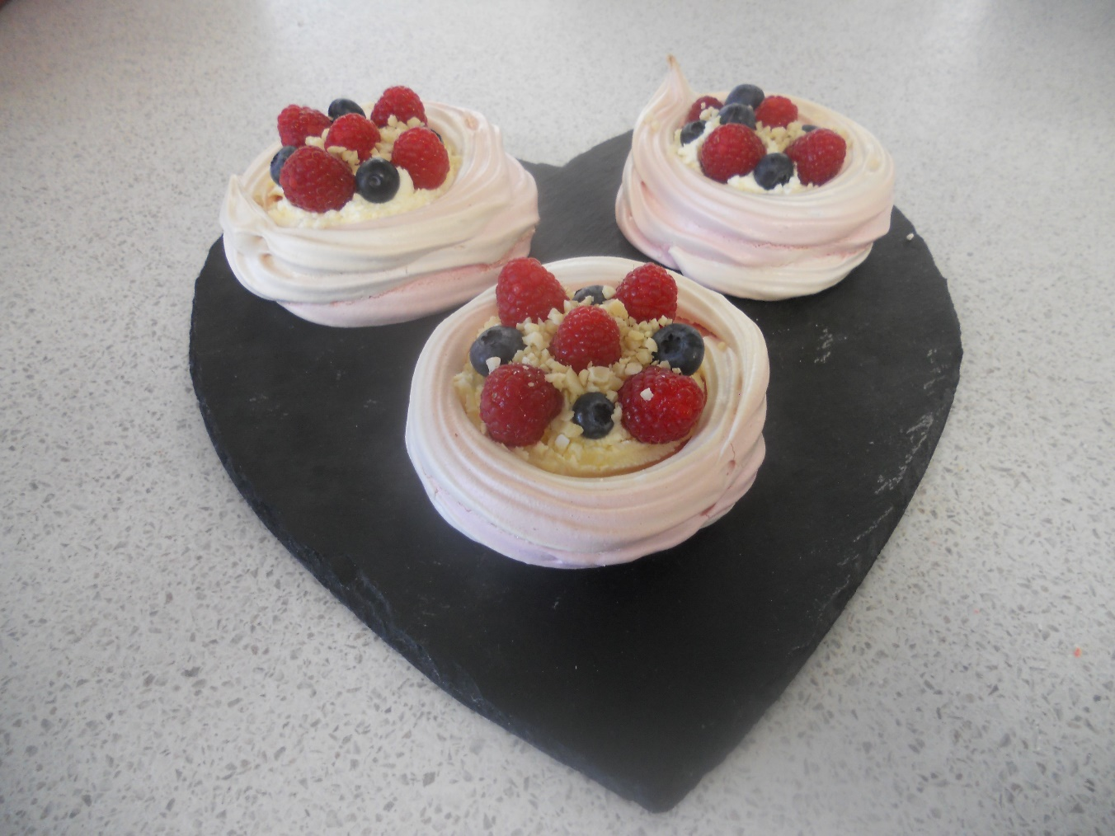
Striped Meringues

Slide 12
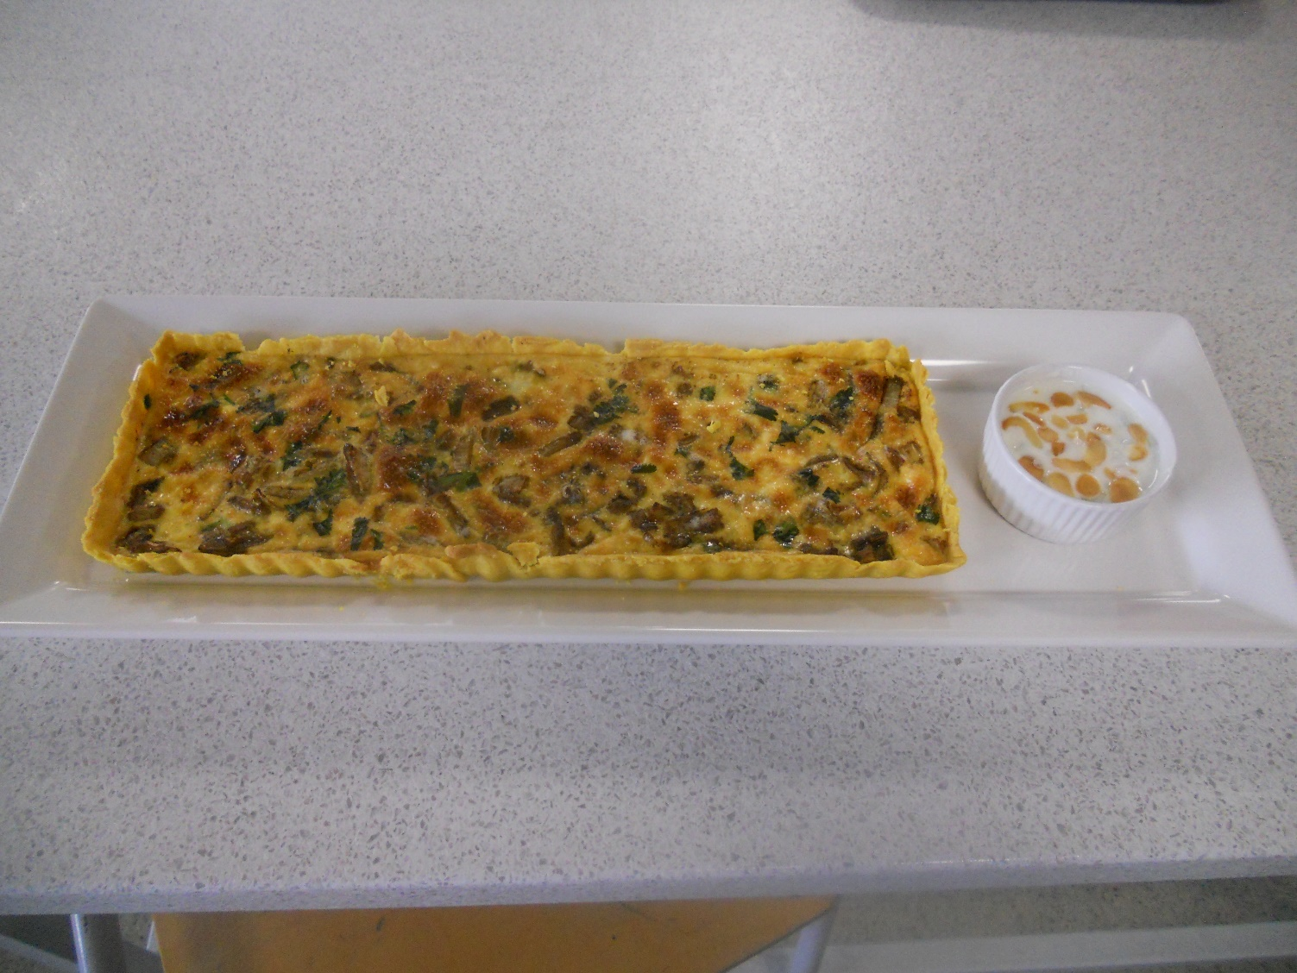
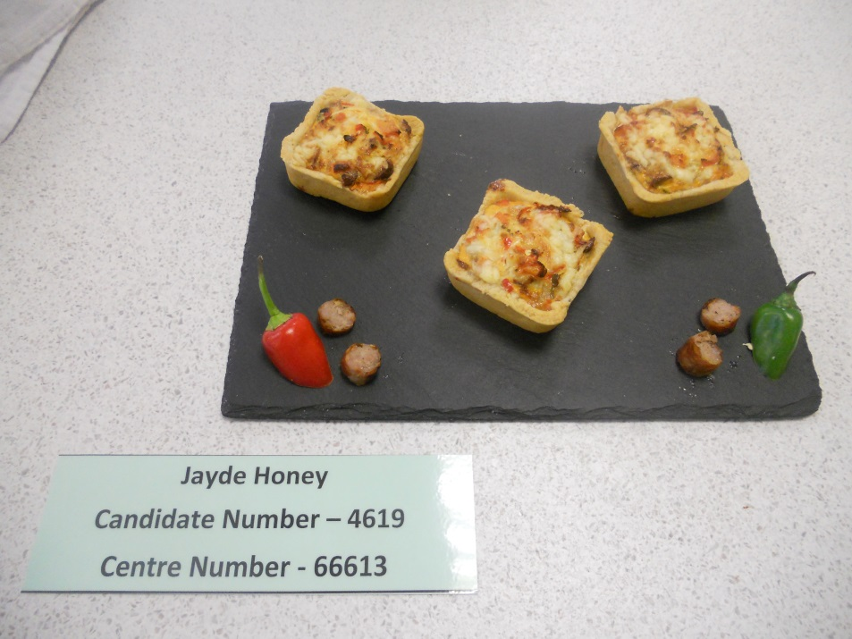
Quiche with a difference……..

Slide 13
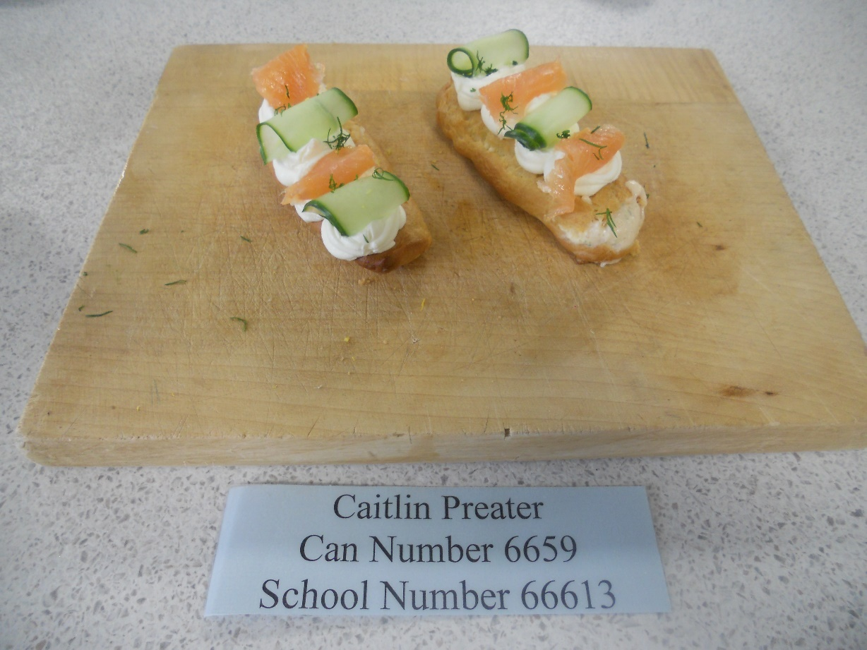
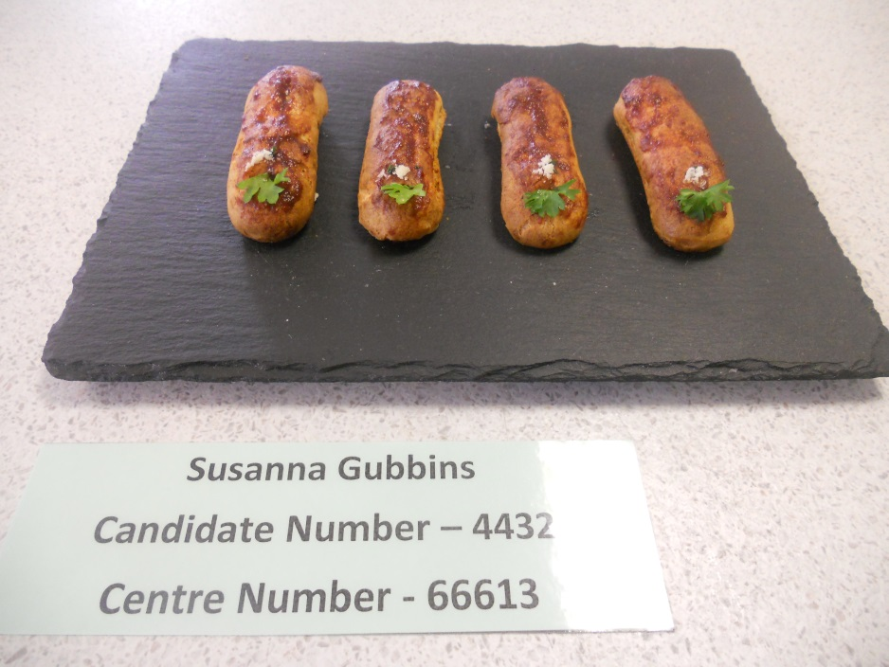
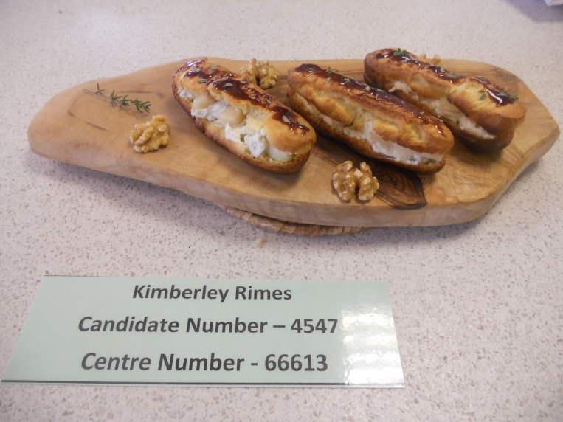
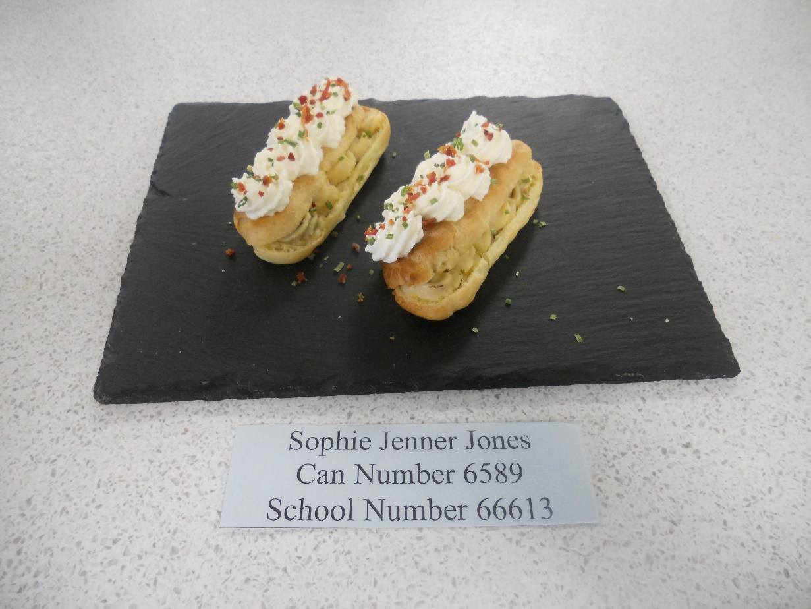
Savoury Choux Pastry fit for Paris……

Slide 14
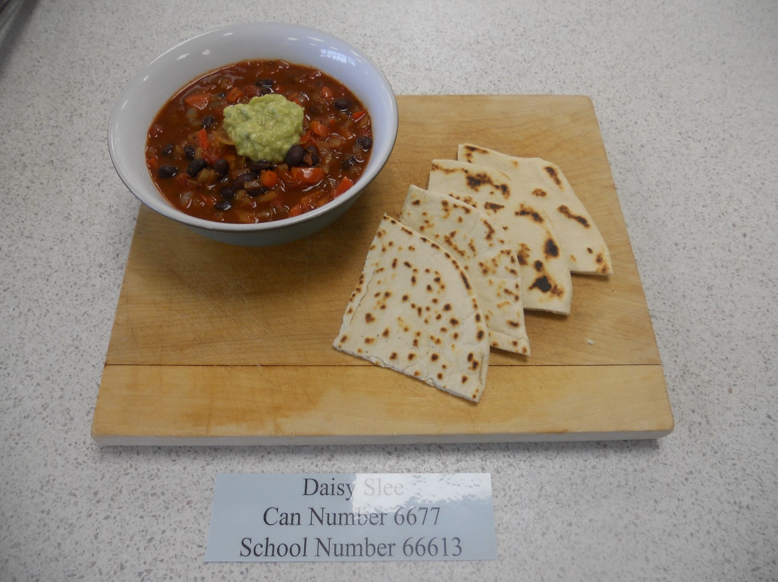
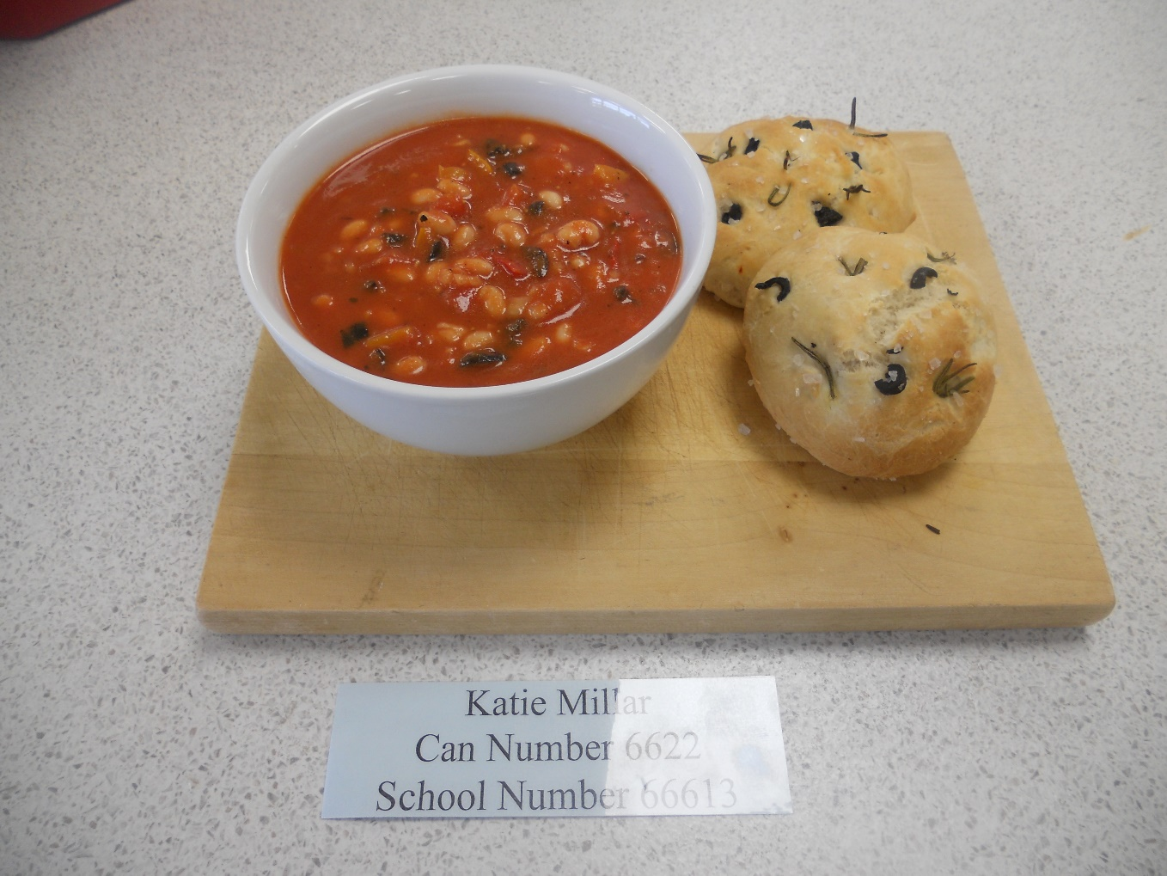
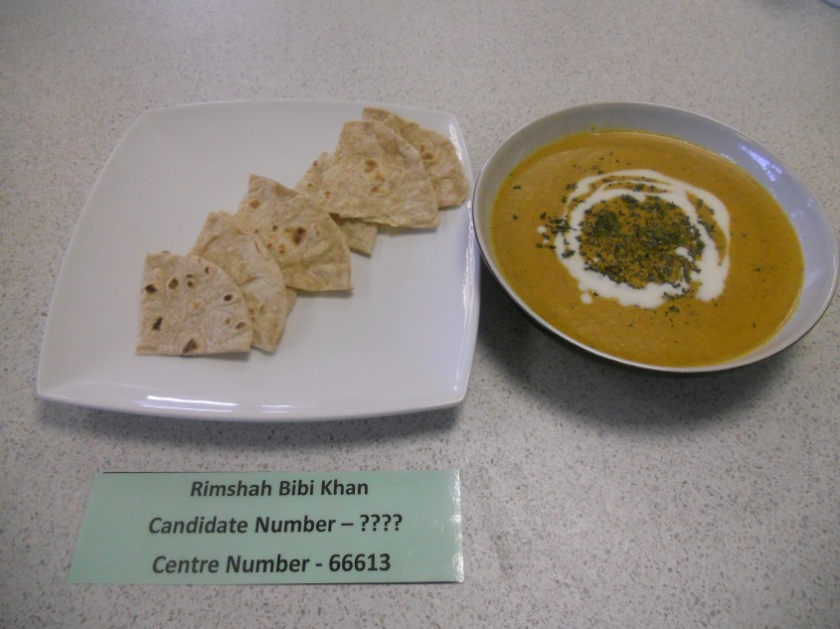
International Soup Day (with international bread)

Slide 15
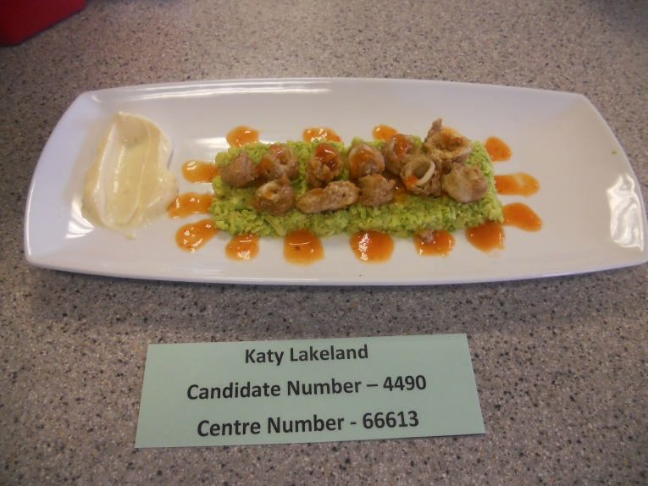
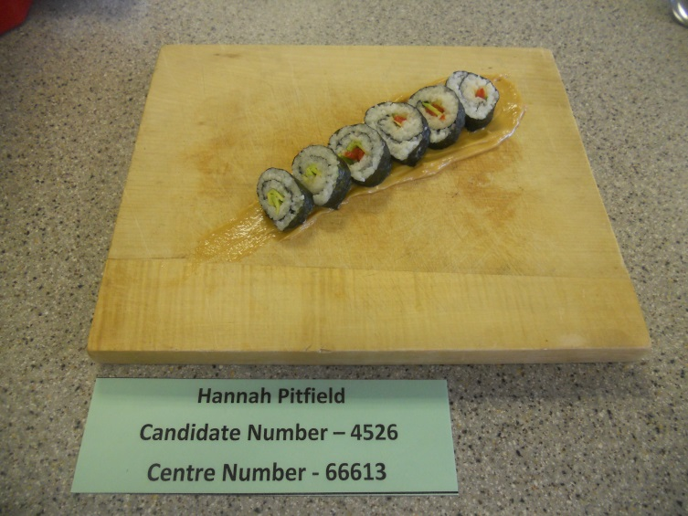
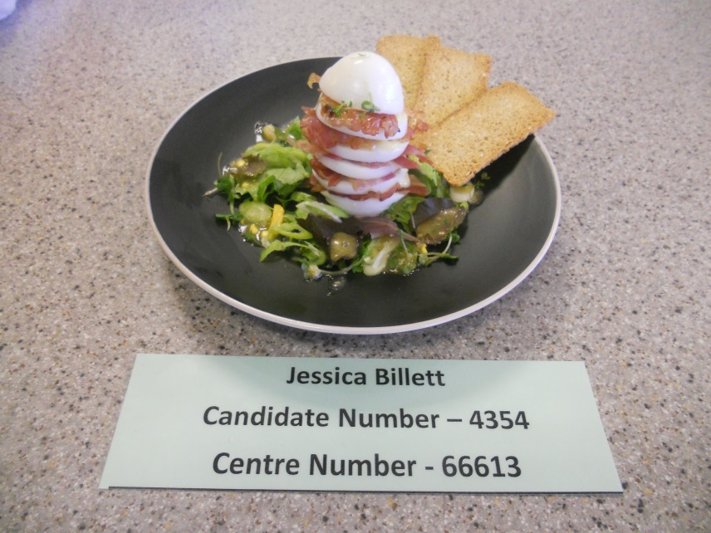
Homemade Mayo - used in a starter.

Slide 16
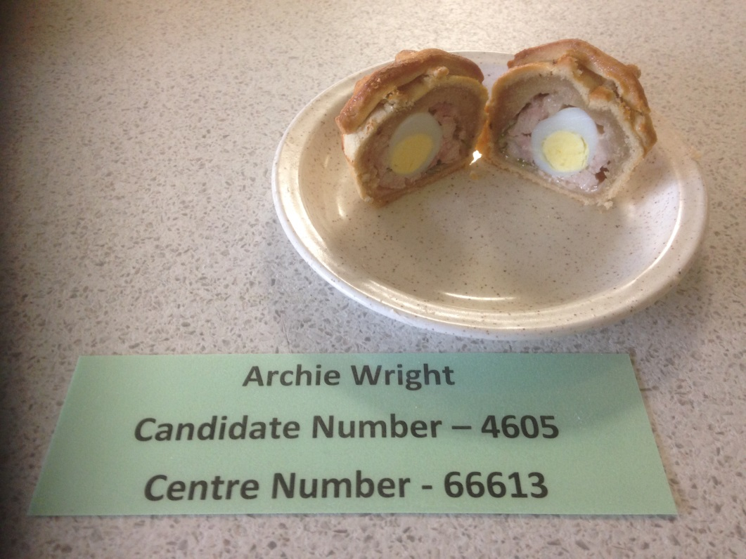
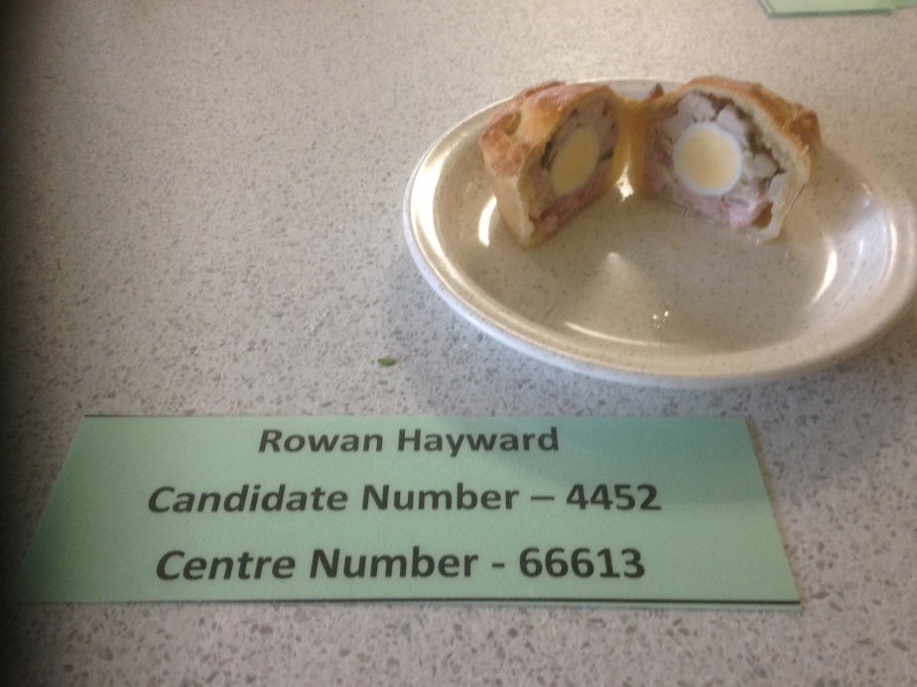
Gala Pie – Bake Off

Slide 17
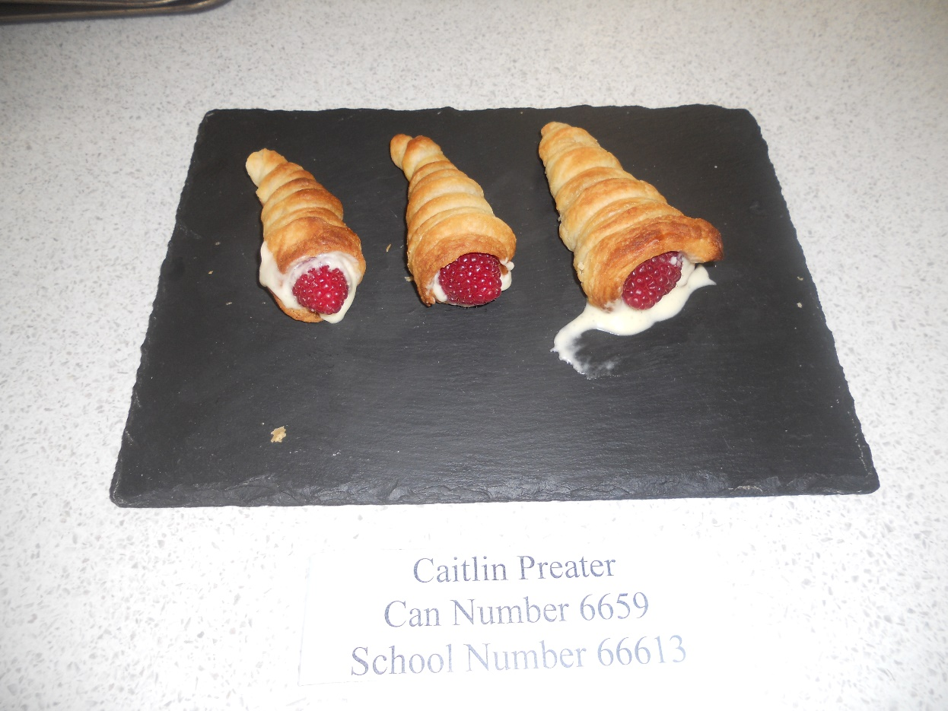
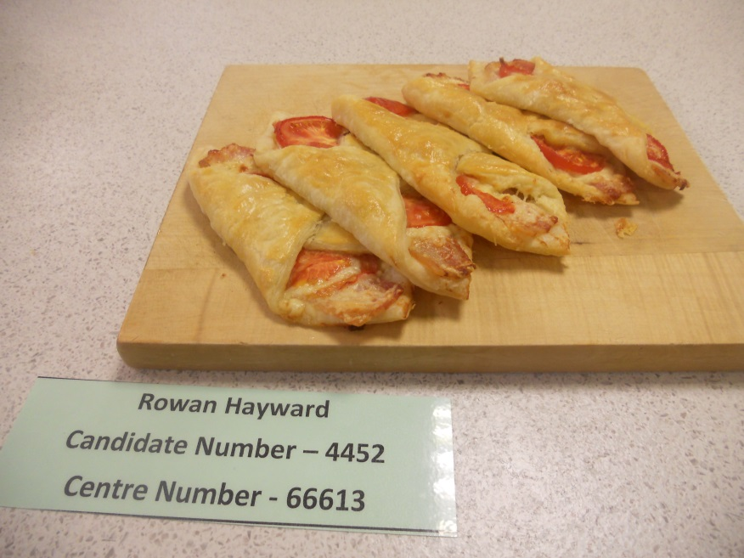
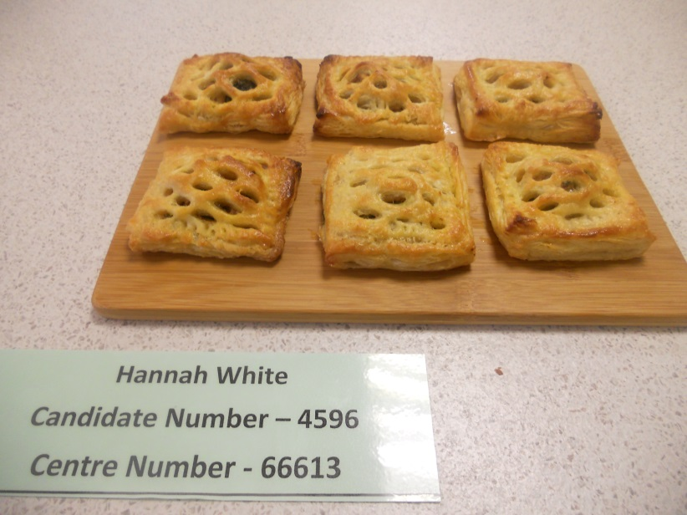
A Puff Pastry Product for a Primary School Break Time Snack

Slide 18
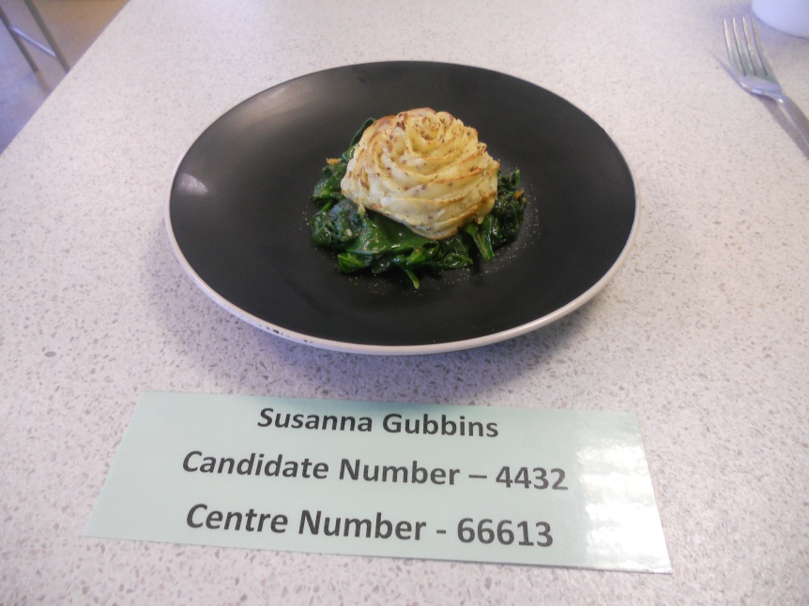
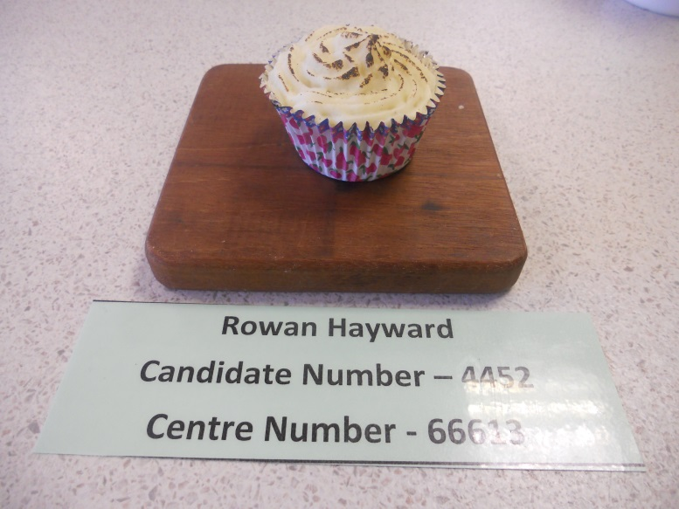
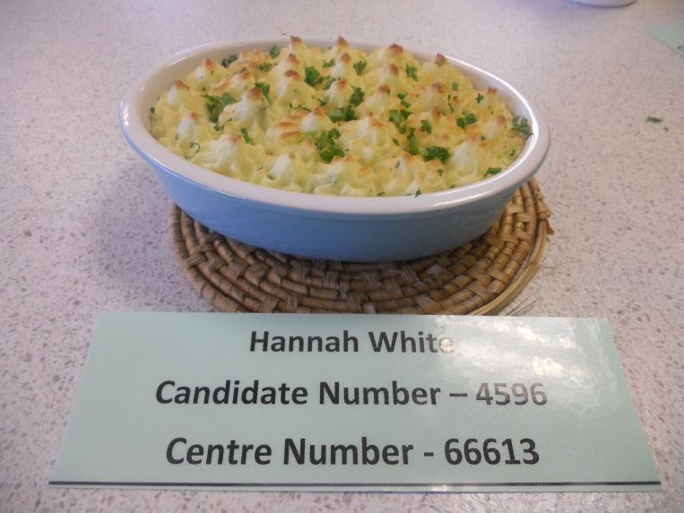
Piped Mash………

Slide 19
Year 12 – Assessment – Examination (50% of Certificate, 25% of Diploma)
Structure: Three sections
Section A is short answer questions
Section B is extended answer questions
Section C relates to a case study
Can be retaken in Year 13.

Slide 20
Year 12 – Assessment – Project Unit 1 (50% of Certificate, 25% of Diploma)
Total time of assessment is 9 ½ hours.
(This will include 3 hour observed practical)
Example Task –
A local gym has just built a new kitchen and the owner wishes to encourage more teenagers to the venue by offering a range of high protein dishes suitable for teenagers. You must email the owner proposing a menu of six potential savoury dishes that meet their needs. You will then be invited to prepare three dishes in three hours.
You will then attend an interview and discuss, with detailed notes, a full proposal of your menu (your notes will be submitted for assessment).

Slide 21
Year 13 Diploma – Content – Unit 2 (25% of Diploma)
Unit 2 - Ensuring Food is safe to Eat (Compulsory Unit)
Learners will develop an understanding of hazards and risks in relation to the storage, preparation and cooking of food in different environments and the control measures needed to minimise these risks. From this understanding, learners will be able to recommend the control measures that need to be in place, in different environments, to ensure that food is safe to eat.

Slide 22
Unit 3 - Experimenting to Solve Food Production Problems (optional)(25% of Diploma)
Where you will be required to investigate a ‘real’ problem that is experienced by a food industry.
You will be given a set of ‘complaints’ about a food product and your project will:
Identify the problems that are occuring
Analyse the scientific properties of the ingredients
Carry out a range of experiments with these ingredients to solve the problems
Propose solutions in the form of a report to the food company

Slide 23
You will need -
Level 5 or above at GCSE.
Very good organisation Skills.
Have a genuine interest in all food related issues and current affairs.
Have a genuine desire to research recipes and to prepare skilful dishes using interesting ingredients.
Be motivated as an independent learner in order to undertake project work successfully.

Slide 24
Works very well with …….
Physical Education.
Science.
Psychology
Sociology
Health and Social Care
Any other subject because Food Science and Nutrition is just that bit different from all other subjects.

Slide 25
And beyond…………
University courses –
Food Science
Food Science and Innovation
Food and Nutrition
Food Science and Microbiology
Food Science and Engineering
Food and Consumer Science
Food Marketing Management

Slide 26
And Beyond…….
Food Production and Supply Management
Food Business Management and Marketing
Hospitality and Food Studies
Nutrition and Health
Fitness, Nutrition and Health
Human Nutrition and Psychology
Human Nutrition and Dietetics
Sport Exercise and Nutrition
Nutrition and Sport Science

Slide 27
And ultimately…..
Supermarkets
Laboratory
Health Sector
Contract Catering
Armed Forces
Sport
Hospitality Sector
Nutrition
Chef
Entrepreneur
Food Manufacturing

