Slide 1
A-LEVEL
PRODUCT DESIGN

Slide 2
What is Product Design?
Product design is the process by which products are designed and produced.
In its basic form it is coming up with new ideas to improve the efficiency or productivity of existing products or the creation of new ones. Developing, planning and producing an outcome.
It is the combination of Graphic Products, Resistant Materials and Systems. Allowing you to develop your skills in all areas.
It is about designing for life, from the Biro to the IPAD.

Slide 3
Why choose Product Design?
Career opportunities.
Enjoy the subject at GCSE.
Using the extra UCAS points for entry into university.

Slide 4
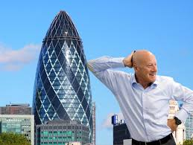
Careers
It is estimated that we will need 100,000 new Designers, STEM Technicians and Engineers every year.
Architecture
Advertising
Teaching
Carpentry
Set design
Landscape / Built environment
Furniture Design
Automotive design
Interior design
Product Design
Product modelling

Slide 5
Year 12
With students coming from different DT backgrounds Year 12 focuses on building skills and developing knowledge.
The year is broken down into mini projects that will focus on the following areas:
Health and Safety
Working with Resistant and Compliant Materials
Mathematics
Manufacturing Processes
Quality Control and Quality Assurance

Slide 6
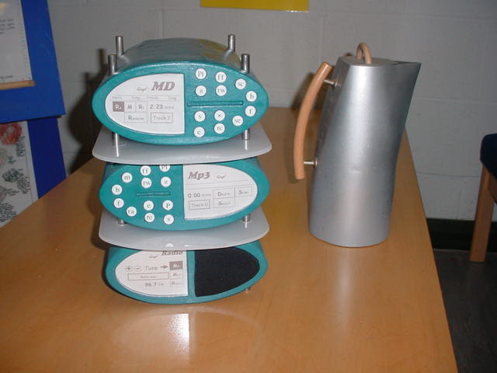
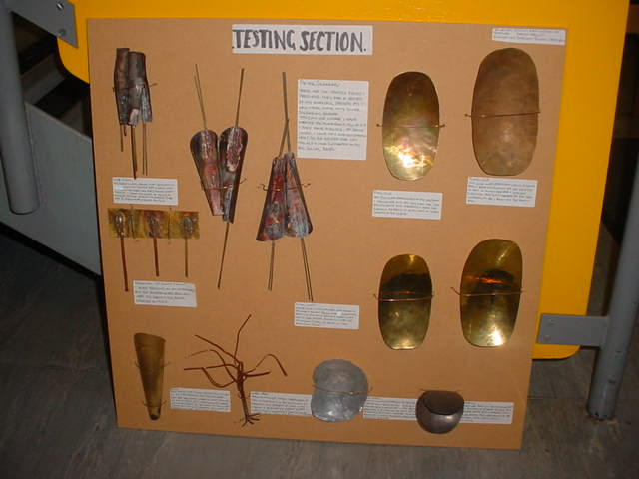
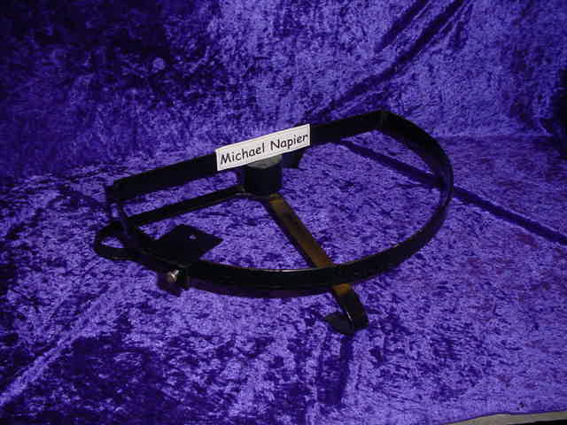
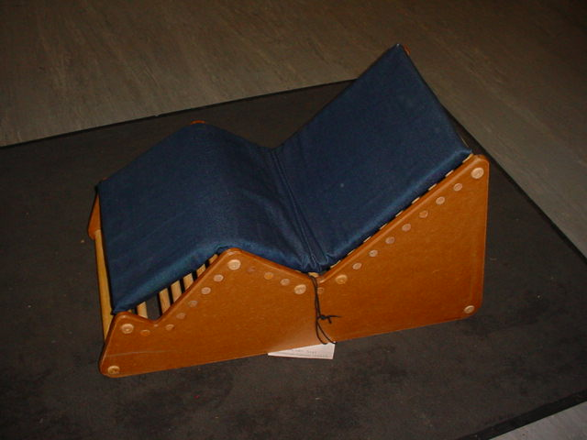
Year 13
Major Project
Real problem with a real client
Design process coursework
Modelling
Manufactured product
Working prototype
Development of existing products
Ergonomic development: Perfect posture chair
50% of A Level qualification. Coursework and Practical based

Slide 7
A Level Course Structure
50% Major Project Coursework
30% 2 hour exam focusing on Technical principles in both design and making.
20% 1 hour 30 minute exam focusing on specialist principles of design and manufacturing.

Slide 8
Links to other courses
Art
Business Studies
ICT
Mathematics
Media Studies
Physics
Psychology

