Slide 1
A-Level English Literature

Slide 2
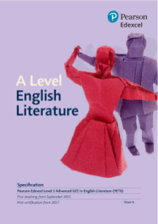
What will I get from the course?
Development of essay writing skills.
An ability to read closely and perceptively.
The chance to debate and discuss ideas.
A course that supports and complements other A Level courses.
Highly enthusiastic and motivated specialist teachers

Slide 3
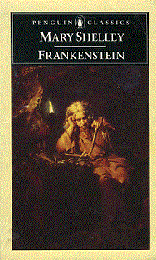
Course Overview
Prose Texts: Science and Society/Women in Society
(20% of the total A Level)
An in-depth comparative study of two prose texts, either Mary Shelley’s ‘Frankenstein’ and Margaret Atwood’s ‘The Handmaid’s Tale’ for the Science aspect or Emily Bronte’s ‘Wuthering Heights’ with Khaled Hosseini's ‘Thousand Splendid Suns’. Students will explore context, language, structure and genre whilst looking at the thematic and narrative connections between the chosen pair of texts.

Slide 4
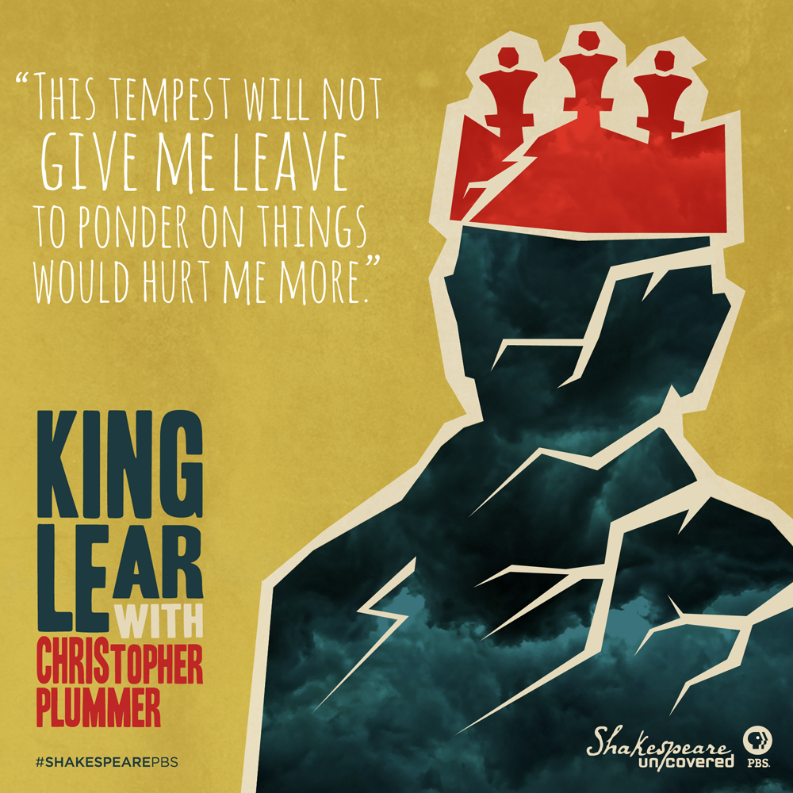
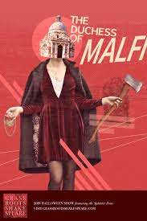
Course Overview
Drama texts.
(30% of the total A Level)
Two drama texts are studied during the A Level course: an exploration of either Shakespeare’s ‘Othello’ or ‘King Lear’, examining the tragic genre and evaluating how the historical context has shaped the meaning of the play for modern audiences. In Year 12, students will focus on Tennessee William’s seminal domestic tragedy ‘Streetcar Named Desire’ or Webster’s revenge tragedy ‘The Duchess of Malfi’.

Slide 5
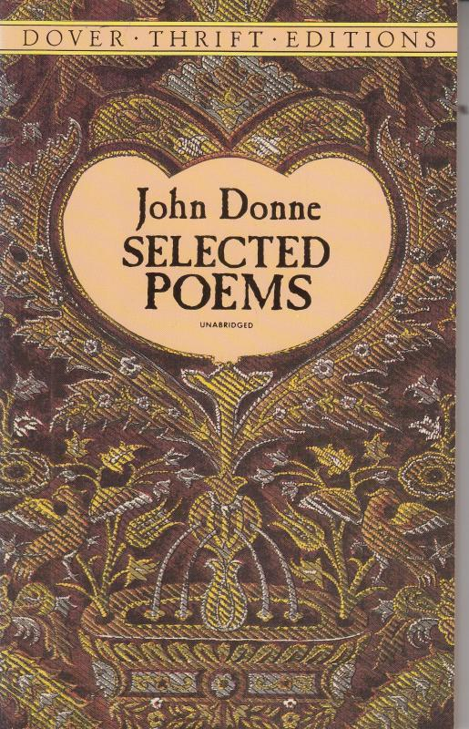
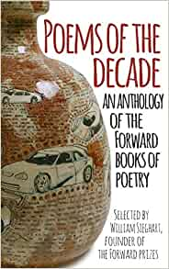
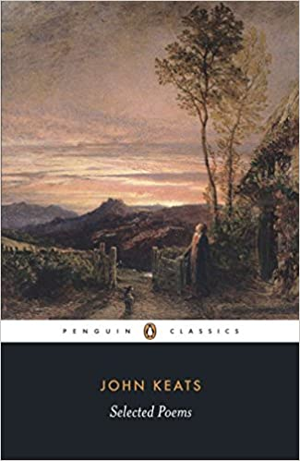
Course Overview
Poetry: ‘Poems of the Decade’, unseen poetry and poet’s collection
(30% of the total A Level)
In the first section of the poetry unit students study a selection of modern poems and compare with unseen poems in the exam.
In the other section the focus is on a collection from a named poet or poetic movement. Eg Romantic Poetry, John Donne, Victorian Poetry, Geoffrey Chaucer

Slide 6
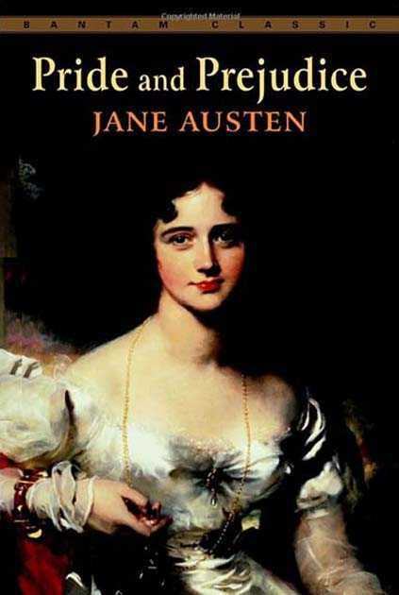
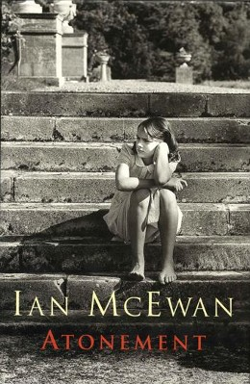
Course Overview
Coursework Project:
(20% of the total A Level)
At the end of Year 12, students will produce an extended essay focusing on one of two taught texts (This year’s cohort studied Fitzgerald’s ‘The Great Gatsby’ and Miller’s ‘All My Sons’) and producing a comparison to a text of their choice. Students have the freedom to devise their own question and focus of study for this module.

Slide 7
Hear what current students have to say…
IMBED VIDEO HERE!

Slide 8
Skills and possible pathways
Skills
Creative analytical reading and writing skills.
The ability to evaluate critical perspectives and concepts.
The ability to read a range of complex texts from a diverse time period.
The ability to conduct focused and in depth independent study.
Verbal reasoning skills, particularly with a comparative or evaluative element.
Possible Pathways
An undergraduate degree in literature, drama or any other relevant arts subject.
Strong connections for undergraduate study in history, law, philosophy, politics and other humanities. Previous students have also pursued medicine and psychology at degree level.
A career in advertising and marketing, writing and journalism, law, consultancy, business, teaching, performing arts, academia, media, film and television.

Slide 9
Course Requirements
Students embarking on the AS and A Level courses need at least a grade 5 in both GCSE English Literature and English Language
Assessment Methods
Any further questions?
Speak to your English teacher: Miss Beange, Miss Dutton, Ms Gale, Mr Merriman, Mrs Reynolds, Miss Dowdle, Miss Palmer and Miss Mundy have all taught the course!
Email ebeange@sheldonschool.co.uk or adutton@sheldonschool.co.uk
3 exam papers (Drama, Prose, Poetry) between 1 hour and 15 minutes and 2 hours.
Coursework is internally assessed and externally moderated.

