Slide 1
A-Level Media Studies

Slide 2
What will I get from the course?
Development of essay writing skills
Discussion and analysis of issues and topics such as media audiences, media companies, gender, representation, ownership and narrative
You will learn media production skills such as page layout, photography and film making
A course that supports and complements other A Level courses. Clear links can be made to English, Business, Psychology, Art and Photography
Highly enthusiastic and motivated specialist teachers

Slide 3
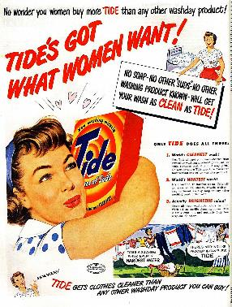
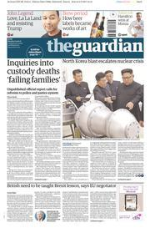
Component 1 Section A: Media Messages All areas – two linked in-depth studies The Guardian and Daily Mail - Two Front Covers/one complete edition of each (45 marks AO1 15 + AO2 30) | Component 1 Section B: Media Messages Media Language and Representation Magazines, Advertising and Marketing, Music Videos (25 marks AO1 10 + AO2 15)
Written exam 1 Media Messages (2hr) 70 marks - 35%
Component 2 Section A: Evolving Media Media Industries and audiences ( 30 marks 2 x 15 mark Qs AO1 30) | Component 2 Section B: Evolving Media All areas - Long form television drama Choose one episode from each list (40 marks AO1 10 + AO2 30)
Film Jungle Book 1967 and 2016 Radio BBC Radio One Breakfast Show Video Games | English Language Season 1 Episode 1 Stranger Things
 | Non-English Language Deutschland 83
Written exam 2 Evolving Media (2hr) 70 marks - 35%
Magazine – The Big Issue
Two Front Covers
Advertising and Marketing
Two Music Videos

Slide 4
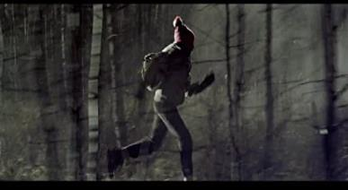
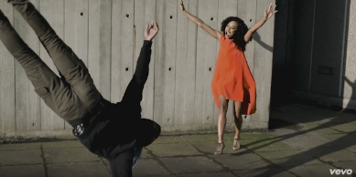
Course Overview
Media Messages: Music Videos
Approx 10 % of the total A Level
An detailed analysis of 2 case studies where you will learn about film language such as cinematography and editing and how it is used to create meaning and to represent an artist and build their public image.

Slide 5
Course Overview
Media Messages: Ads
Approx 10% of the total A Level
An in-depth study of a selection of print ads with a focus on how meaning is created and ideas around representation and social ideologies.

Slide 6
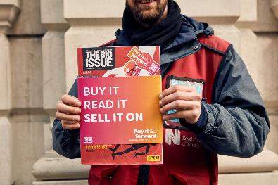
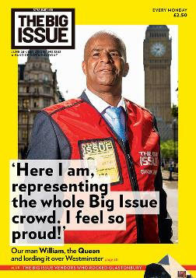
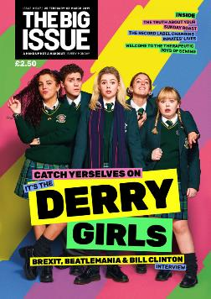
Course Overview
Media Messages: Magazines
Approx 10% of the total A Level
An in-depth study of two front covers from ‘The Big Issue’, focusing on representations and meaning in this social enterprise magazine.

Slide 7
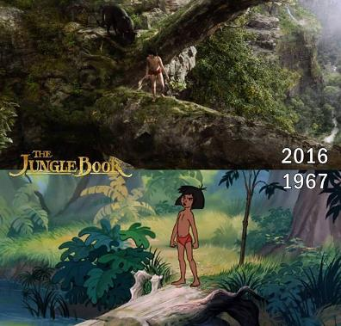
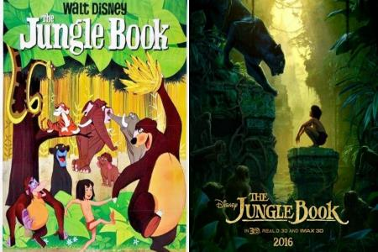
Course Overview
Evolving Media: The Jungle Book
Approx 10 % of the total A Level
An in depth analysis of how film making has evolved through the digital revolution and how that has effected the film making business. This is illustrated through a study of the original Jungle Book movie and its recent live action reboot.

Slide 8
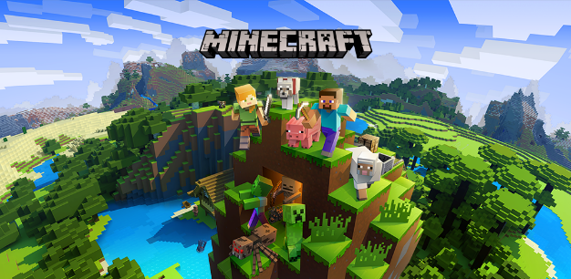
Course Overview
Evolving Media: Minecraft
Approx 10 % of the total A Level)
We look closely at the rise of Minecraft and explore how internet connectivity allowed an independent Swedish production to became one of the biggest games in the world.

Slide 9
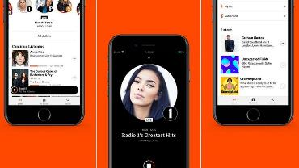
Course Overview
Evolving Media: Radio
Approx 10 % of the total A Level
Through close analysis of the Radio Breakfast Show you will develop an understanding of how the UK’s public service broadcaster, the BBC, meets the challenge of justifying its license fee while appealing to a youth audience and surviving in a digital media landscape.

Slide 10
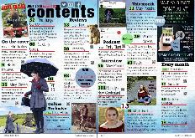
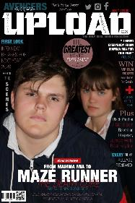
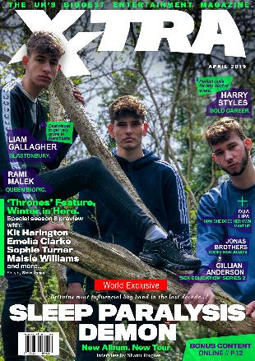
Course Overview
Coursework Project:
Approx 20% of the total A Level-
You will respond to an exam board brief and be given a choice of producing:
a moving image product such as a music video or short film
pages for a new magazine concept
a radio show excerpt
Alongside the above, you will also produce pages of an accompanying website

Slide 11
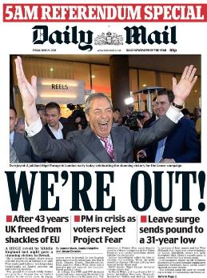
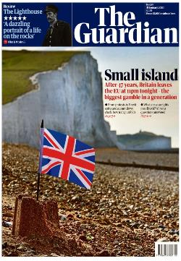
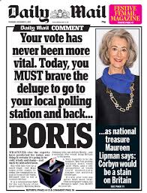
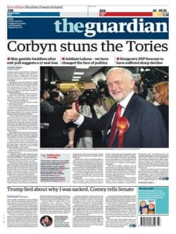
Course Overview
Media Messages: The News
Approx 20 % of the total A Level
A wide ranging study of print and online news which looks at representation, political and ideological viewpoints and ownership of the British press.

Slide 12
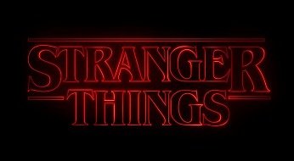
Course Overview
Evolving Media: Television Drama
Approx 20% of the total A Level
Through the close study of 2 opening episodes of Stranger Things and Deutschland 83 we get insight into television drama audiences, narratives, production processes and contexts.

Slide 13
Skills and possible pathways
Skills
Textual analysis of media language across a range of media texts
Industry insight into a variety of media products
Media production using video editing and image editing tools as well as use of media hardware such as camera and mics.
Possible Pathways
A career in advertising and marketing, writing and journalism, law, consultancy, business, teaching, performing arts, academia, creative media production such as radio, graphic design, film, television and digital moving image.

Slide 14
Component 1 Section A: Media Messages All areas – two linked in-depth studies The Guardian and Daily Mail - Two Front Covers/one complete edition of each (45 marks AO1 15 + AO2 30) | Component 1 Section B: Media Messages Media Language and Representation Magazines, Advertising and Marketing, Music Videos (25 marks AO1 10 + AO2 15)
Written exam 1 Media Messages (2hr) 70 marks - 35%
Component 2 Section A: Evolving Media Media Industries and audiences ( 30 marks 2 x 15 mark Qs AO1 30) | Component 2 Section B: Evolving Media All areas - Long form television drama Choose one episode from each list (40 marks AO1 10 + AO2 30)
Film Jungle Book 1967 and 2016 Radio BBC Radio One Breakfast Show Video Games | English Language Season 1 Episode 1 Stranger Things
 | Non-English Language Deutschland 83
Written exam 2 Evolving Media (2hr) 70 marks - 35%
Magazine – The Big Issue
Two Front Covers
Advertising and Marketing
Two Music Videos

Slide 15
Course Requirements
Students embarking on the A Level courses need at least a grade 5 in both GCSE English Literature and English Language
Assessment Methods
Any further questions?
Speak to your English teacher: Mr Edwards, Miss Dutton, Mr Clark and Mrs Law have all taught the course!
Email dedwards@sheldonschool.co.uk
2 exam papers Coursework is internally assessed and externally moderated.

