Slide 1
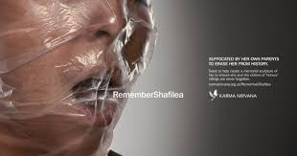
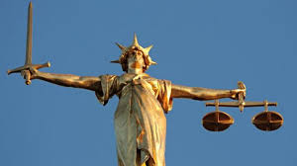
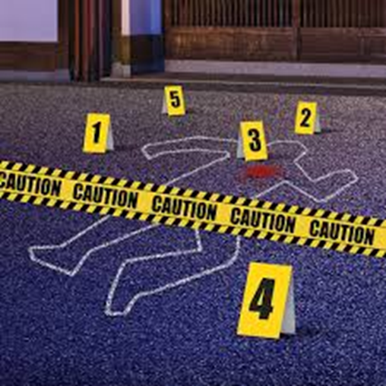
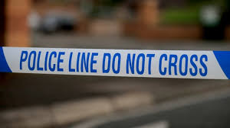
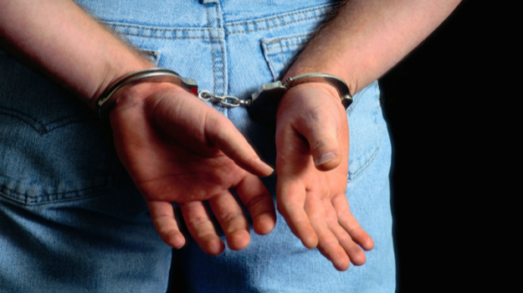
CRIMINOLOGY
A LEVEL DIPLOMA

Slide 2
Yr 12 Changing awareness of crime : Controlled assessment
Understanding different types of crime
Understanding how crime reporting affects people’s perception of criminality
Understanding of how campaigns are used to elicit change
Planning a campaign for change

Slide 3
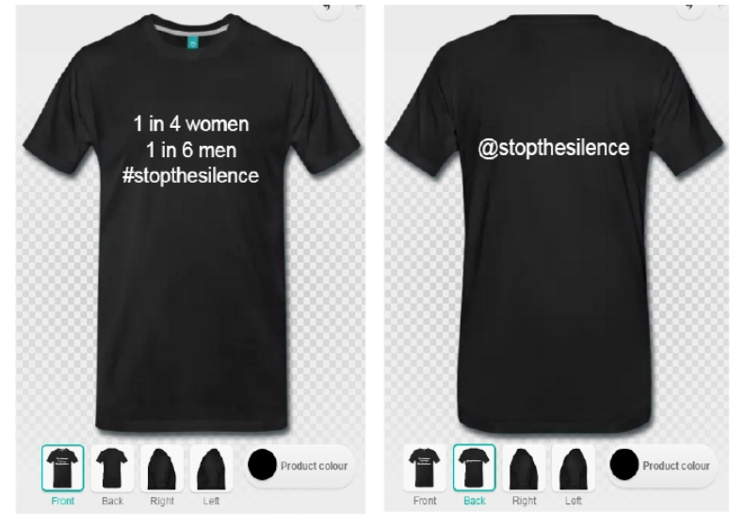
Controlled assessment
8 hour write up on types of crime and designing a campaign to raise awareness of unreported crimes.

Slide 4
Yr 12 Criminological theories Exam
Understanding the difference between crime and deviance
Understanding the theories of criminality (Biological, sociological and psychological)
Understanding the causes of different types of crime
Understanding causes of policy change

Slide 5
Yr 13 Crime scene to court room Controlled assessment
Follow a crime from the initial crime scene and investigation
Discover techniques used by the police
Rules of evidence and role of magistrate and jury
Validity of verdicts and sentencing including miscarriages of justice

Slide 6
Yr 13 : Crime and punishment Exam
Understanding law making processes
Understanding how agencies such as CPS, probation service and prisons work.
Consider how other agencies e.g. charities and pressure groups can play a role in social control

Slide 7


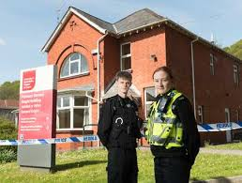
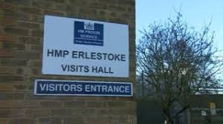
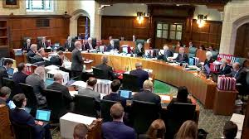
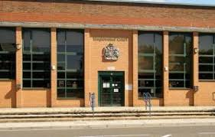
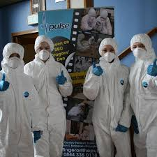
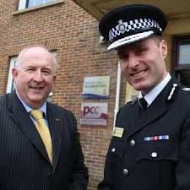

Slide 8
How is this qualification assessed?
This course is assessed by means of 50% controlled assessment and 50% examination
Controlled assessments take place in TERM 2. You will have completed 2 exams at the end of year 13 and have completed 2 controlled assessments.

Slide 9
Career progression
Community worker.
Detective in police.
Prison officer.
Probation officer.
Social worker.
Youth worker.
Data scientist.
Forensic analyst.
Government officer.
Solicitor.
Typical employers
include:
Central and local government
The police and prison services
The court services
Security services
Non-profit-making organisations, including the NHS, educational institutions and charities that work with young offenders or victims of crime.

Slide 10


Any questions?
@psysocatsheldon
agoldsmith@sheldonschool.co.uk
Or speak to me and our students face to face

