Slide 1
Welcome to Sheldon School History Department
An introduction to
A Level History
ifrater@sheldonschool.co.uk

Slide 2

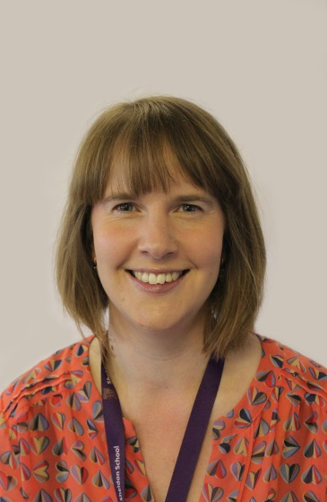
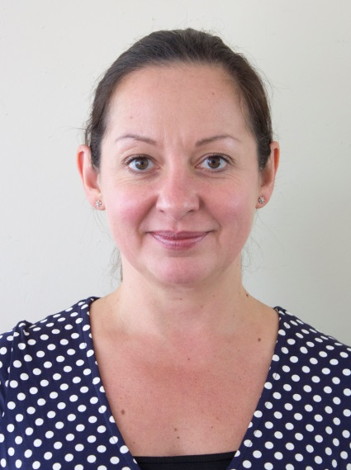
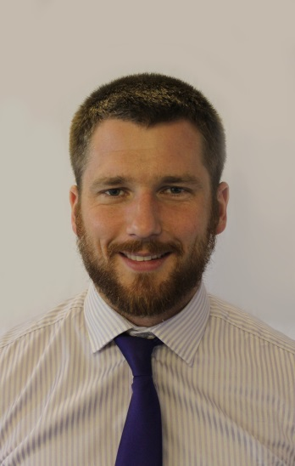

History at Sheldon
Mrs Alice Allen
Miss Ingrid Frater
Miss Judith Owen
Mr Richard Page
Mrs Tracey Tillotson
A Level History teachers:

Slide 3
Why choose A Level History?
Many students choose history for three key reasons:
They are interested in history as a subject to understand their own and other cultures. They also want to learn historical skills.
History as preparation for higher education and careers. It is an academic and well respected A-Level.
History as a passion. They are interested in the enquiry; in the heroes and villains and in the debate.

Slide 4
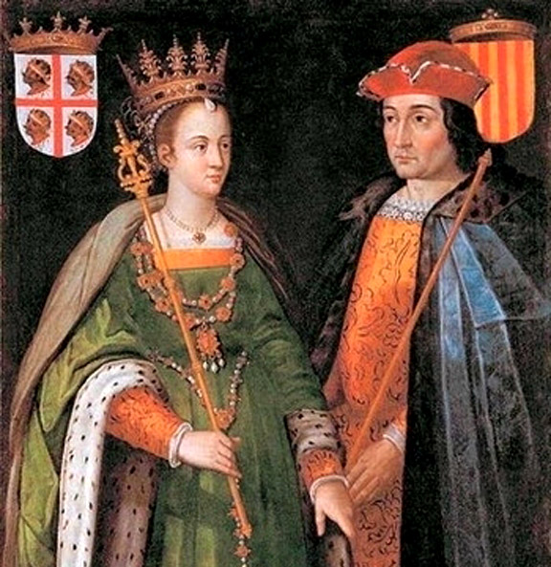
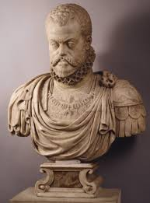
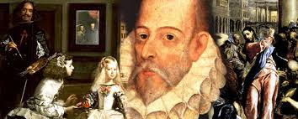
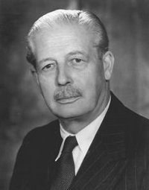
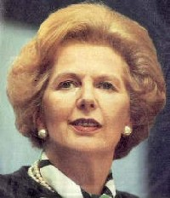
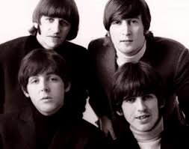
What will I study?

Slide 5
The structure of the A Level course
Year 12 | Spain in the Age of Discovery Part 1: 1469 – 1556 The Making of Modern Britain Part 1: 1951 – 1979 Preparation for Historical Enquiry: Historical themes in Europe and/or America 1792 – 1945
Year 13 | Spain in the Age of Discovery Part 2: 1556 – 1598 The Making of Modern Britain Part 2: 1979 – 2007 Historical Enquiry (as above)

Slide 6
Year 12

Slide 7
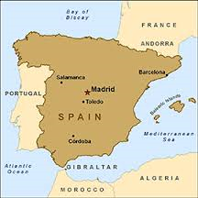
Spain in the Age of Discovery, 1469 – 1598
This is a breadth study. The first year of the course is entitled ‘The Establishment of a New Monarchy, 1469 – 1556’ and is divided into two areas:
The forging of a new state, 1469 – 1516:
The drive to 'Great Power' status, 1516 – 1556

Slide 8
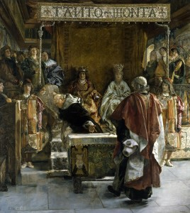
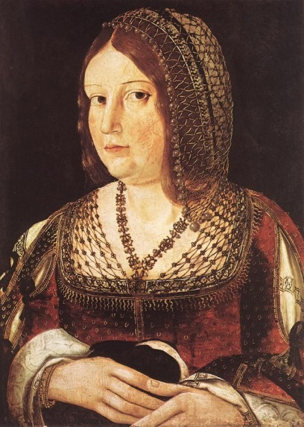
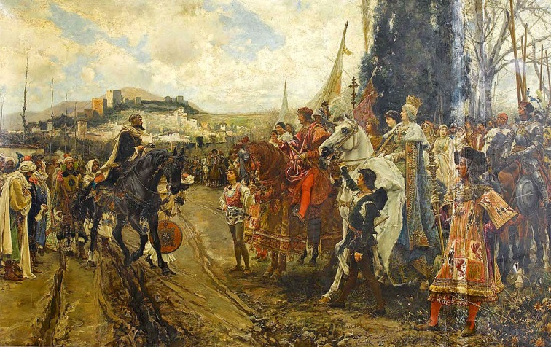
The forging of a new state, 1469–1516
Including:
• The political, economic, social and religious condition of the Iberian Peninsula
• The restoration of royal authority
• Social issues and policies: the nobility, the peasantry, urban communities and the Church
• Muslims/Moriscos; the Reconquista; Jews/conversos and anti-Semitism
• Trade and exploration in Europe and North Africa; discovery and first settlements in the New World

Slide 9
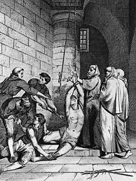
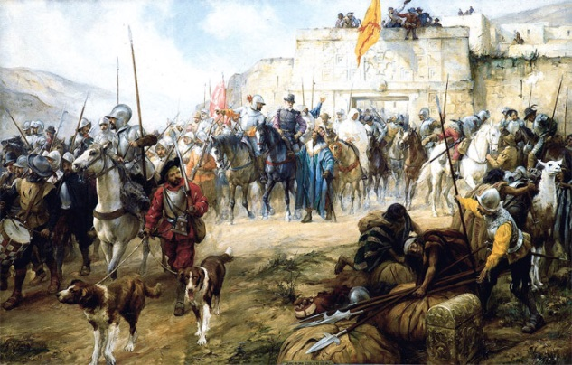
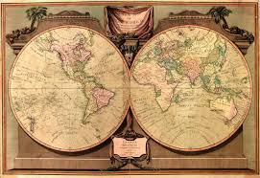
The drive to 'Great Power' status, 1516–1556
Including:
• Charles' inheritance; opposition and consolidation; revolts of the Communeros and Germania
• The workings of Empire: ideas and image
• Foreign relations within Europe; campaigns against the Turks
• Religious policies and the Church in Spain
• The expansion of Empire: the conquistadores; the economic and social impact of the New World on Spain

Slide 10
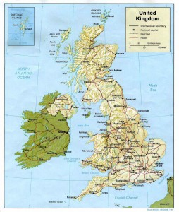
The Making of Modern Britain 1951 – 2007
This is a depth study. The first year of the course is entitled ‘Building a new Britain, 1951 – 1979’ and is divided into three areas:
The Affluent Society 1951 – 64
The Sixties 1964 – 70
The End of the Post-War Consensus 1970 – 79
Follows strands of political, economic, social and international history
Shows the change and continuity of British history

Slide 11
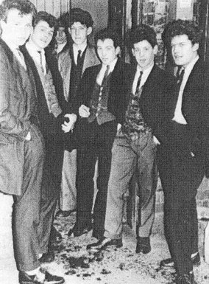
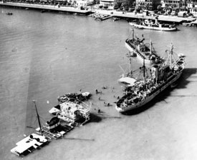
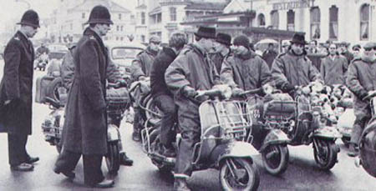
The Affluent Society 1951 – 1964
Including:
The reasons for Conservative political dominance from 1951. Key personalities inc. Churchill, Eden, Butler, and MacMillan
The growth of the economy and rising living standards
Social tension; criminality, hooliganism, the divisive nature of secondary education
Britain’s declining role: the Suez crisis of 1956
The reasons why Britain did not join the EEC between 1955 and 1973

Slide 12

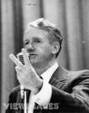
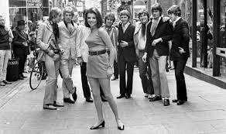
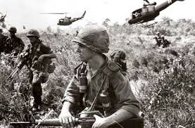
The Sixties 1964 – 1970
The role of key personalities, Wilson and Heath
Problems in N. Ireland
The growth of the mass media, reduction of censorship
Changes in legislation – the end of capital punishment, reduction in censorship, changing moral attitudes, the ‘Youth Culture’ and the ‘permissive society’.
Relations with the USA, especially over the war in Vietnam.
The problem of Rhodesia and the withdrawal from Empire

Slide 13

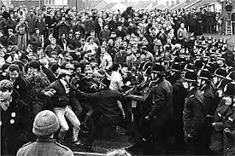
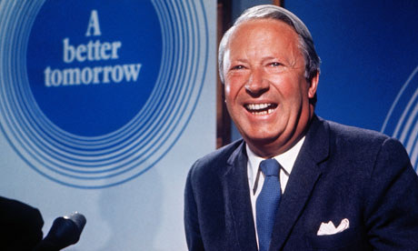
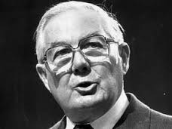
The End of the Post-War Consensus 1970 – 79
Heath’s government; economic policies, industrial relations and the Miners’ strike; the ‘Troubles in Northern Ireland
Labour governments of Wilson and Callaghan; political economic and industrial problems
Society in the 1970s the progress of feminism, the Sex and Discrimination Act; race and immigration, youth, environmentalism
Britain’s entry into Europe, the state of the ‘special relationship’ with the USA

Slide 14
Year 13

Slide 15
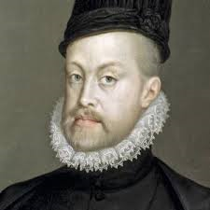
Spain in the Age of Discovery, 1469 – 1598
The second part of this course is entitled ‘Philip II's Spain, 1556 – 1598’ and is divided into two sections:
The 'Golden Age', 1556 – 1598
Spain: The 'Great Power', 1556 – 1598

Slide 16
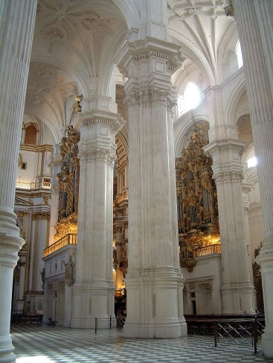
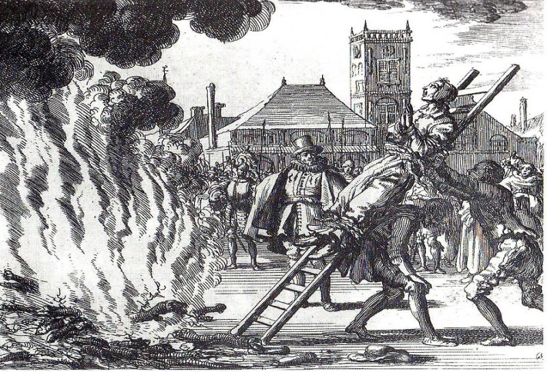

The 'Golden Age', 1556 – 1598
• Philip II as ruler: character; change and continuity in government; administration and policy
• Opposition of individuals and groups: factions and rebellions
• Religion and society; the Jesuits, Inquisition and relations with the Papacy
• Economic developments; royal finances, policies and impact of overseas empire
• Social and cultural developments of the ‘Golden Age’; impact of new ideas and intellectual movements

Slide 17
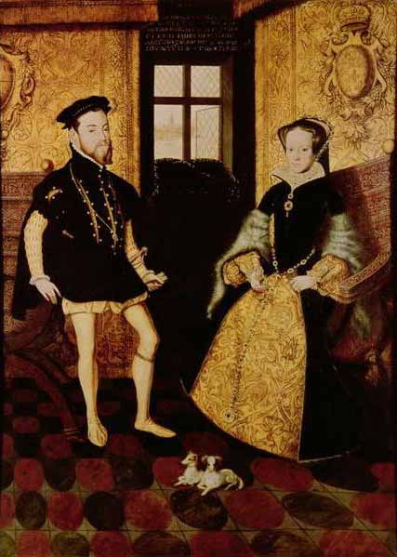
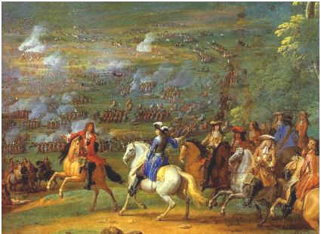
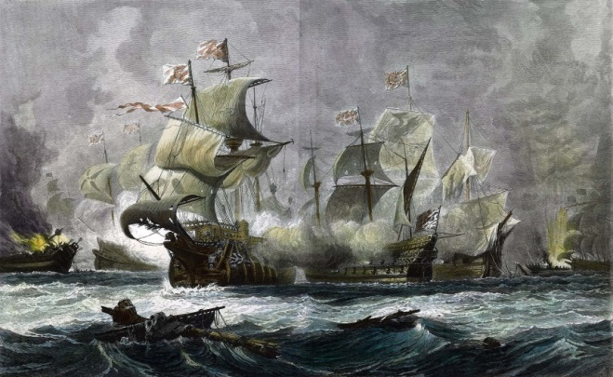
Spain: The 'Great Power', 1556 – 1598
• Philip’s inheritance and ambitions; ideas and pressures; the army and navy
• Control of the Mediterranean: challenging the Turks; the conquest of and relationship with Portugal
Revolt in the Netherlands; relations with England: conflict in Europe and the Caribbean
• Spain in the New World: expansion, settlement and trade; the impact of empire
• The extent of Spain's power; illusion or reality?

Slide 18
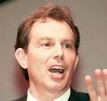
The Making of Modern Britain 1951 – 2007
The second part of this course is entitled ‘Modern Britain, 1979 – 2007’ and is divided into three sections:
The impact of Thatcherism 1979 – 1987
Towards a new consensus 1987 – 1997
The era of New Labour 1997 – 2007

Slide 19

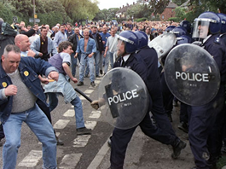
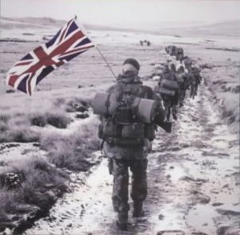
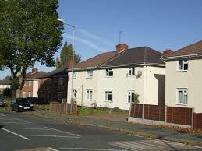
The impact of Thatcherism 1979 – 1987
Monetarist policies and the impact on the economy
The social impact of Thatcherism, including privatisations, council house sales, the Miners’ strikes and industrial relations
The Falklands War;
Britain’s relations with Europe;
Mrs Thatcher’s ‘special relationship’ with the United States;
Britain’s role in ending the Cold War

Slide 20
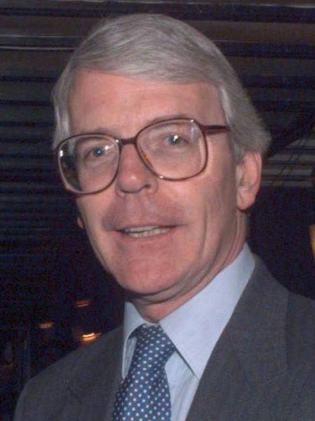

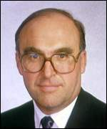
Towards a new consensus 1987 – 1997
The fall of Thatcher and her legacy. Major as leader; political sleaze; approach to Northern Ireland
The revival of Labour under Neil Kinnock. The reasons for the Labour victories in 1997. The role of John Smith, and Tony Blair
‘Black Wednesday’ and other economic issues.
Britain’s position in the European Union. The ‘special relationship’ with the United States and its impact on Britain

Slide 21
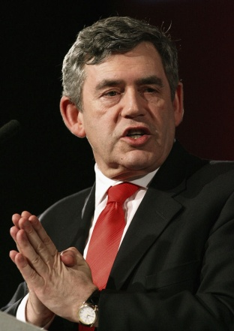
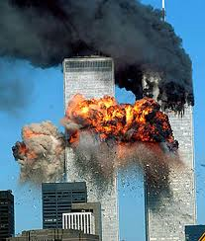
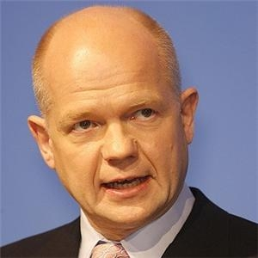
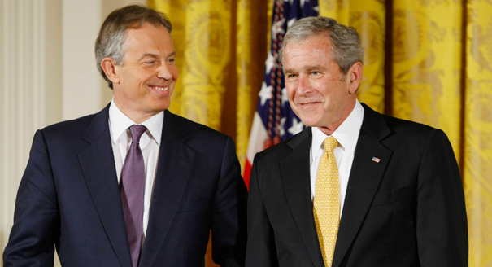
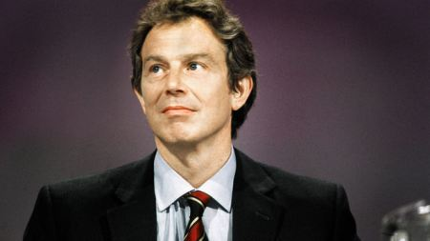
The era of New Labour 1997 – 2007
Blair as leader, character and ideology; Brown and economic policy, Northern Ireland and the Good Friday Agreement.
The Conservative Party: leaders and reasons for divisions; reason for their failures in 2001 and 2005.
Social issues: the extent to which Britain had become a multicultural society by 2007.
Relationship with the USA; the ‘war on terror’; attitudes to Europe; Britain’s role in the world by 2007

Slide 22

Historical Enquiry
Personal and independent study, with continued 1:1 support from history teachers
Requires own argument (well-structured, explained and evidenced), historiography (two different historians’ beliefs about your chosen topic/question evaluated) and sources (three sources analysed)
Needs to cover a period of 80-100 years
4,500 words maximum
Excellent preparation for university

Slide 23
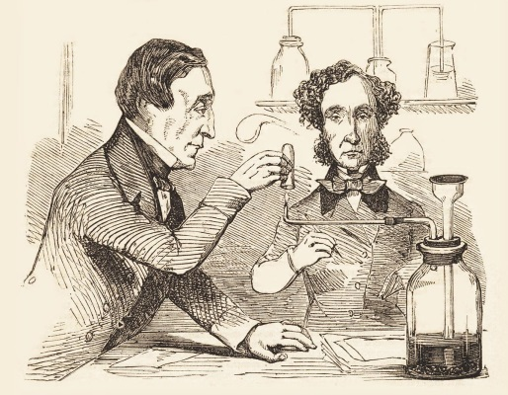
Some examples of questions:
To what extent did wars, as opposed to the work of individuals, lead to medical developments in Britain during the years 1853-1945?
Which had the greatest influence on French involvement in conflict during the years 1780-1871 – nationalism, economic aims or the role of individuals?
To what extent was the Treaty of Vienna successful in meeting its aims in the years 1815-1914?

Slide 24
Exam success
In 2019, 53% of students achieved A*-A, 73% A*-B and 93% A*-C.
In 2018, 43% of students achieved A*-A, 87% A*-B and 96% A*-C.
In 2017, 36% of students achieved A*-A, 68% A*-B and 88% A*-C.
In 2016, 36% of students achieved A*-A, 60% A*-B and 92% A*-C
In 2015, 41% of students achieved A*-A, 86% A*-B and 96% A*-C

Slide 25
Extra-Curricular
Voluntary projects at the History Centre
Residential trip to Spain, February half term 2023
Visits to Universities and the National Army Museum (London)
Conference Day with eminent historians in London
Essay competitions

Slide 26
Thank you
Please email us if you have any questions?

