Slide 1
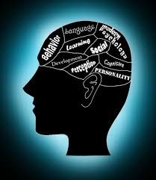
WELCOME TO PSYCHOLOGY!!!!
Mrs Sparrow

Slide 2
What is psychology and what do psychologists do?

Slide 3
Congratulations!
You have been granted the power of being invisible for 24 hours!!!!

Slide 4
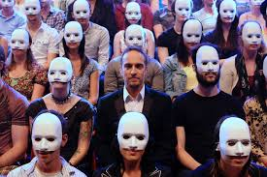
deindividuation

Slide 5
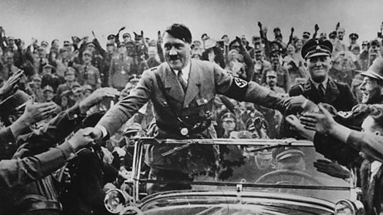
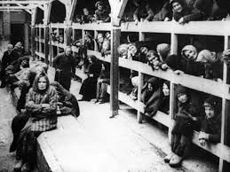

Slide 6
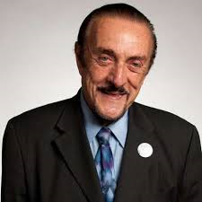
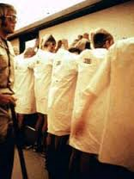
Professor philip Zimbardo
The Lucifer Effect

Slide 7
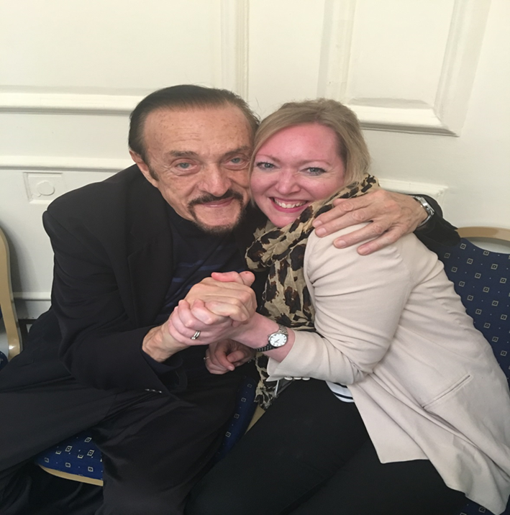

Slide 8
Remember………..
It IS a science!
Good essay skills
However…………

Slide 11
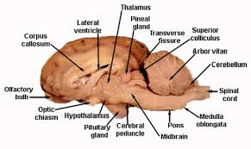
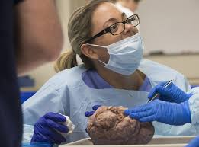
Brain dissection!!!!

Slide 12
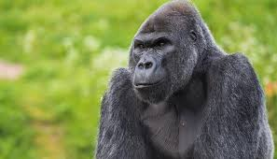
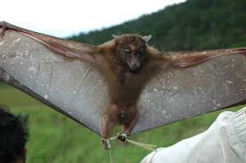

Slide 13
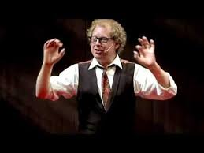
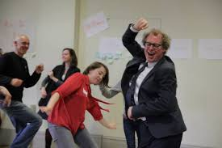
Dr Dance: Professor peter Lovatt
C
Watch his Ted Talks session and dance along!!!

Slide 14
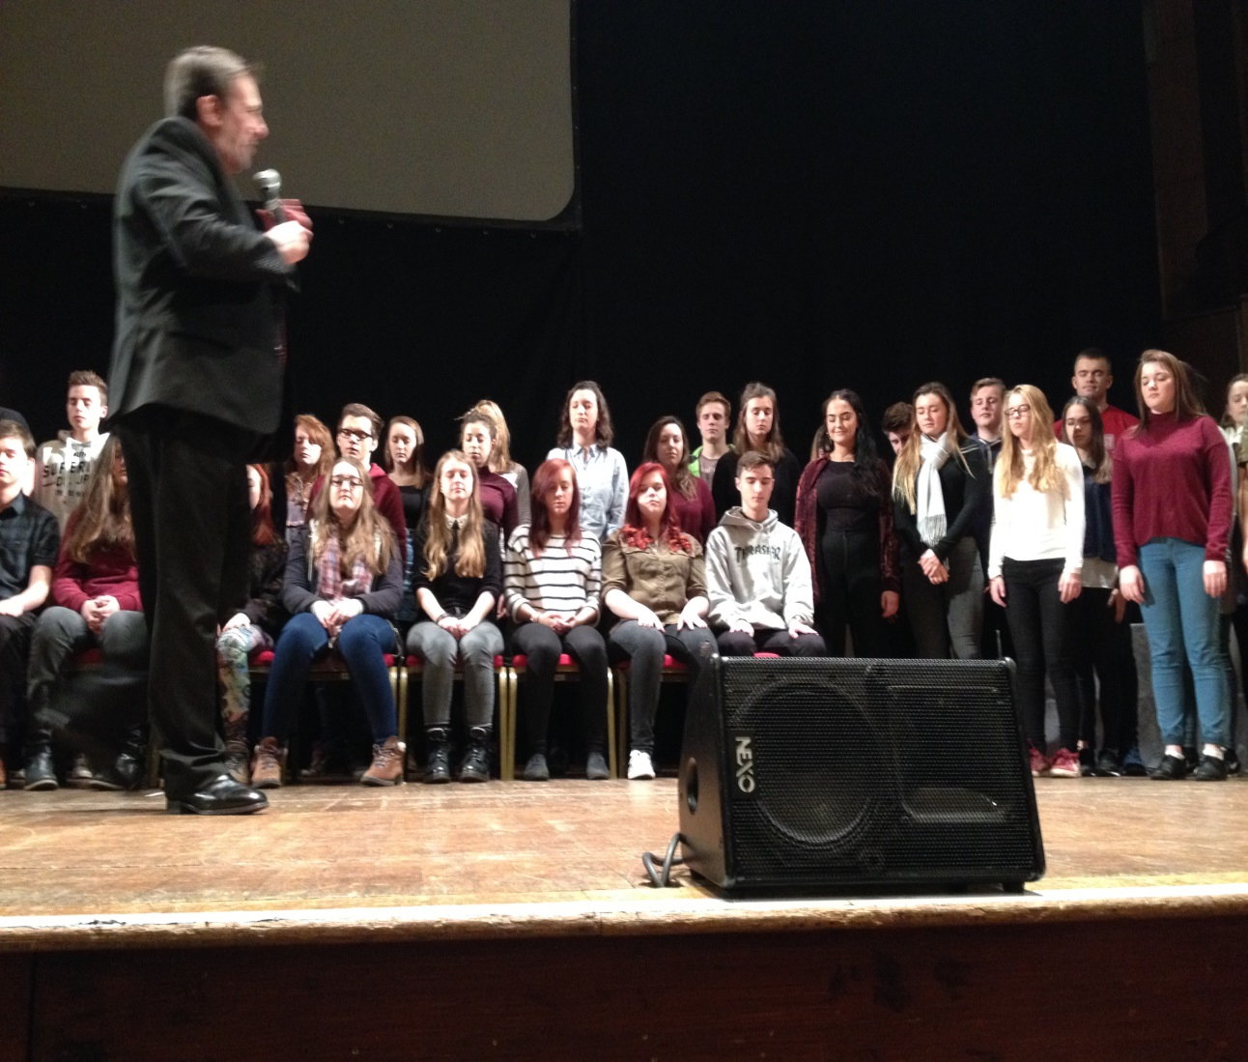
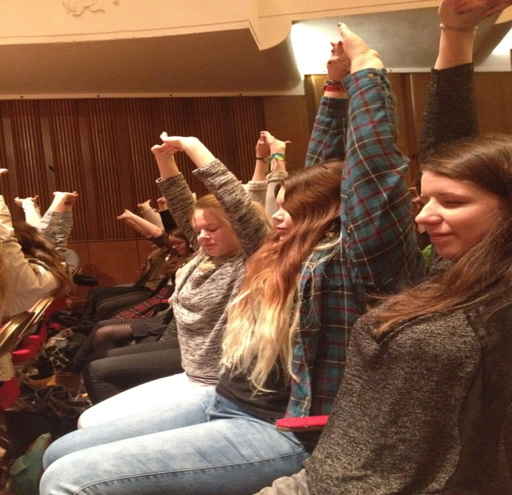
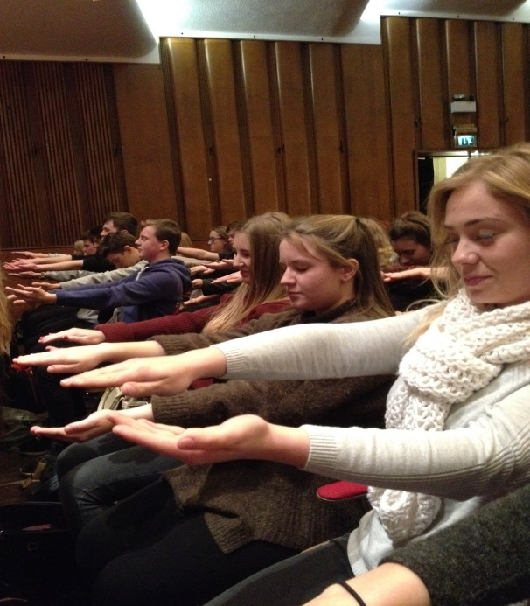
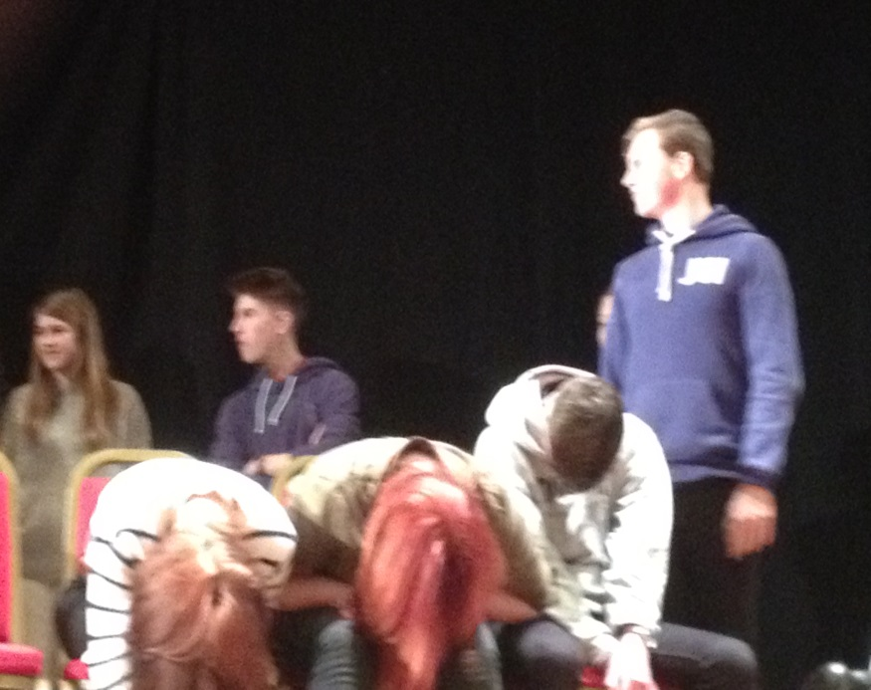

Slide 15
Year 1
Social Influence
Memory
Attachments
Approaches
Biopsychology
Research Methods
Psychopathology
Paper 1
Paper 2

Slide 16
Follow us on twitter!!!
@psysocatsheldon

Slide 17
What now????
Go visit the stall and speak to the students – they will let you know how much they enjoy studying Psychology here at Sheldon School!!!
THANKYOU!!!!

