Slide 1
Philosophy & Ethics (RS) at Sheldon
Watch the clip carefully and think about what dilemma the father faces?

Slide 2
Philosophy & Ethics (RS) at Sheldon
What does he have to decide?
What is he choosing between?

Slide 3
think…
Is there a ‘Right’ choice?
Philosophy & Ethics (RS) at Sheldon

Slide 4
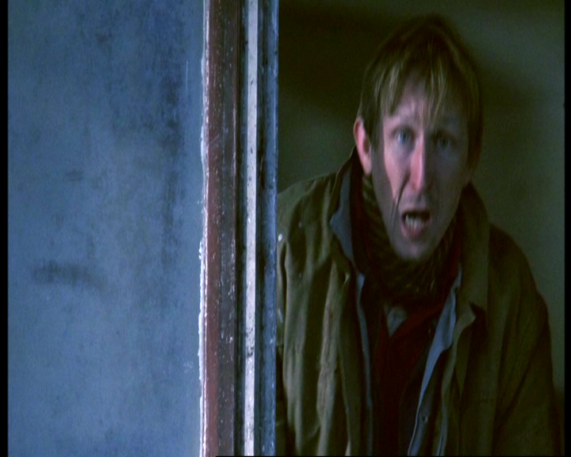
What would you do?
Why?
Philosophy & Ethics (RS) at Sheldon

Slide 5
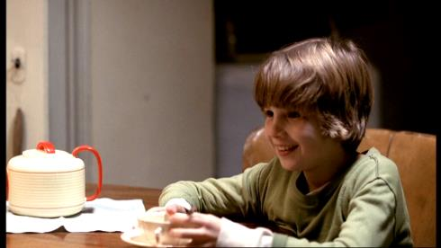
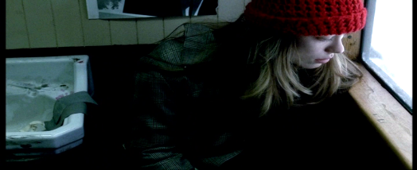
Comparison 01
THINK…
How could anyone choose?
How could anyone know what the right choice would be?
Philosophy & Ethics (RS) at Sheldon

Slide 6
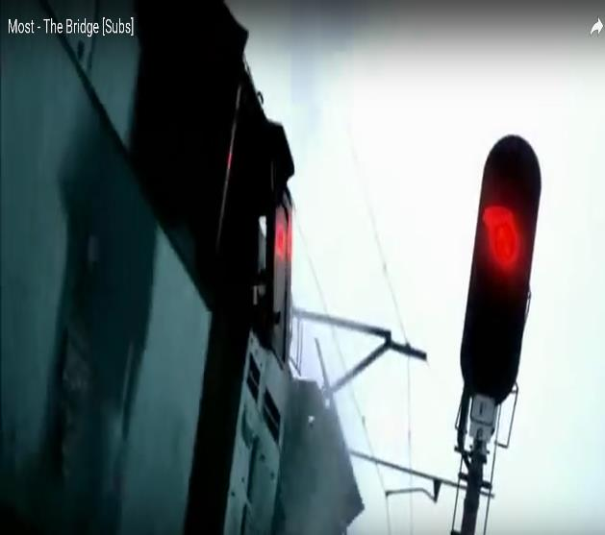
This is an ethical dilemma
We are all faced with choices about our actions every day – even though most are as critical as this
Modern life is full of ethical choices
Philosophy & Ethics (RS) at Sheldon

Slide 7
Over centuries philosophers have wondered how to make good ethical decisions.
They have developed theories about how we might make good choices.
Today these ethical theories are used in medicine, business, politics, the military and many other fields.
Philosophy & Ethics (RS) at Sheldon

Slide 8
This course is an academic course that explores some of the following themes:
Is there a way of knowing what actions are right and which are wrong?
Can we answer some of the big questions all people ask such as . . . Is there a God? What is evil? Do people have a soul?
Is Christian belief relevant today?
Flora@contoso.com
http://www.contoso.com/

Slide 9
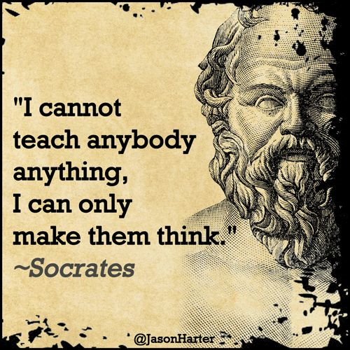
Some of the things we will study include:
Euthanasia
Is there evidence for God?
Belief in an afterlife
Atheism
Sexual ethics
Human nature – good or bad?
Business ethics
Was Jesus God?
The issue of Gender
Flora@contoso.com
http://www.contoso.com/

Slide 10
Why choose A level
RS?
All good universities value philosophy.
It is a rigorous academic subject.
It shows you understand how culture and
thought have developed in the West.
A philosophy student learns how to argue a point.
It can be combined at degree with so many other disciplines:
Law
Sciences
Medicine
Psychology
Criminology
. . . to name just a few!
Politics
Business
Theology
Public Services
Philosophy & Ethics (RS) at Sheldon

