Slide 1
A Level Art & Design Fine Art Art Textiles Photography

Slide 2
WJEC Educas A level Art & Design
The WJEC Eduqas A level in Art and Design has been designed to provide engaging and innovative creative learning experiences, where art, craft and design practice is meaningfully integrated with theoretical knowledge and understanding.
This specification provides learners with opportunities to develop a broad foundation of critical, practical and theoretical skills that offers learners a holistic understanding of a range of practices and contexts in the visual arts, crafts and design fields, culminating in greater specialism and achievement.

Slide 3
A Level Art Options… possible areas of study
Fine Art: Painting, drawing, mixed media, performance and conceptual art, sculpture, land and environmental art, installation, printmaking, film, video, photography, digital media.
Art Textiles: Fashion, costume, surface textile design and embellishment, interior design, constructed textiles, accessories, installation, fine art textiles.
Photography: Photographing people, places, still-life, documentary, photojournalism, fashion, moving image. Experimental photography.

Slide 4
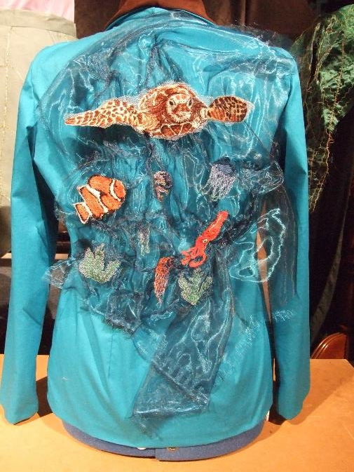

Slide 5
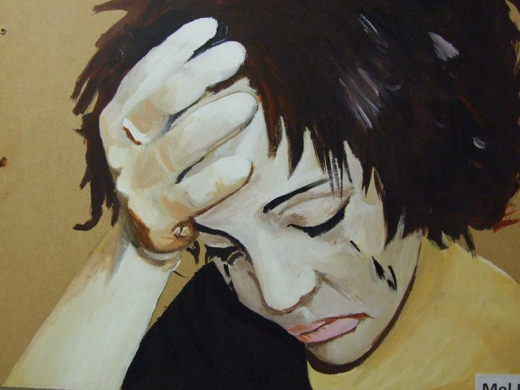

Slide 6
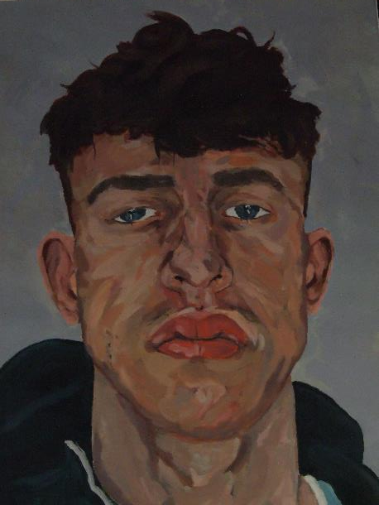

Slide 7
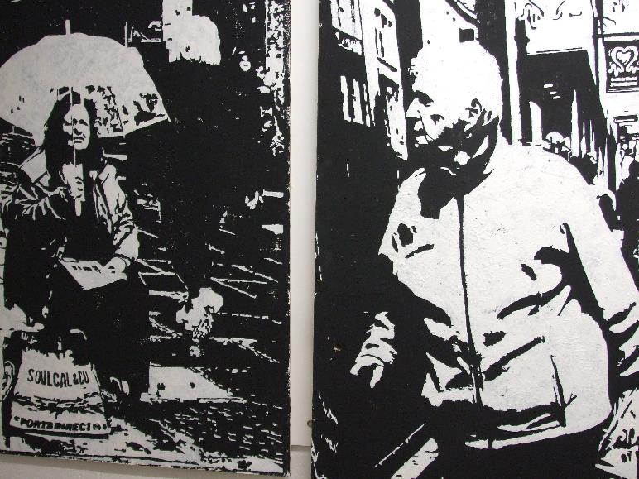

Slide 8
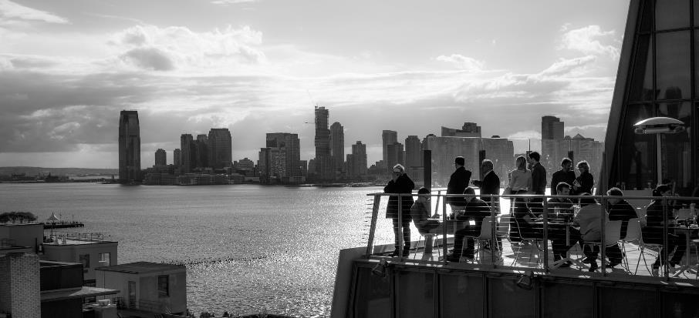

Slide 9
Course Structure
This is a two year, linear qualification.
It consists of two components;
Component 1: Personal Investigation, 60% of qualification, internally assessed, externally moderated.
Component 2: Externally Set Assignment, 40% of qualification, internally assessed, externally moderated.

Slide 10
Year12 / Year 13
Year 12: In all 3 Art & Design options (Fine Art, photography, Art Textiles), practical skills appropriate to the option are taught / learned and study / research skills acquired. Students begin their Personal Investigation in the Summer term.
Year 13: In all 3 options, Students work on their Personal Investigation until February.
The Externally Set Assignment (Exam project) takes place between February and May of Year 13. (2 months of preparatory work followed by 15 hour sustained focus period to complete Final Outcome)

Slide 11
Assessment Objectives
AO1 Contextual Understanding
AO2 Creative Making
AO3 Reflective Recording
AO4 Personal Presentation

Slide 12
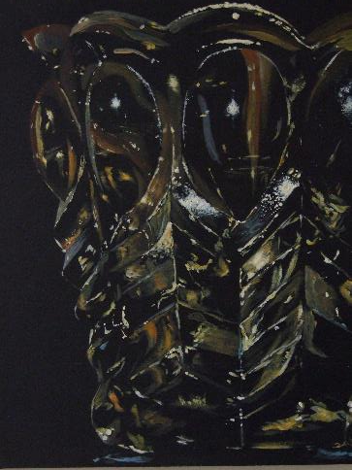
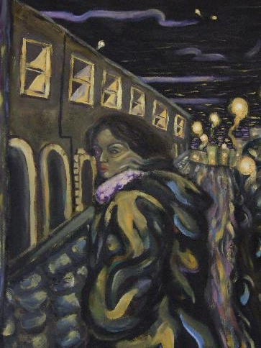

Slide 13
Trips and opportunities
Trips to major exhibitions and galleries. Students commit to at least one trip each year.
Trips abroad.
Visits to local galleries etc. for critical and visual research.
Visiting artists, photographers and designers.
Life Drawing.
Other opportunities in the community.

Slide 14
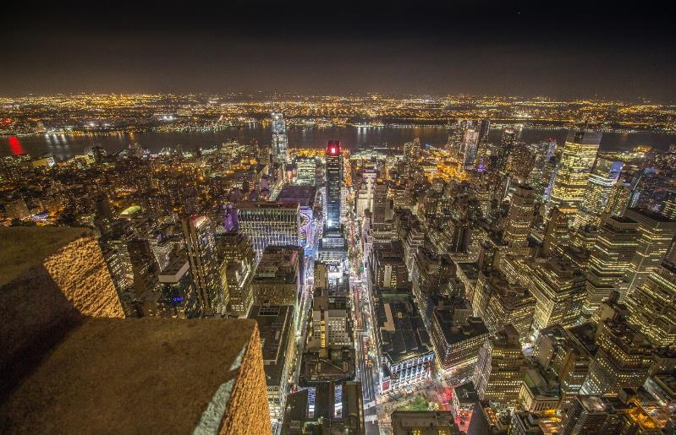

Slide 15
Who would an A level Art course suit?
.Course requirement of at least a grade 5 in art at GCSE. Individual circumstances also reviewed.
Enthusiastic, imaginative, willing to work hard!
Could be considering an art related career.
Creative thinker, keen on exploring ideas.
Good at working independently. Motivated.
Expect to work at home and out of lessons.

Slide 16
Career Progression Many of our Art students progress to art related training and careers, including the following;
Art Foundation course, leading to degree course applications.
Degree courses; Fine Art, Photography, Illustration, Graphic design, Architecture, Interior design, Textile design, Fashion design, Costume design for stage and film, Tailoring, Drawing, Fashion promotion and marketing, Film studies, Media, ……… and more!
Arts subjects contribute to skills in lateral and creative thinking, discussion and collaboration, research and analysis, expressive writing, manipulative and practical skills, confidence in expressing ideas, time management, planning, presenting etc. Useful in a range of applications and contexts.

Slide 17
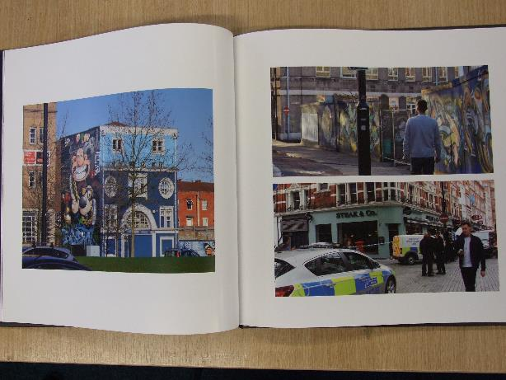

Slide 18
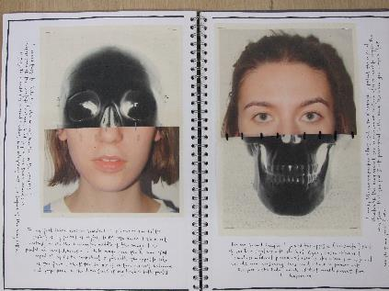
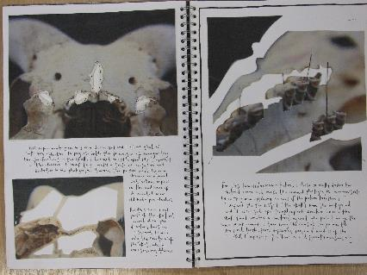

Slide 19
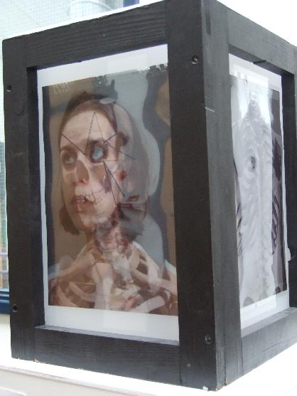

Slide 20
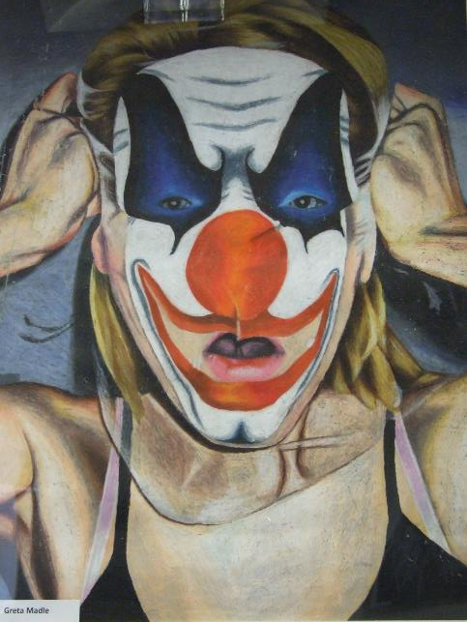

Slide 21
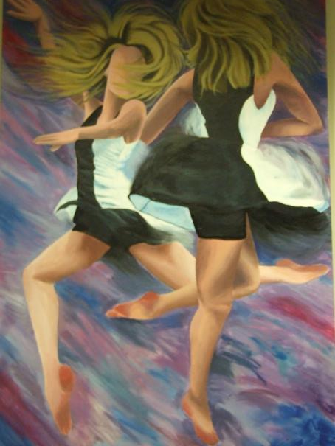

Slide 22
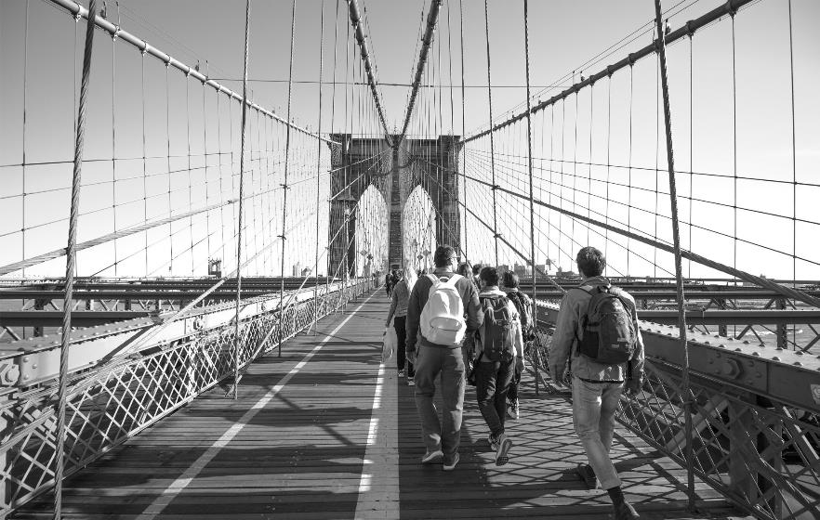

Slide 23
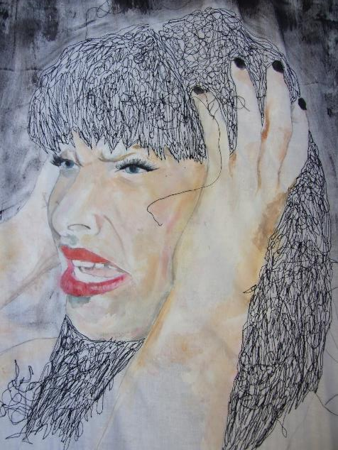

Slide 24
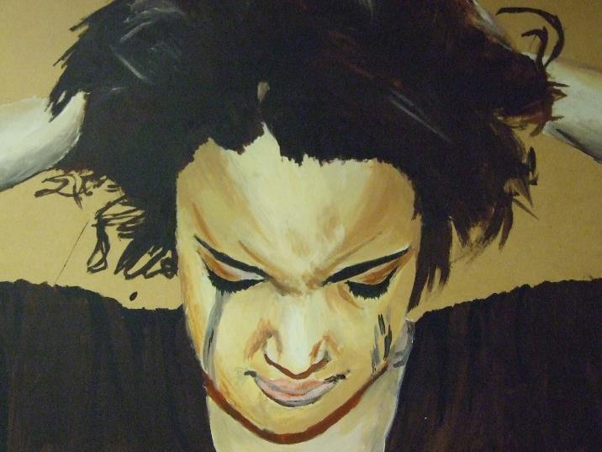

Slide 25
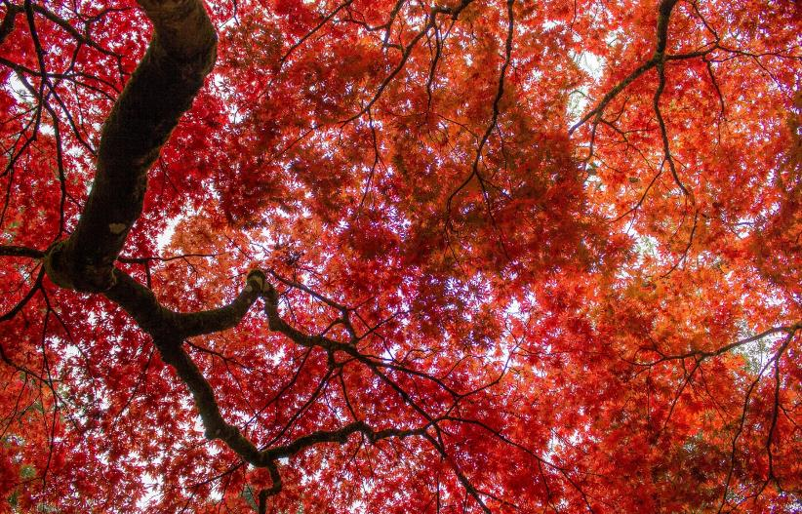

Slide 27
Thank You
Please ask staff or students if you have any questions.

