Slide 1
Introduction to A-Level Dance

Slide 2
Core Content
Core Content
Performance & Choreography
80 marks; 50%
Appreciation
100 marks; 50%

Slide 3
Entry Requirements
What do I need at GCSE Level?
Minimum of Grade 5
Can I do A-Level dance if I have not done GCSE dance?
If you have done some dance outside of school we are happy to consider candidates who have not done GCSE dance.
These will be considered case by case.

Slide 4
Performance
Solo based on a named practitioner in the Independent Contemporary Dance Scene
Group performance; quartet
- Include a programme note of 120-150 words

Slide 5
Must Understand and Present:
Physical skills/technical skills (physical skills)
Spatial elements
Dynamic elements
Interpretive/performance skills
(expressive skills)

Slide 6
Choreography
Group choreography; 3-5 dancers
(3 minutes)
Include a programme note of no more than
300 words
Cannot to be in own choreography

Slide 7
Must Understand and Present:
Action, dynamics and space
Manipulation components/
Choreographic devices
Structuring devices
Constituent features
(production features)

Slide 8
Appreciation
Rambert Dance Company
- Rooster, Christopher Bruce
Independent Contemporary Dance Scene
- Sutra, Sidi Larbi Cherkaoui
Written exam: 2 hour 30 minutes

Slide 9
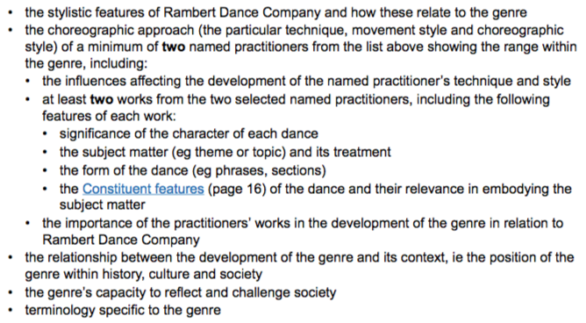
Rambert Dance Company:

Slide 10
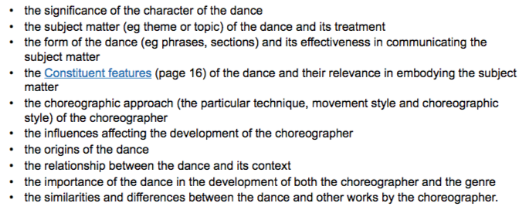
Rooster:

Slide 11
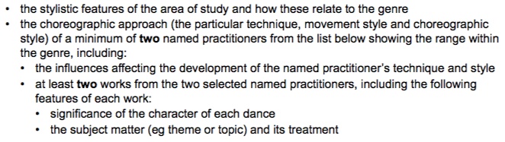
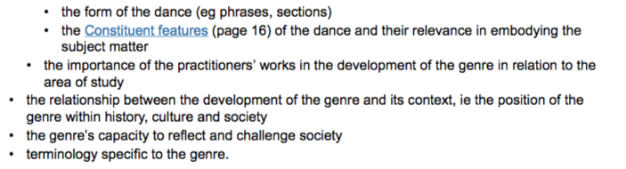
Independent Contemporary Dance Scene:

Slide 12
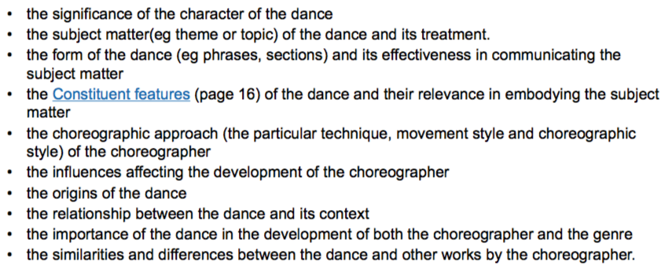
Sutra:

Slide 13
Universities or Vocational
Universities
Chichester
Surrey
Falmouth
Kingston
Bournemouth
Northampton
Roehampton
Bath Spa
Vocational
Trinity Laban Conservatoire
Northern School
Bird
Rambert School
London Contemporary Dance School
National Centre for Circus Arts
Central School of Ballet
YOU need to look for what suits YOU!

Slide 14
Career Pathways
Teaching
Performing
Choreographer
Dance critic
Dance therapist
Dance photographer
Marketing/Graphic design
Writer/Journalist
Freelance artist
Community work
Company manager
Dance administrators
Backstage crew
Collaborators such as lighting design, visual design, costume design and composer

Slide 15
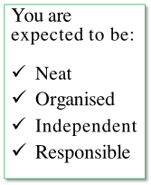
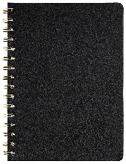
Lessons
Lessons
You will need:
Ideally two dance folder
(for Miss Billington and myself)
Lined paper
A notebook/notepad
Dance kit
(no set kit or colour but needs to be appropriate and suitable for dancing)

Slide 16
Absences
If you are absent you MUST catch up on work. All information given in class is vital and you MUST be responsible for keeping up to date.
You can do this by get notes from friends or contacting me via email

Slide 17
Suggestion:
I highly suggest wearing dance clothing for everyday you have dance!
EXTRAS:
Want to gain some experience and come into KS3 classes?
Want to do Yr 7 club? Or Yr 10?

