Slide 1
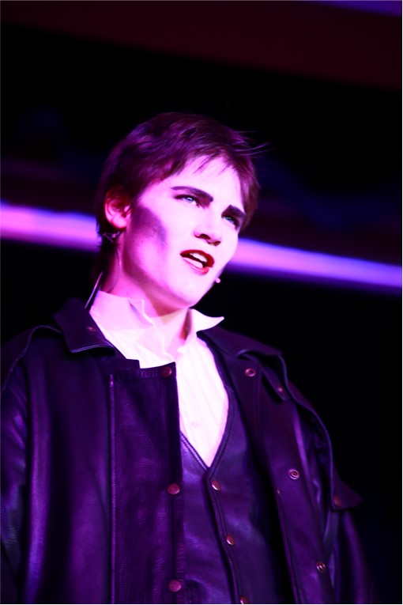
Introduction to
A level Drama

Slide 2

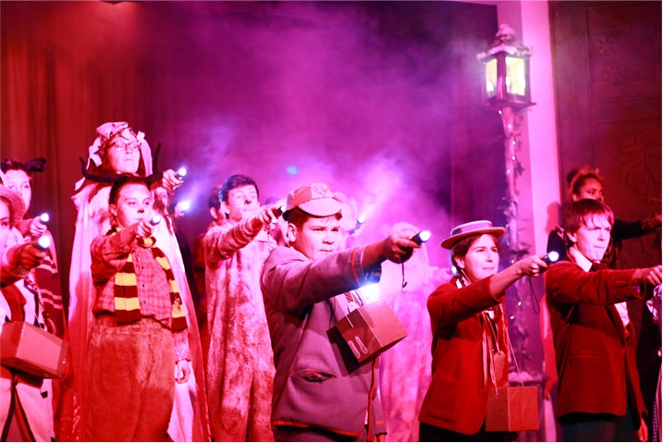
Why choose A level Drama?
You will find the course engaging as it encourages creativity and focuses on practical work which reflects 21st century theatre practice.
You will develop a multitude of skills including collaboration, communication and an understanding of how to amend and refine work.
You can choose to be part of the major school production.
You will have opportunities to attend theatre trips.
You will develop valuable academic and practical transferable skills for the future.

Slide 3

What are the entry requirements?
Students need to have a grade 4 in GCSE Drama.
Students who did not take drama at GCSE will need to demonstrate their keen interest in Drama to the subject leader.

Slide 4
Core Content
Year 12 Devised Piece and Portfolio 40%
Year 13 Acting Exam 20%
Year 13 Final Written Paper 40%

Slide 5
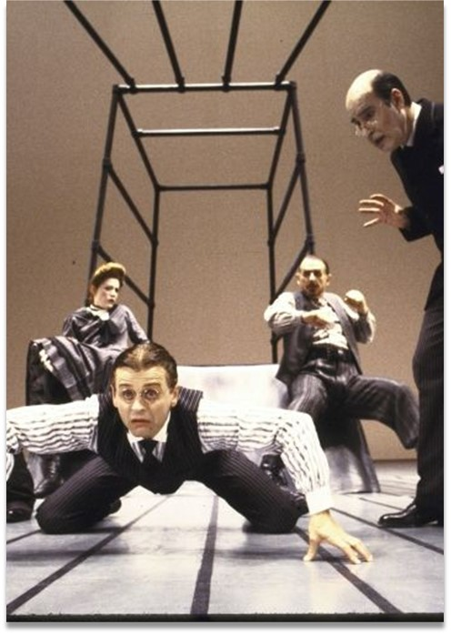
Year 12 Devised Piece 40%
For this part of the course you are taught a wide range of techniques and skills from a variety of theatre companies and practitioners.
As a centre we choose one main practitioner and one play to use as a starting point for your final devised group piece. This year we have chosen Berkoff as our main practitioner and Metamorphosis as the play. Your devised piece will be approx. 25-30 mins long.
You are always marked as an individual for the acting exam.
You will then complete a written portfolio of 3,000 words evaluating the process.

Slide 6
Year 13
Acting Exam – Text in Performance 20%
Candidates perform in both a scripted group piece and a scripted duo or monologue.
Centre has the choice of the text.
Candidates are always marked individually.
This module is externally examined by an external examiner.

Slide 7

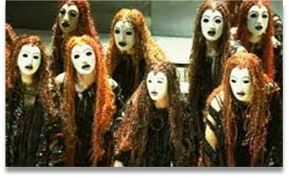
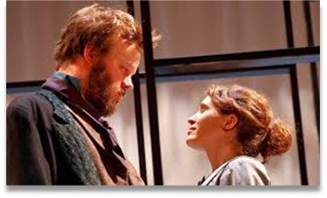
Unit 3: Theatre makers in Practice -Written exam: 2 1/2 hours (40%) This unit is taught through practical acting and directing sessions.
Live Theatre Review Questions
That Face’ by Polly Stenham’
Set Text- Lysistrata Greek Theatre

Slide 8
CAREER PROGRESSION – Destinations of past Sheldon A Level Drama students
Psychology at Exeter University
Business at Swansea University
Ethics at Reading University
Maths at Cambridge University
English at Cambridge University
Interior Design at Solent Southampton University
English Literature at Exeter University
Law at York University
Apprenticeship in Business Management with Microsoft
Central School of Drama
LIPA-Liverpool Institute of Performing Arts
Drama at Exeter University
Nursing Southampton University
English and Drama Manchester University

