Slide 1
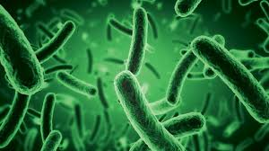
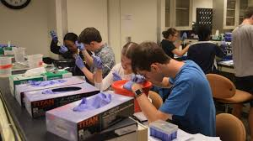
Welcome to the Biology Open Evening Presentation

Slide 2
A level Biology
“Biology is bigger than physics.
It enjoys bigger budgets, a
bigger workforce, and achieves
more major discoveries. Biology
is likely to remain the biggest
part of science through the
twenty-first century.”
Freeman Dyson, theoretical physicist and
mathematician

Slide 3
Why study A Level Biology?
Biology involves the study of a wide range of exciting topics,
ranging from molecular biology to the study of ecosystems
from microorganisms to the human body.
Biology developments are always in the news and never far from the headlines.....

Slide 4
Year 1 in detail
Biological molecules | Monomers and Polymers Carbohydrates Lipids Proteins Nucleic acids and important information carrying molecules DNA replication ATP Water inorganic ions
2. Cells | Cell Structure Transport across all cell membranes Cell recognition and the immune system
3. How organisms exchange substances with their environment | Surface area to volume ratio Gas exchange Digestion and absorption Mass transport
4. Genetic information, variation, and the relationship between organisms | DNA, genes, and chromosomes DNA and protein synthesis Genetic diversity and mutation Genetic diversity and adaptation Species and taxonomy Biodiversity within the community Investigating diversity

Slide 5
Year 2 in detail
5. Energy transfers in and between organisms | Photosynthesis Respiration Energy and Ecosystem Nutrient Cycles
6. Organism response to changes in the internal and external environment | Stimuli Nervous coordination Skeletal muscles and nerves Homeostasis
7. Genetic population, evolution, and ecosystem | Inheritance Populations Evolution and speciation Populations in ecosystems
8. The control of gene expression | Alteration of the sequence of bases in DNA Gene expression Using genome projects Gene technologies

Slide 6
What Sheldon offers:
Textbooks in class
Kerboodle online digital textbook
LOTS of online resources via sixth form portal
Excellent results
Ever popular field trip (corona virus regulations permitting) during the summer term of Y12

Slide 7
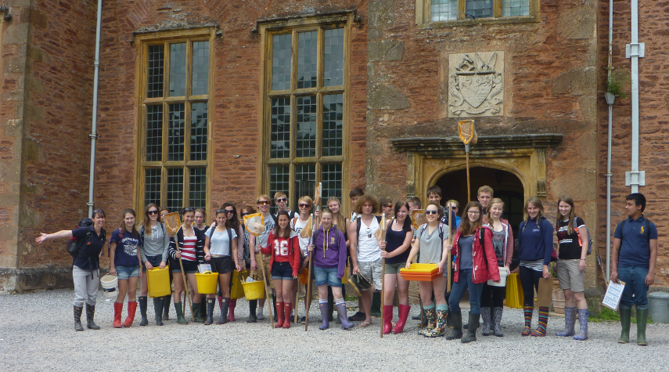
Field Trip
One week residential field trip

Slide 8
Grassland Studies

Slide 9
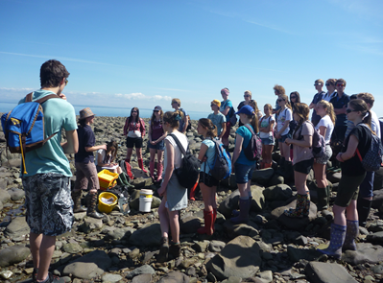
Rocky Shore Sampling

Slide 10
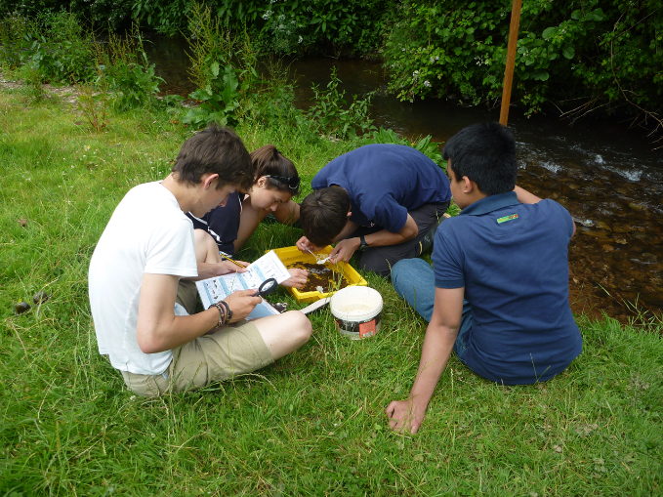
Freshwater Sampling

Slide 11
Admission Criteria for Biology
66 or higher in Trilogy Science or 6 in Biology with high 6s for other two sciences for separate science
5 or preferably higher in GCSE Maths, due to high maths demand in A level

Slide 12
There are so many different topics with something of interest for everyone – you’ll never get bored in biology class
I love all the detail we get to go into and the dissection lessons are great!
The field trip is really good
Biology is a really interesting subject that you want to go home and learn more about

Slide 13
I love learning about the human body and then seeing how it works in your own body
The Biology teachers are really helpful easing transition between GCSE and A Level
Dissecting fish and viewing the anatomy of other animals is incredibly interesting, as is the opportunity to use specialist equipment in the lab.

Slide 14
MASSIVE step up from GCSE because there is so much new information to learn but every lesson is interesting
Its very challenging but worth it!
There is a lot of content to get to grips with, so you need to keep up to date with looking over your notes from class

Slide 15
“A Level Biology is definitely a big step up from GCSE but if you are passionate about the subject then you will fit in easily on the course.
It’s a very interesting course and you will have fun. “

Slide 16
Career Opportunities Leading from Study of Biology A Level

Slide 17
A Level Biology….
Biology A Level is a fascinating course and opens many career routes.
It is academically highly respected
And So it is challenging
The jump from GCSE to AS is a large step up
Sheldon Biology department always offers lots of personal support and there are ample resources made available to enable all students of all ability levels to make very good progress.

Slide 18
