Slide 1
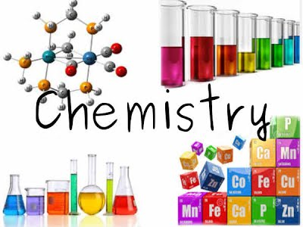

Slide 2
Why study a-level chemistry?
Challenging
Highly valued qualification – academic and practical
Lots of opportunities – employability
Fun

Slide 3
Entrance requirements and other criteria
GCSE Combined Science 66 or GCSE Chemistry 6
GCSE Maths 5
Like chemistry
Willingness to be challenged and take responsibility
Confidence with numbers
Maturity in approach and attitude

Slide 4
A-level chemistry at Sheldon OCR Salters Course H433
Course structured around a range of different contexts
Ideas are introduced in a spiral way
Particular emphasis on an investigational and problem-solving approach to practical work
Course is supported by extensive materials developed by the University of York.
https://www.ocr.org.uk/qualifications/as-and-a-level/chemistry-b-salters-h033-h433-from-2015/specification-at-a-glance/

Slide 6
OCR Salters Course H433 Exam structure
Fundamentals of chemistry (01) 110 2 hour 15 mins 41%
Scientific literacy in chemistry (02) 100 2 hour 15 mins 37%
Practical skills in chemistry (03) 60 1 hour 30 mins 22%
Practical endorsement (04) Reported separately. Non-exam assessment.

Slide 7
A-level – 2 year course
Papers 1, 2 and 3 can assess content from all modules as well as practical skills.
Paper 1 “breadth” - assessed by mainly shorter structured questions.
Paper 2 “depth” assessed by a mixture of short structured questions, extended response items and more open problem solving style questions.
Includes an advanced notice article aimed at testing skills of chemical literacy developed during the course.
Paper 3 focuses on the assessment of practical skills with a particular emphasis on investigational and problem solving skills.

Slide 8
What we expect of you
Hard work
To ask questions
To discuss things
To be organised and stick to deadlines

Slide 9
Opportunities
Science Ambassadors – school events, clubs, supporting other students
Mentoring Programme

Slide 10
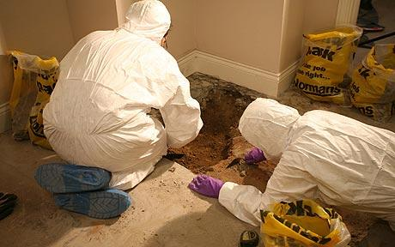
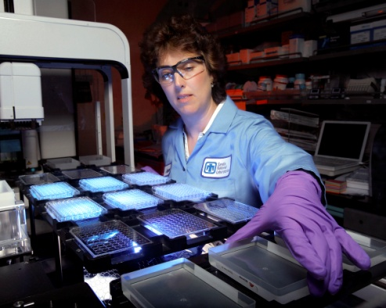
Careers
Link to Royal Society of Chemistry:
https://edu.rsc.org/future-in-chemistry/career-options
Medicine
Veterinary
Nursing
Pharmacist
Forensic Scientist
Analytical chemistry
Engineering
Nanotechnology
Pharmacology

Slide 11
Industrial Careers
Research chemists
Pharmaceuticals
Plastics
Paints and Inks
Food and Drinks
Textiles
Motor industry

Slide 12
Careers studying Chemistry can help you to get into:
Accountancy
Quality control
Scientific Journalist
Technical Author
Patent Agent
Law ...

Slide 13
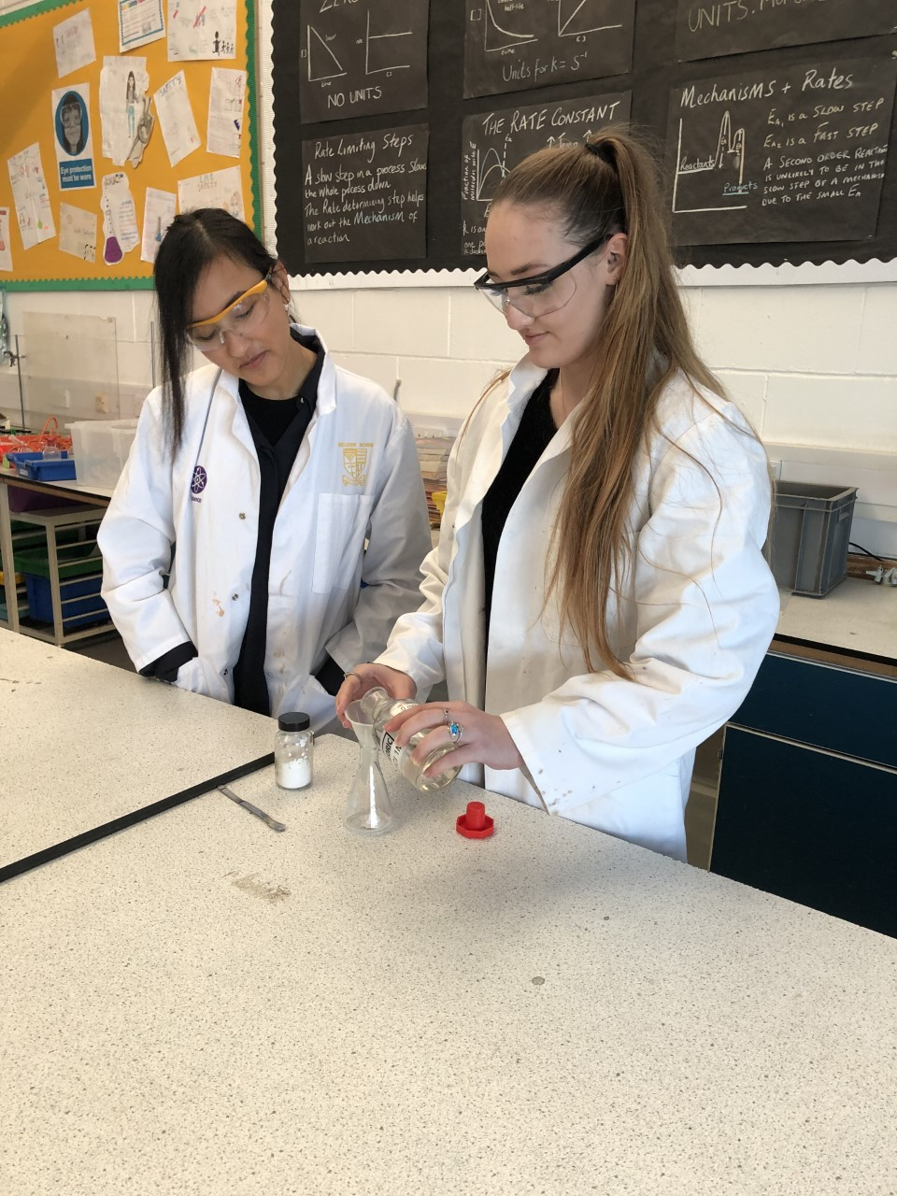
Some thoughts from current students:
Meet Lara and Melissa, two of our final year A-level chemistry students.

Slide 14
Do you have any questions?
Teachers of A-level chemistry:
Dr Aicken
Mrs Hayward Jezard
Mr Prevett
Dr Simpson

