Slide 1
Health and Social Care OCR Level 3 Cambridge Technical Extended Certificate/Diploma

Slide 2
What is health and social care?
Health and social care is the treatment of ill health and medical conditions in hospitals,
health centres and in the community.
Social care is the care and support of vulnerable people, usually in the community.

Slide 3
Structure: Extended Certificate (1 A level equivalent)
This course is made up of 6 units to be studied over two years.
3 exam units and 3 moderated portfolio work units.
2 exams in Year 12, 1 exam in Year 13.

Slide 4
YEAR 12:
Unit 1: Building positive relationships in Health and Social Care
Unit 2: Equality, Diversity and Rights in Health and Social Care
Unit 3: Health, Safety and Security in Health and Social Care
YEAR 13:
Unit 4: Anatomy and Physiology
Unit 10: Nutrition for Health
Unit 17: Supporting people with Mental Health Conditions

Slide 5
Structure: Diploma (2 A level equivalent)
This course is made up of 12 units to be studied over two years.
5 exam units and 7 moderated portfolio work units.
3 exams in Year 12, 2 exam in Year 13.

Slide 6
Structure: Diploma (2 A level equivalent)
Year 12
Unit 1.Building positive relationships in health and social care
Unit 2.Equality, diversity and rights in health and social care
Unit 3.Health, safety and security in health and social care
Unit 5.Infection control
Unit 7.Safeguarding
Unit 8.Creativity and activity for children and young people
Year 13
Unit 4.Anatomy and physiology for health and social care
Unit 10. Nutrition for health
Unit 17. Supporting people with mental health conditions
Unit 6.Personalisation and a person-centred approach to care
Unit 14.The impact of long term physiological conditions
Unit 16.Supporting people with dementia

Slide 7
Skills and Qualities
Students who study this course must have:
Good organisational skills
Good attendance
Ability to work on feedback given
Commitment
Passion for the health care sector and a real interest in working with people.

Slide 8
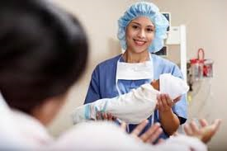
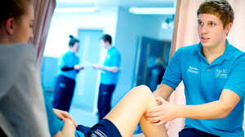
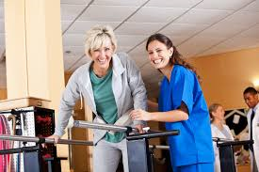
Careers
Could include: Midwifery, Social Work, Occupational Therapy, Nursing, Sports Therapist, and Child Care worker.

Slide 9
More examples of careers in health and social care
Therapy
Adult learning difficulties
Ambulance and patient transport
Children and young adults
Home care
Live in care/ respite
Older people care
Palliative/ end of life care
Care worker
Key worker- social care
Advocacy worker

Slide 10
What do you need?
You must have a folder. This needs to be brought with you to every lesson.
I suggest that the folder is for a topic and you can use dividers to separate the sections within the topic.
You will need access to IT. All portfolio work is completed in word. You will need to research aspects of the course to obtain secondary information.
We use the text book but these cannot be taken out of the classroom.

