Slide 1
Physics AQA Physics A level course code 7408

Slide 2
Why study Physics?
From cancer treatment to tackling climate change, gaming to robotics and artificial intelligence, physics and physicists are on the front line, helping to shape the future. At a time when jobs are changing, physics offers a vast and expanding range of career paths.
And it’s not only science and technology. What many people don’t realise is how valued and respected physics skills and ways of thinking are in other, often well-paid, industries – like finance and law. (IOP)
Notes:
You might have already decided to study a physics or STEM subject at university and so need physics at A level, you might be unsure of what you want to do after you’re A levels and want to keep your options open, physics is an excellent choice in that case, you might just enjoy physics (this hopefully applies to the previous categories) and want to study it further.

Slide 3
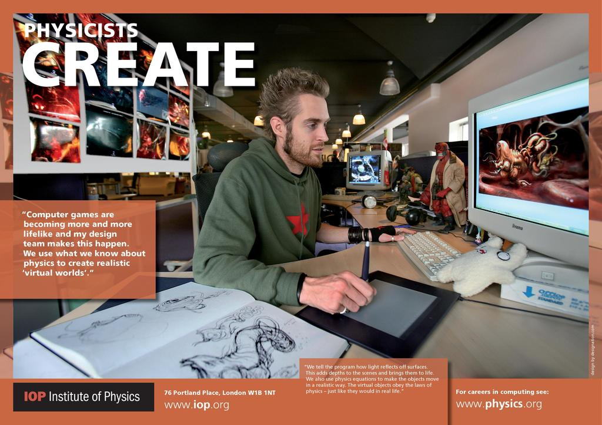
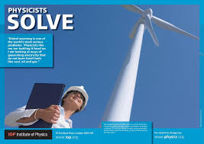
Careers This is a small selection of possible career paths open to you.
Astrophysics
Material Science/ Solid State Physics
Medical Physics
Nuclear Physics
Theoretical/ Experimental Physics/
High Energy Physics
Applied Physics/Optics/ Nanotechnology
Biophysics
Engineering
Computational Physics
This links to the IOP with some paths in more detail.
Notes:
We have listed a number of career areas that you might have thought about and the IOP link will take you to many more.

Slide 4
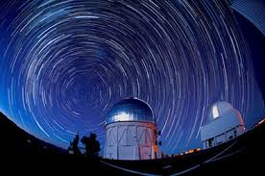
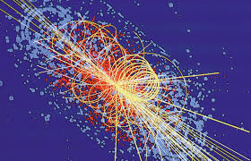
Topics Taught
Year12
Measurements and errors
Particles and radiation
Waves
Mechanics and materials
Electricity
Year 13
Further mechanics
Thermal physics
Fields and their consequences
Radioactivity
Astrophysics

Slide 5
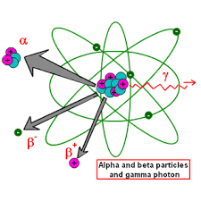
Structure
Exams
Papers 1 + 2 – 2 hours each, consisting of 60 marks of short and long answer questions and 25 multiple choice questions.
Paper 3 – 2 hours consisting of 45 marks of short and long answer questions on practical experiments and data analysis and 35 marks of short and long answer questions on astrophysics.
Entry requirements
66 in Trilogy or 6 in Physics
6 in maths

Slide 6
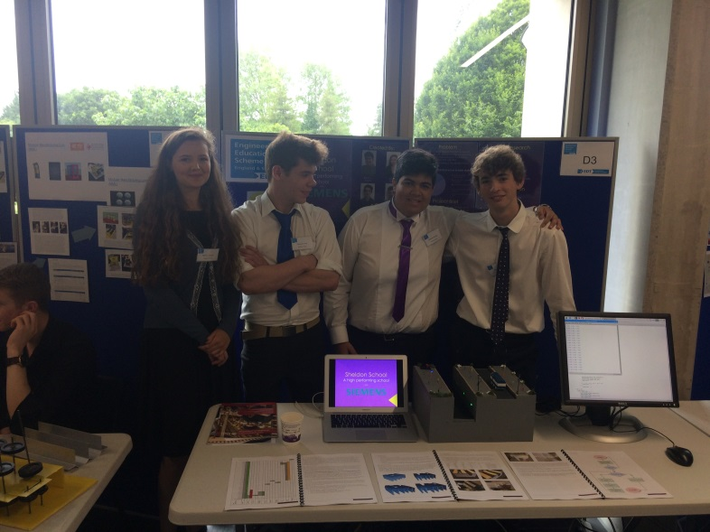
Opportunities beyond the course
Science ambassadors linked with events and/ or clubs.
Engineering programme.
Mentoring lower school students

Slide 7
For further information
Mr Grainger (Head of Science)
Mrs Moyle
Mr Croucher

